Slide 1
RAISING THE BAR:
Leveraging Innovation to Extend Standard 8 and Advance Accessibility
eLearning Design and Services
INDIANA UNIVERSITY

Slide 2
Make a peanut butter & jelly sandwich
Learning objective:

Slide 3
Auto captions
Mashup videos
Choose your own adventure
Local field trips
Physical objects
Group work options
“Quick Check” tools
Student shopping lists
Writing exam Q’s

Slide 4
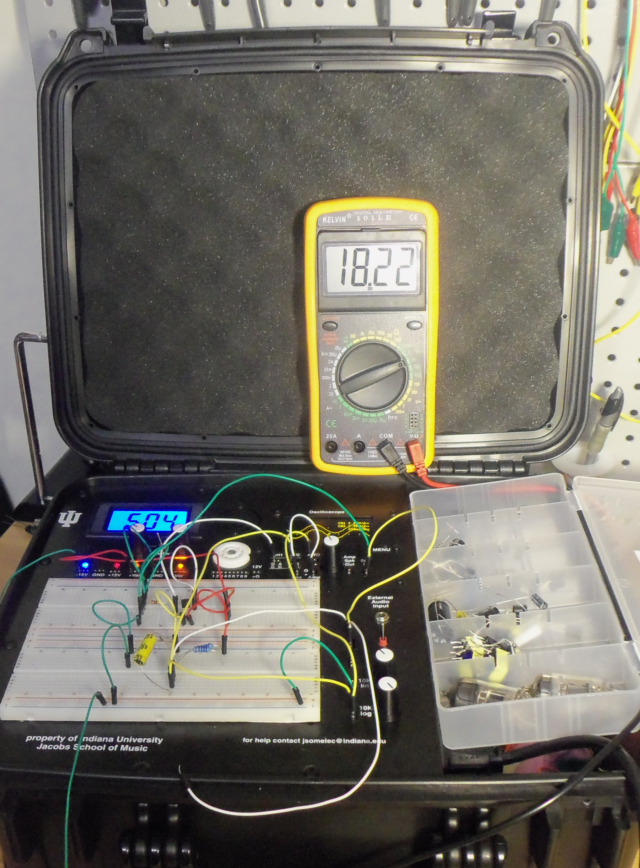
Physical objects
Students still live in the real world!
Audio lab kit
Distance science labs

Slide 5
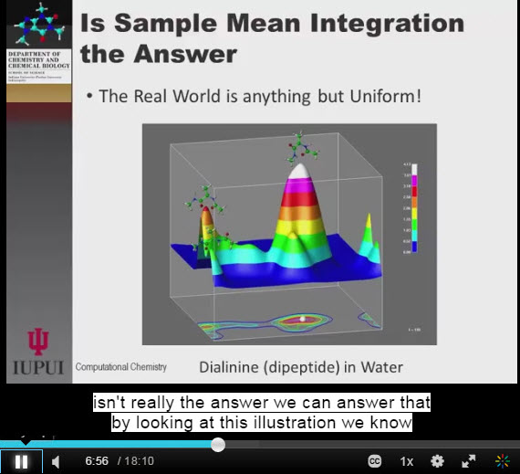
Automatic captioning
Students needing accommodations don’t get behind
Helps ESL learners
Helps with technical jargon
IU uses Kaltura

Slide 6
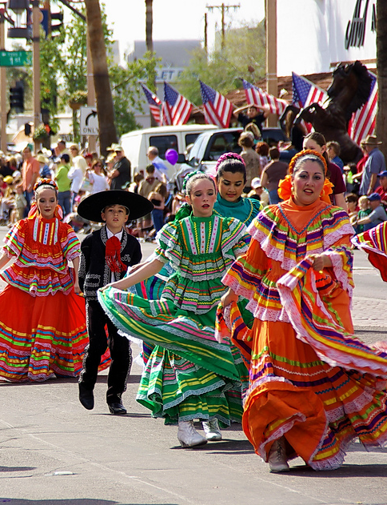
Local field trips
Language and culture classes
Careers courses
Course beyond the computer screen
Notes:
Photo via MorgueFile
Go to a Hispanic-owned business or festival
Take photos
Classify things that are similar/different from your experiences
Speak with people

Slide 7

Mashup videos
Student-created content
Meets fair use test
Transferring concepts to new medium
Examples for future classes
Notes:
Photo via Splitshire

Slide 8
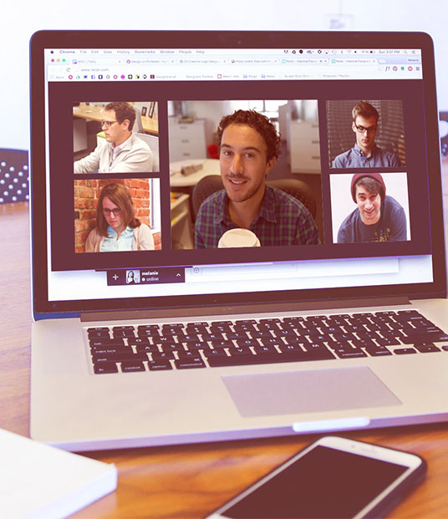
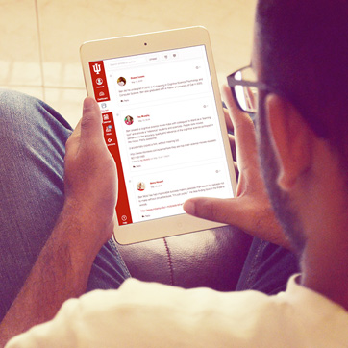
Group work options
Asynchronously
Synchronously

Slide 9
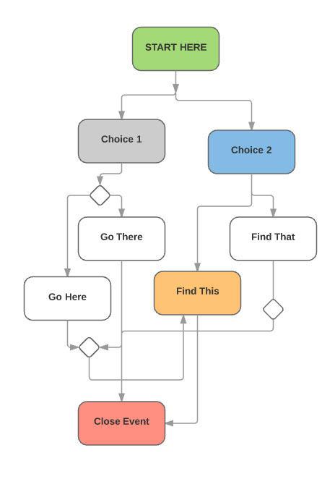
Choose your own adventure
Branching course navigation
Nonlinear hyperlinks
Interaction with content

Slide 10

Writing exam questions
Inquiry-based learning
Practice learning
Sense of ownership

Slide 11
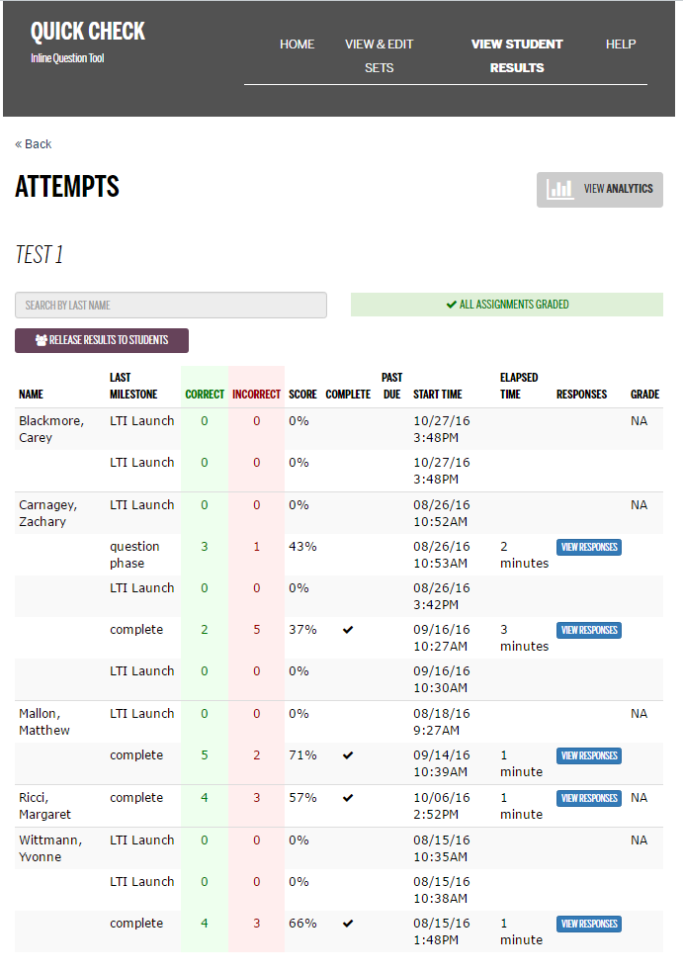
Quick Check tools
Lightweight assessment
Aligns with learning research
Data to instructors

Slide 12
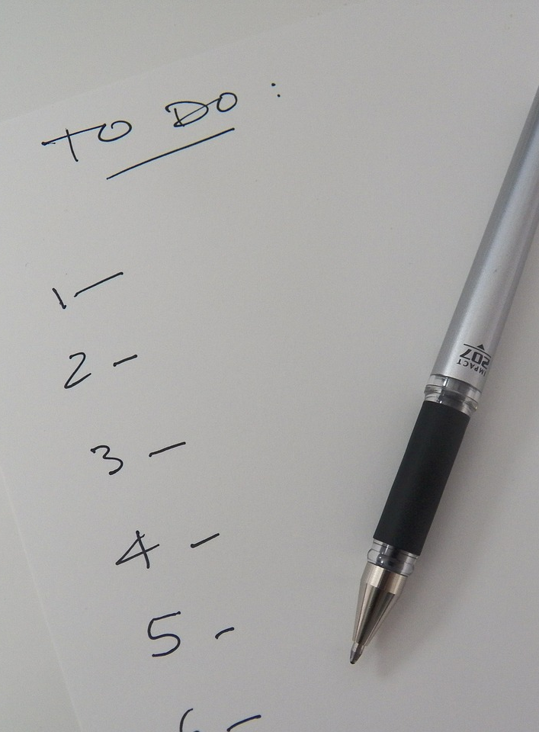
Student shopping lists
Graphing and design
Fine arts
Simple science experiments
Audio lab
Notes:
Photo via Pixabay

Slide 13
eLearning Design & Services
Anna Lynch: ahlynch@iu.edu
Renée Petrina: rpetrina@iu.edu @Skill2Teach

