Slide 1
Online Revitalization Starts with QM
Vicki Westergard
St. Petersburg College

Slide 2
Today’s Objectives
Identify SPC's challenges and goals for the course revitalization project and how they relate to your project
Compile best practices for your institution from SPC's strategies, faculty preparation, process, timelines, team makeup, results and next steps
Gather ideas for new approaches as participants share what they are doing

Slide 3
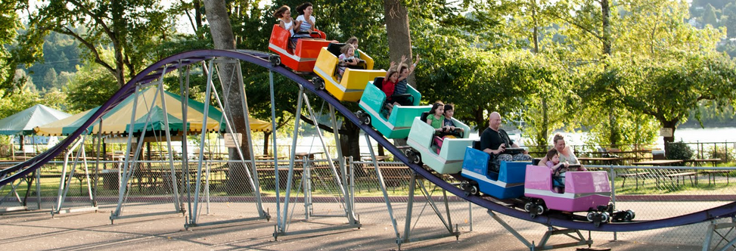
Scenario in the year 2000
First FIPSE grant in 1999 – Project Eagle
Centralized authority - eCampus
Established expectations
50 courses created
3000 students enrolled

Slide 4
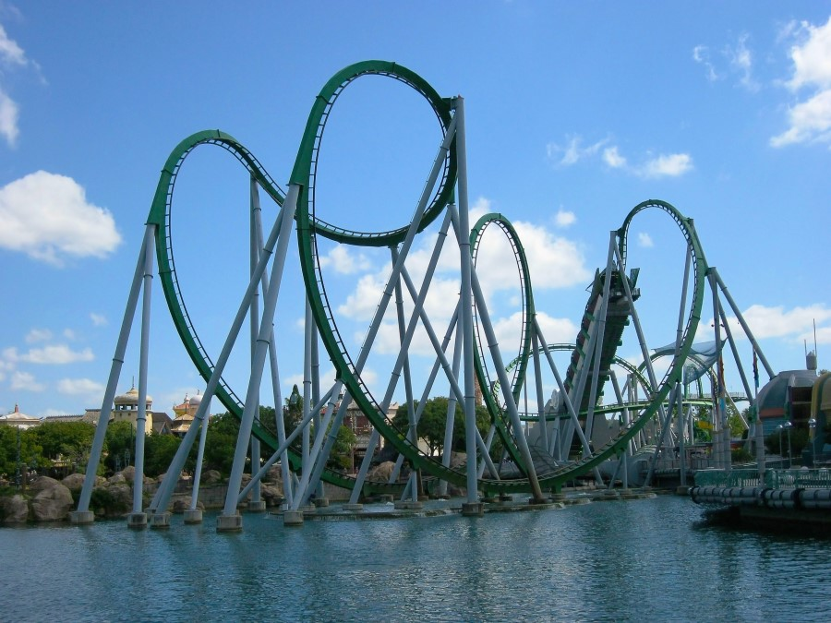
Scenario in 2010
Final Project Eagle grant ends
Gen Ed deans established in 2006
Authority decentralized
Expectations questioned
450 courses
31,000 students in 2010

Slide 5

Challenges in 2014
600+ courses
32,000 students
Quality varies
Inconsistent accessibility
No expectation of collaboration, consistency, conformance
No maintenance of courses planned
Faculty concerns about peers grasp of technology

Slide 6
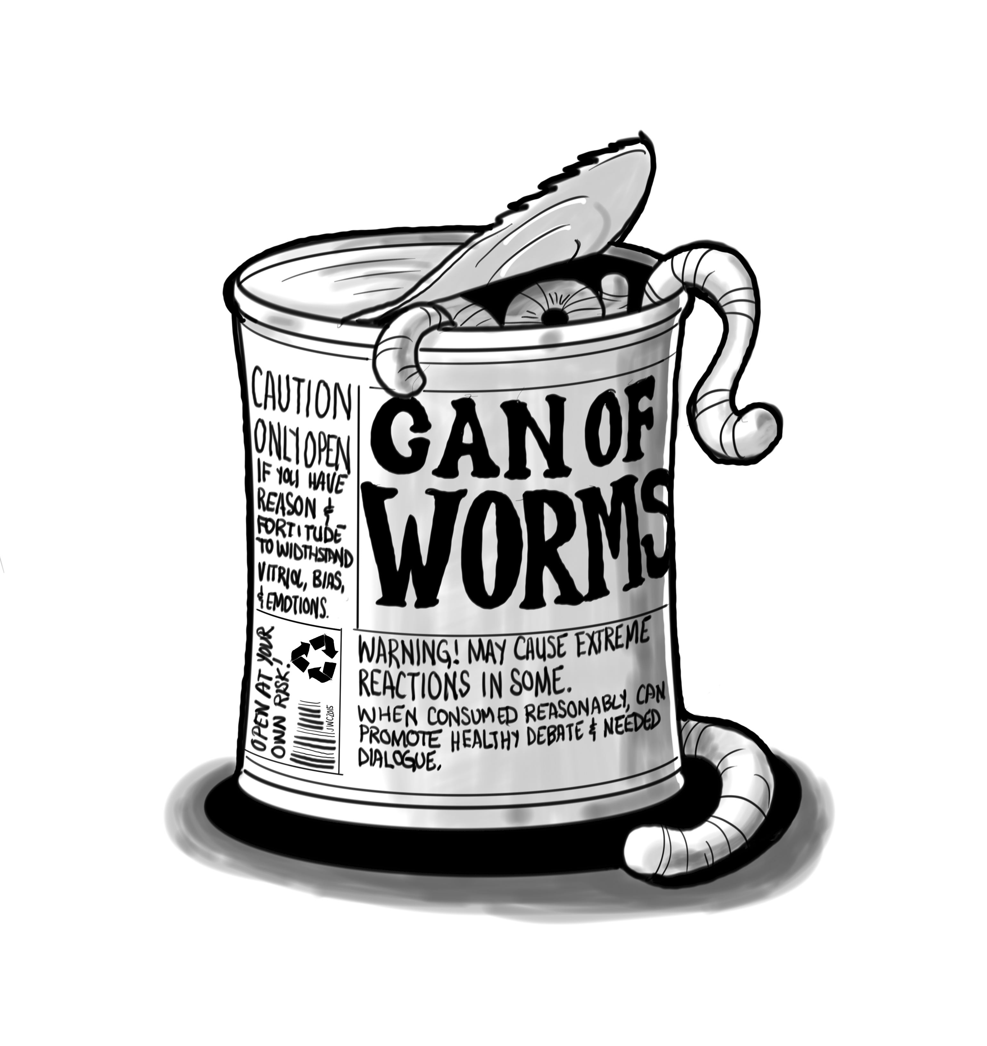
Online Revitalization project
Committee focus on course design process and standards, faculty preparedness, services, organization
80 faculty and staff – 3 months
Recommendations included:
Adopt QM
Require training
ID team assists in course creation
Plan for course maintenance

Slide 7
Our strategy
One or two faculty SMEs per course
Team members involved in ID complete APPQMR
Collaboration expected among teaching faculty
Start with the course outline, not with a review of existing course content
Faculty don’t touch the course during development
Informal QM reviews only during development

Slide 8
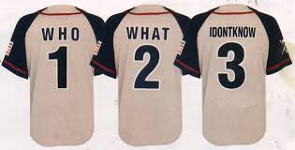
Change countdown 3…
Team assembled:
  5 Instructional Design Specialists
  4 Instructional Design Technicians
  2 Videographers
  1 graphic designer
  1 course assistant

Slide 9
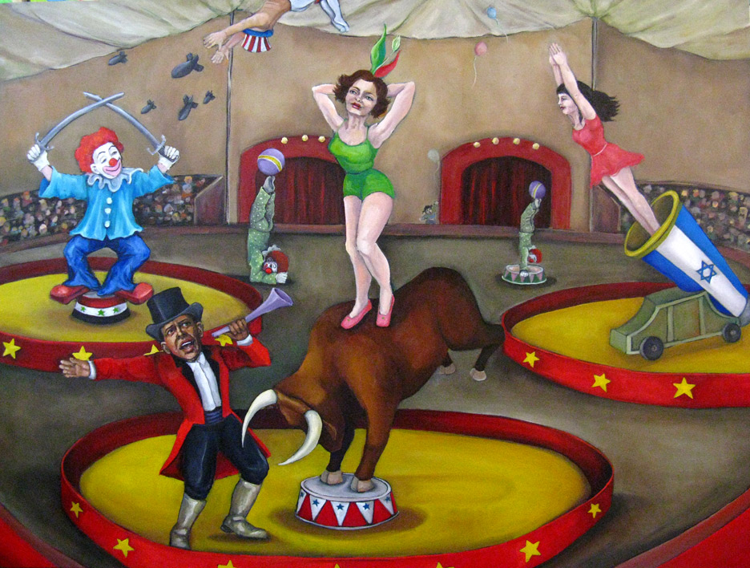
Change countdown 2…
Required training – no grandfathering
  APPQMR
  Developing an Online Course
  Peer Reviewer Course
  Plus Faculty Certification for MyCourses (aka D2L)
Unexpected benefits of QM training
  Dean and Faculty ‘Aha!’ moments
  Course outlines appreciated

Slide 10
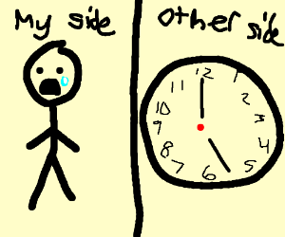
Change countdown 1…
Standard Course Documents
  MLO Worksheet
  Course Design Document
  Module Design Documents
Schedule set – 5 courses/5 IDS
Duties defined, paperwork created
Tracking for process, informal reviews and completion

Slide 11

We’re Ready!
Peer reviewers established
Paperwork complete for Content Experts
Ability to QM review a solo-developed course announced
Plan in place for Course Coordinators post-development
Kick-off meetings held
First rounds begin in April 2015

Slide 12
unanticipated speed bumps
“Content Expert” offends those who are not called “Content Expert”
  Changed to Development Facilitator (DF)
Rules Schedules are made to be broken
  Course is scheduled, but DF isn’t ready
  DF is ready but the course outline changes are not approved
  DFs and reviewers can’t work over summer break
Culture shift takes time and patience

Slide 13
Hindsight part 1
Design document redundancy
Team building & communication need guidance
Simplify the hoops for informal reviews
QM-ready template needed
No official process set for faculty who don’t choose to use the standard course
A spreadsheet to track the spreadsheets

Slide 14
Hindsight part 2
New rounds of 5 courses start every 3 weeks, one ID
Redundancy eliminated
Allow ample time for training & paperwork
Extra time needed for training & paperwork
Budget time for orientations of the courses for teaching faculty
Spreadsheet for the spreadsheets – Google drive

Slide 15
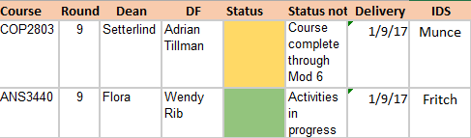
Hindsight part 3
Setting weekly meetings helps keep the deadlines
Closure is good for informal peer reviewers
Simple status reports for deans reduce surprises
Course coordinators get a guide, plus DF to CC transition meetings
Solo-developers need QM review process guidelines and counseling

Slide 16
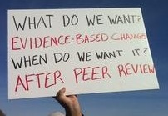
What are your strategies?
Best or worst practices:

Slide 17
Current standings
Collaborative processes established
Continuous improvement expected
Disorganization out, Accessibility in
54 standard courses created and launched
38 standard courses in progress
Faculty praise for the process

Slide 18
Questions?
Vicki Westergard
Westergard.Vicki@spcollege.edu

