Slide 1

What is your institutional
SARA status?
cc: m01229 - https://www.flickr.com/photos/39908901@N06

Slide 2
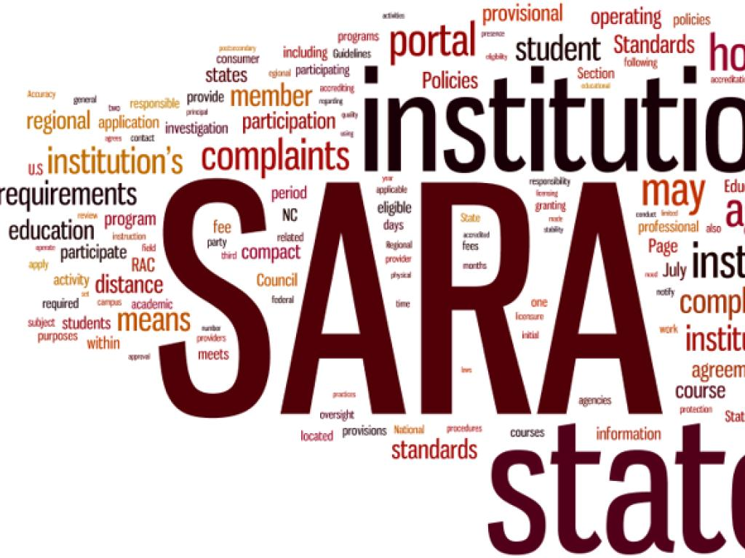
Kia Stone, M.S.
Compliance and Quality Assurance Coordinator, Ohio University
Jason Piatt, M.Ed.
Director, Online Compliance and Communication, Kent State University
Janet Staderman, M.Ed.
Assistant Academic Director/DL Coordinator, University of Cincinnati
Is it right for you?

Slide 3

Disclaimers
We are not your attorneys.
This is not legal advice.
This is not about how to apply for SARA or State Authorization.
But, we hope we can still be friends.
cc: SalFalko - https://www.flickr.com/photos/57567419@N00

Slide 4

Learning Objectives
Analyze specific SARA considerations and determine who to engage in the SARA conversation.
Develop a strategy for dual maintenance of SARA and non-SARA states.
Perform a cost-benefit analysis depending on the institutions current S/A status.

Slide 5

Brief History of SARA
cc: comedy_nose - https://www.flickr.com/photos/23408922@N07

Slide 6
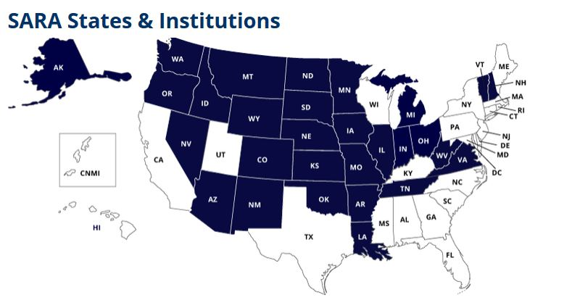
http://nc-sara.org/
*Current as of 10/1/2015

Slide 7
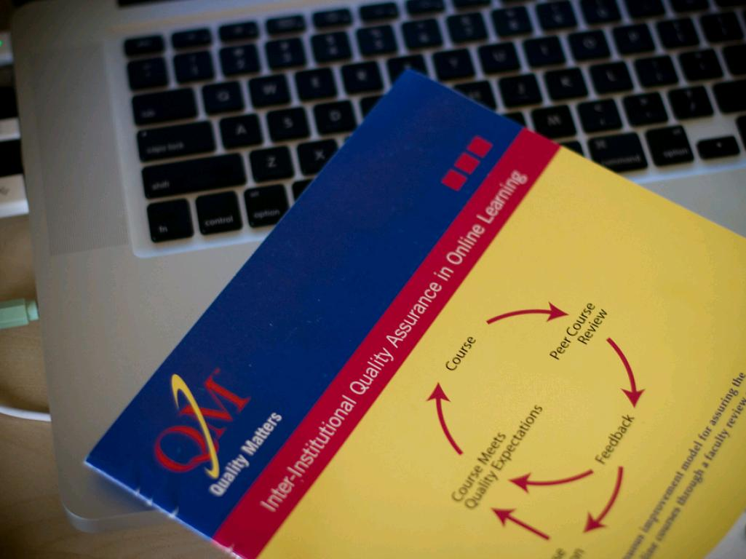
Why are we here?
cc: seantoyer - https://www.flickr.com/photos/16143699@N00

Slide 8
SARA is about
quality assurance
accountability
being student-centered

Slide 9
What are your institutional goals with regard to State Authorization?
cc: m01229 - https://www.flickr.com/photos/39908901@N06

Slide 10

Starting the SARA Conversation
Who to engage?
cc: ibm4381 - https://www.flickr.com/photos/13836948@N04

Slide 11
What are the benefits of SARA
to your Students?
to your Institution?

Slide 12
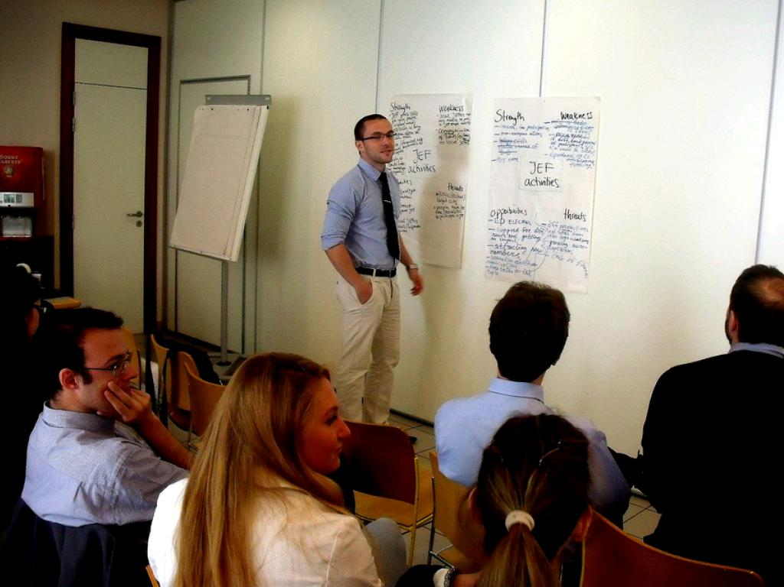
SWOT Analysis
cc: Young European Federalists - https://www.flickr.com/photos/33178774@N03

Slide 13

Questions?
cc: .reid. - https://www.flickr.com/photos/29406311@N04

