Slide 1
Framework that Supports a QM Culture
University of Cincinnati
cc: shonk - https://www.flickr.com/photos/35356228@N00

Slide 2
Learning Objectives
Discuss how organizational structure could be leveraged to support and coordinate QM resources.
Describe how specific departments collaborate across campus to support a university-wide culture of quality.
Differentiate roles and responsibilities for QM administration, training and implementation.

Slide 3
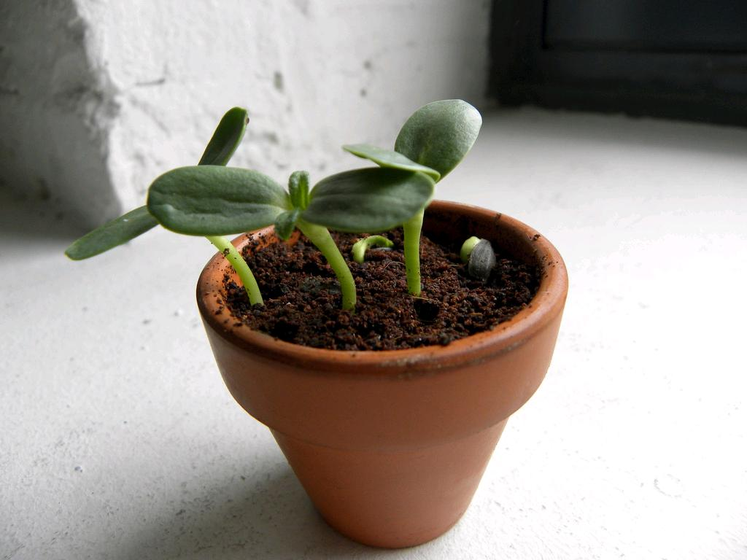
History of QM at UC
Growing familiarity and expertise…
cc: nathanmac87 - https://www.flickr.com/photos/72841285@N00

Slide 4

By the numbers
640+ QM Accounts
445+ APPQMR Trained
29 Peer Reviewers
6 F2F APPQMR Trainers
5 Master Reviewers
4 IDA Members
cc: ibm4381 - https://www.flickr.com/photos/13836948@N04

Slide 5
The Framework
Office of Distance Learning
Center of Enhancement for Teaching and Learning
Colleges/
Academic Programs
Administration
Training and Development
Implementation
cc: shonk - https://www.flickr.com/photos/35356228@N00

Slide 6
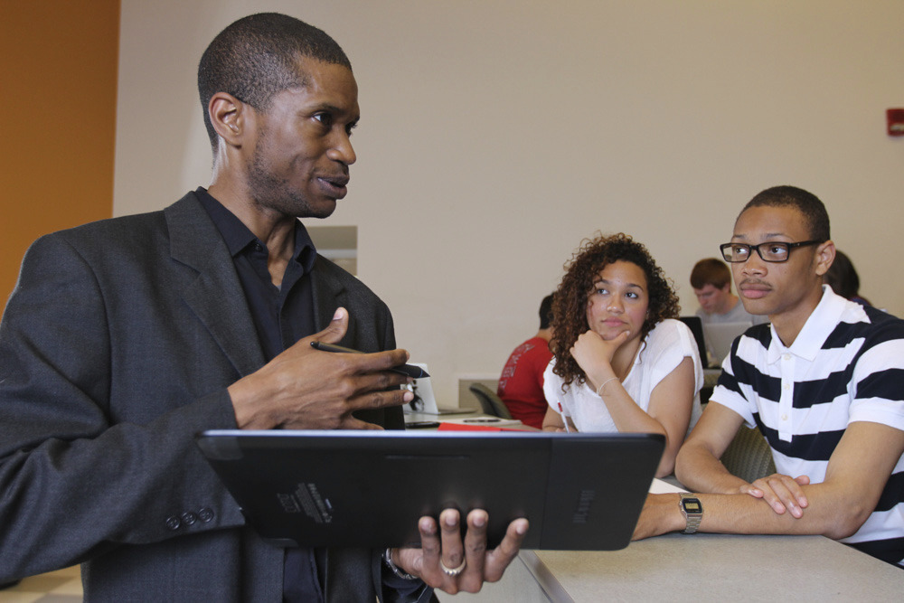
Office of Distance Learning
QM Administration
Maintains Institutional Membership
Manages QM Website
Schedules/Organizes APPQMR Training
Promotes/Supports “Culture of Quality”
http://www.uc.edu/distance/faculty/quality-matters.html

Slide 7
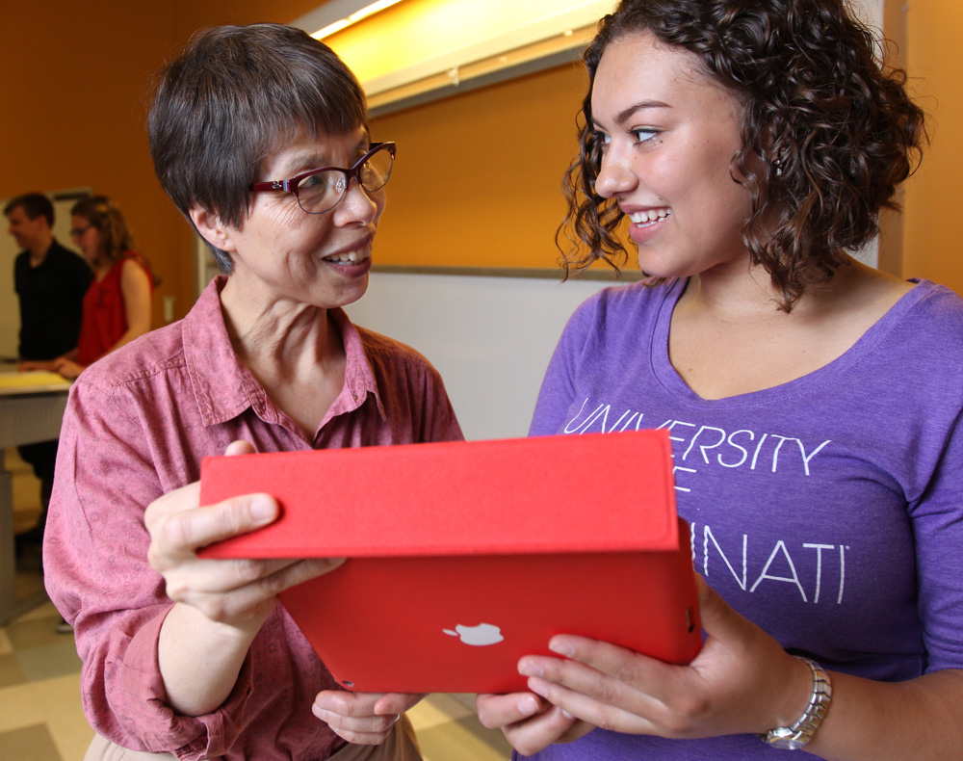
Center of Enhancement for Teaching and Learning
QM Training and Development
  Professional Development
  Centralized ID Support
  QM Trained Staff
  QM Course Template
cc: ibm4381 - https://www.flickr.com/photos/13836948@N04

Slide 8
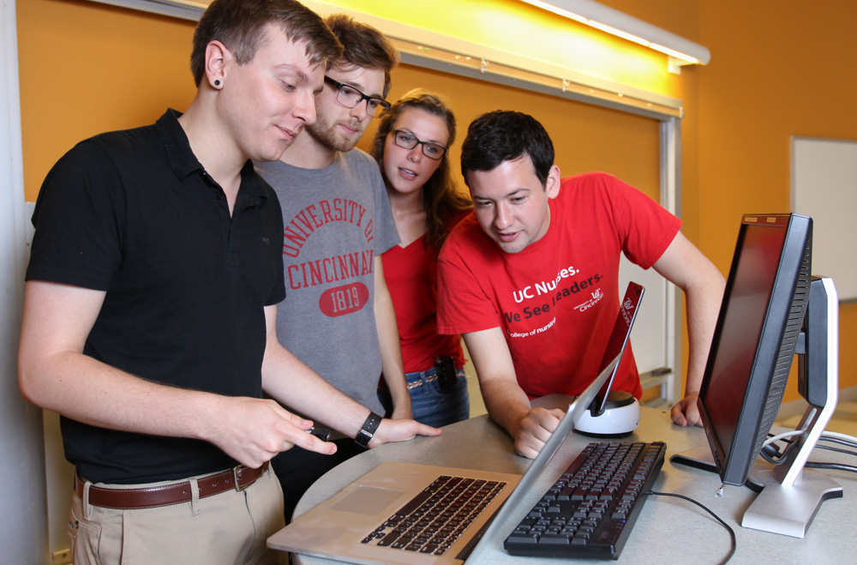
Colleges/Academic Programs
QM Implementation
  Full Autonomy
  Mixed Implementation
  Formal/Informal Reviews
  QM Course Template
cc: ibm4381 - https://www.flickr.com/photos/13836948@N04

Slide 9
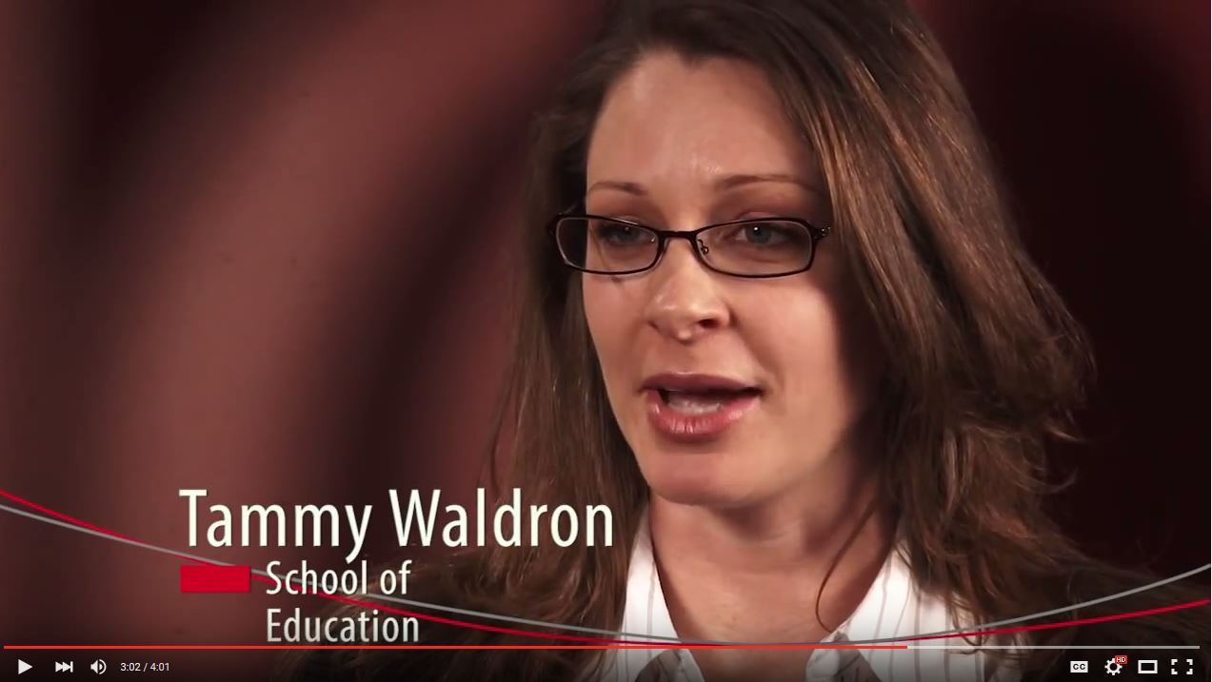
Putting it all together
Office of Distance Learning
Colleges/
Academic Programs
Center of Enhancement for Teaching and Learning
cc: nathanmac87 - https://www.flickr.com/photos/72841285@N00

