Slide 1

Systemwide Support for
Development of Quality Matters:
Backing Campuses to Implement QM
California State University System

Slide 2
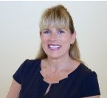
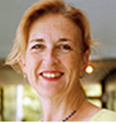
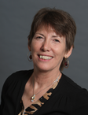

Meet the Presenters
Emily Magruder
Director
CSU Institute for Teaching & Learning
Marsha Orr
CSU Fullerton
Distance Education Faculty Liaison
Beverly Bondad-Brown
CSU Los Angeles
Associate Director, Center for Effective Teaching & Learning
Ashley Skylar
Chancellor’s Office
Academic Technology Services
Quality Assurance Manager

Slide 3
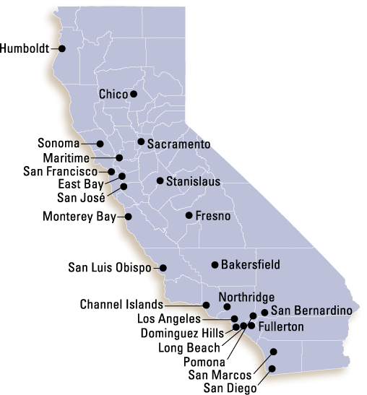
23 campuses
447,000 students
45,000 faculty & staff
Largest university system
in the world
Most diverse university system in the U.S.
One of the most affordable universities in the U.S.

Slide 4
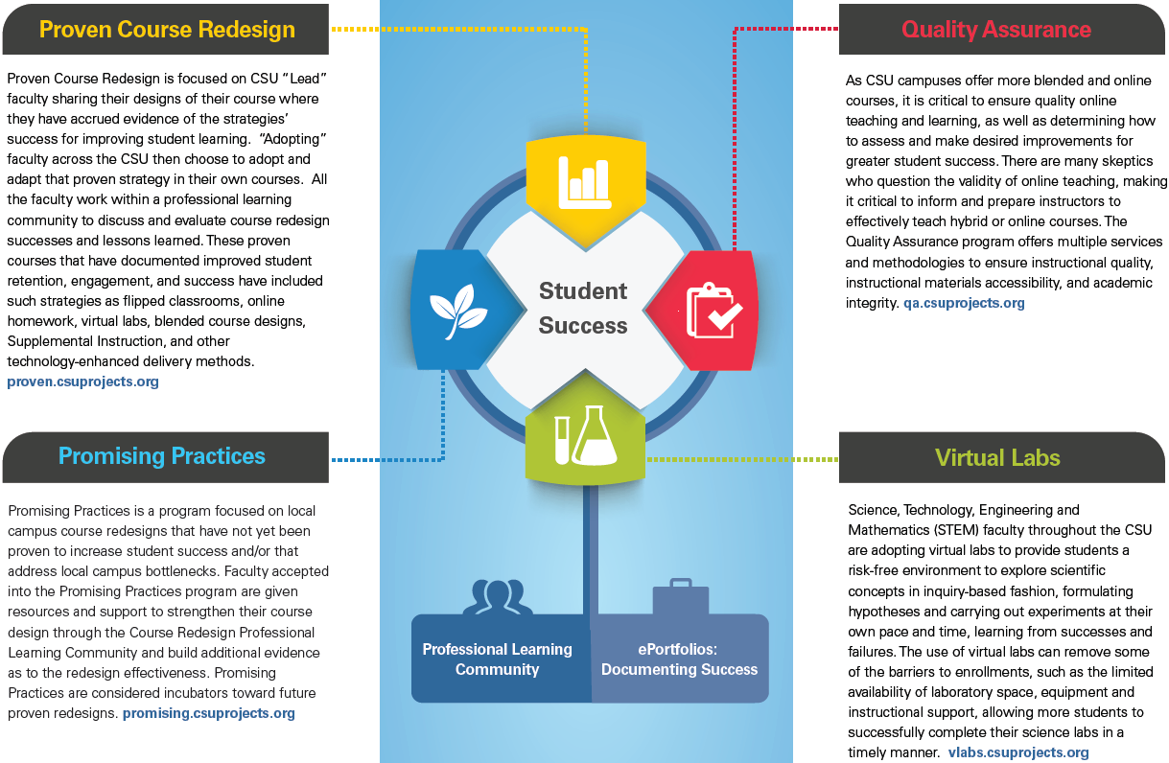
www.calstate.edu/courseredesign

Slide 5

Systemwide Support for QA Efforts
In an effort to increasingly support effective teaching and learning in blended and online course formats, we have developed a well-rounded program of QA training and resources for faculty and staff:
Instructional Quality
Academic Integrity
Universal Design for Learning/Accessibility
Student Readiness

Slide 6
CSU Quality Assurance Program
Chancellor’s Office implemented “CSU Quality Assurance” RFP Program
  May 2015: 18 Campuses Funded, up to $20,000 per campus
  November 2014-2015: 21 Campuses Funded, up to $20,000 per campus
  June 2015-2016: 20 Campuses Funded, up to $20,000 per campus
Summer
Institutes
Enroll in
QM Workshops
Online Training Course / Repository
Informal
Review
of Courses

Slide 7
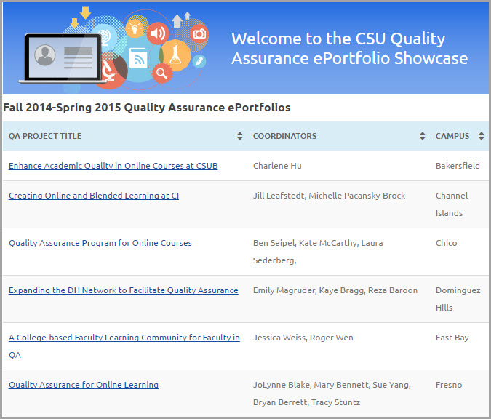
http://tinyurl.com/QA-eportfolios

Slide 8
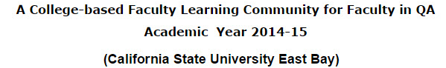
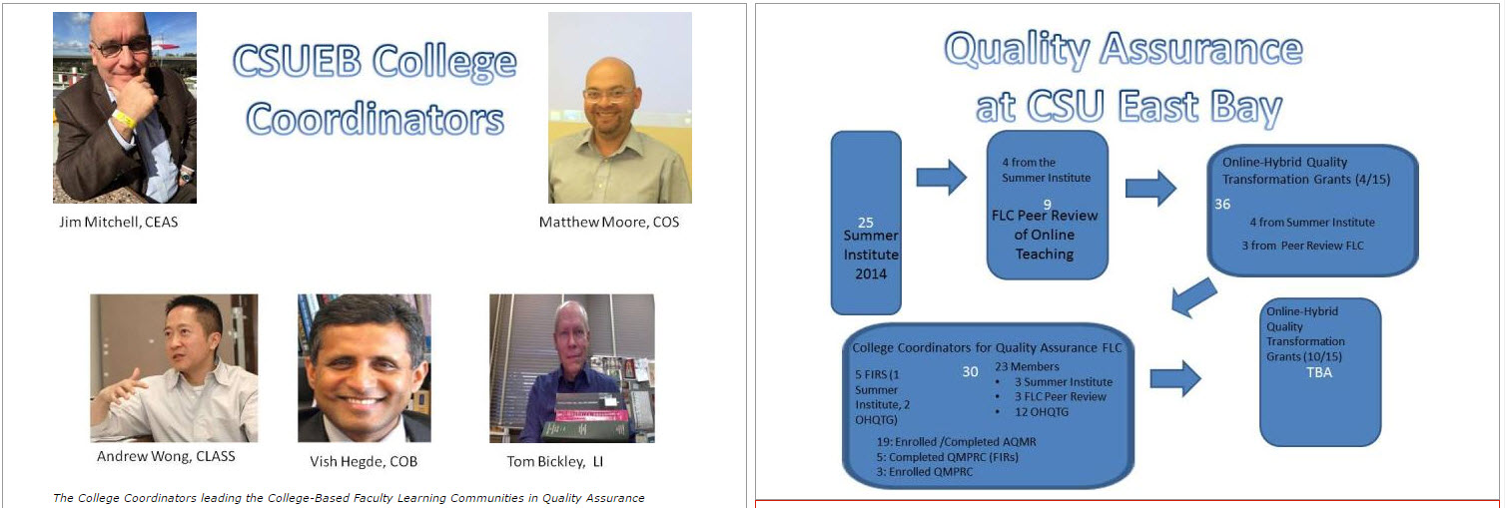

Slide 9

Quality Matters Training
16 CSU QM Campus Affiliates
QM Course/Certification | CSU Faculty/Staff
Applying the QM Rubric | 297
Peer Reviewer Certification | 90
Master Reviewer Certification | 15
Online Facilitator Certification (APPQMR) | 6
Face-to-Face Facilitator Certification (APPQMR) | 5
Designing Your Online Course | 25
Designing Your Blended Course | 55
Improving Your Online Course | 16
Introduction to Teaching Online | 42
Addressing Accessibility and Usability (ST8) | 7
 | Total = 558

Slide 10

Chancellor’s Office Sponsored APPQMR’s
Sponsored 4 faculty/staff to obtain APPQMR Facilitator Certifications:
3 Online, 1 F2F
12/05/14: 11 (ONLINE)
01/05/15: 12 (ONLINE)
01/09/15: 6 (F2F)
01/14/15: 26 (F2F)
02/02/15: 14 (ONLINE)
03/02/15: 15 (ONLINE)
04/13/15: 15 (ONLINE)
04/17/15: 19 (F2F)
04/24/15: 11 (F2F)
06/26/15: 9 (ONLINE)
08/03/15: 14 (ONLINE)
10/02/15: 16 (F2F)
10/23/15: 20 (F2F)
Total: 188 Faculty Trained

Slide 11
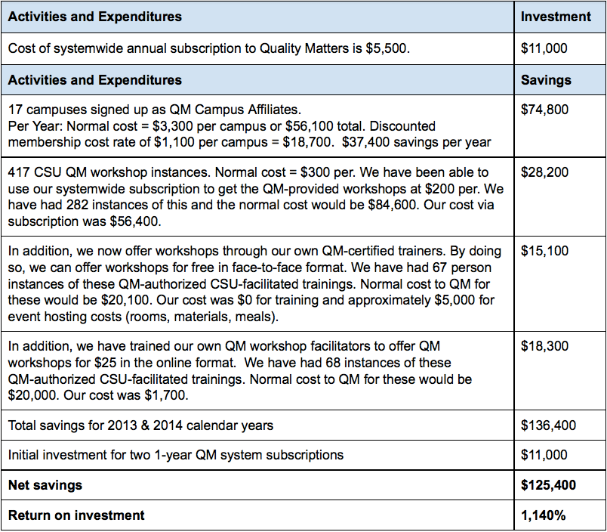
QM Systemwide Subscription Cost Savings

Slide 12
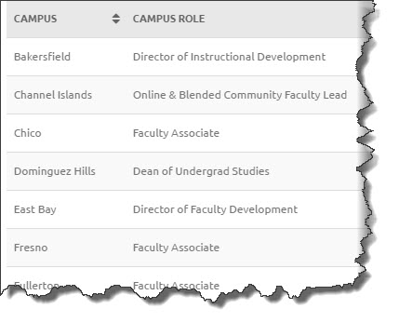
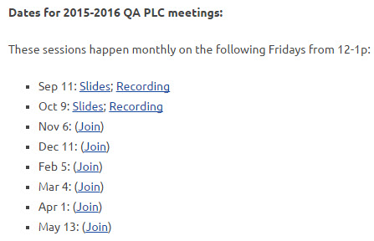

Professional Learning Community

Slide 13

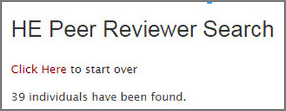
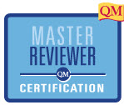
Building a Cadre of CSU QM Reviewers
Work over Spring/Summer 2015 to “fast track” CSU faculty/staff who have PRC certification to serve on “2” QM Reviews
39 Total CSU Peer Reviewers
14 MRC

Slide 14



Fall 2015: Pilot Subscriber Managed Reviews
2 CSU Campuses
3 Courses Per Campus
Meet Monthly During Pilot
Sponsored by CSU Academic Technology Services
Using Cadre of CSU QM Peer Reviewers
CSU QM Course Review Manager
Additionally, CSU Bakersfield been submitting
courses for QM recognition since 2012
11 Courses QM Certification

Slide 15


DH Network
E-Academy

Slide 16


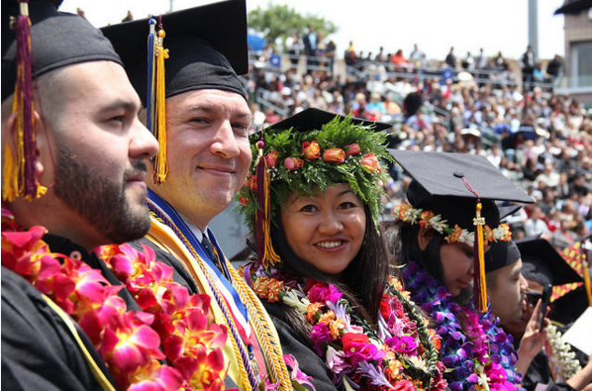
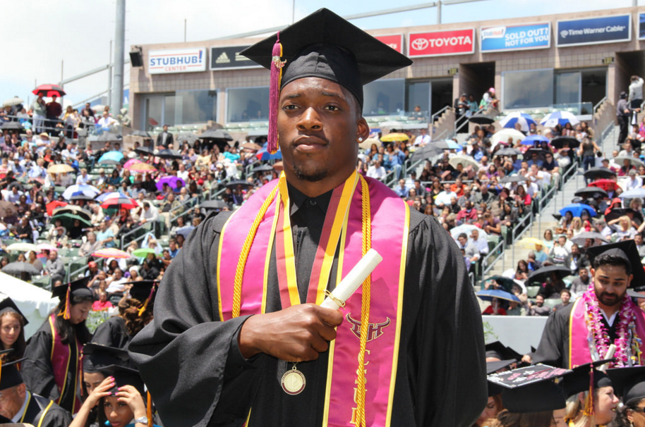
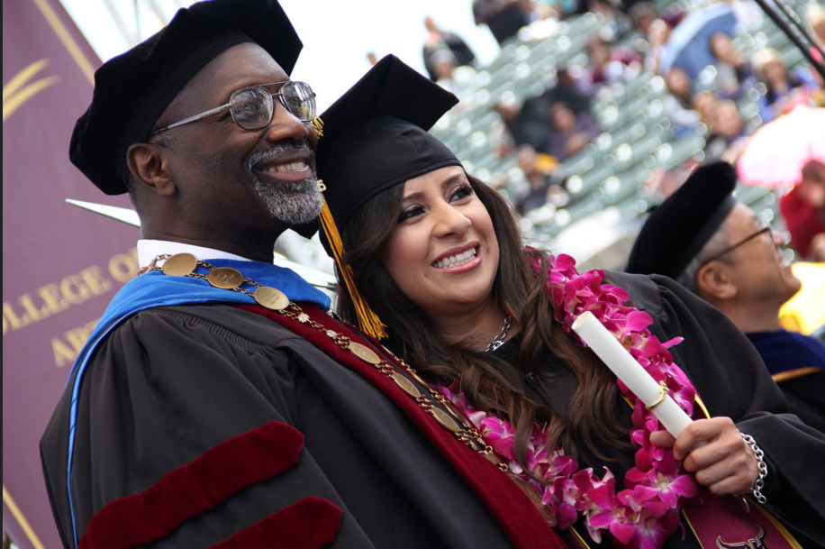
Dominguez Hills circa 2013

Slide 17
Research Informing Design
“More radical transformations of the overall social and cultural context of the university teaching practices are . . . likely to be required.”
Blin and Munroe
“We need not only to design change for our institutions but redesign our institutions for change.”
Tagg
“We yearn for frictionless, technological solutions. But people talking to people is still the way that norms and standards change.”
Gawande via Cox and Richlin

Slide 18
DH QA Program Design
Needs
1.Capitalize upon unique forms of engagement available online.
2.Provide a framework for discussing online teaching and learning.
3.Orient and retain faculty.
Goals
Create the DH Network
DH E-Academy
One-on-One
Consultations

Slide 19
Creating the Network
Recruiting Faculty
Taking QM Courses
Collaborating
May
June and July
July and August

Slide 20
E-Academy Design
Desired Outcomes | Agenda | Delivery Format
•Redesign one module of a current course •Engage in collegial peer review •Option to receive stipend for full re-design and in-house peer review | Intro to QM Criteria Applying QM Rubric to Sample Course “Mapping” and Alignment Breakouts Materials Engagement Activities Assessment Accessibility Feedback → Time for hands-on work, consultation, peer review and presentation | Face-to-Face 2 Fridays, 2 weeks apart 2 consecutive days (Friday & Saturday) Hybrid Half-day F2F Intro Online Modules Half-day F2F Presentation → Follow-up: 1:1 consultation with Network members

Slide 21


Slide 22



Slide 23
References
“The DH Network for Quality Assurance.” (2014) CSU Dominguez Hills, QA ePortfolio Summer 2014.
http://contentbuilder.merlot.org/toolkit/html/snapshot.php?id=21377770715745
Blin, F. and Munro, M. (2008) “Why hasn’t technology disrupted academics’ teaching practices?
Understanding resistance to change through the lens of activity theory.” Computers and Education 50: 475-490.
Cox, B. E., McIntosh, K.L., Reason, R. D., and Terenzini, P. T. (2011) “A culture of teaching: Policy,
perception,and practice in higher education.” Research in Higher Education 52.8: 808-829.
Cox, M. D. and Richlin, L. (November 2013) “From bench to bedside in faculty development: Using
implementation science.” Presentation at POD Annual Conference.
Gawande, A. (July 29, 2013) “Slow ideas: Some innovations spread fast. How do you speed the one’s
that don’t?” New Yorker. Retrieved from http://www.newyorker.com/magazine/2013/07/29/slow-ideas.
Karasavvidis, I. (2009) “Activity Theory as a conceptual framework for understanding teacher approaches
to information and communication technologies.” Computers and Education 53 (2009): 436-444.
Tagg, J. (January-February 2012) “Why Does the Faculty Resist Change?” Change. Retrieved from
http://www.changemag.org/Archives/Back%20Issues/2012/January-February%202012/index.html

Slide 24

Fullerton by the Numbers:
38,000 Students
2,140 Faculty
55 Undergraduate programs
54 Graduate programs
16 Online Degrees
18 Online Certificates
275 State-supported online courses
Located in Southern California, Orange County.
QM Initiative:
56 Individuals Trained
2 Peer Reviewers
1 Master Reviewer
4 Courses Reviewed by Internal Reviewers

Slide 25
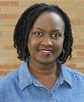
Summer 2014
27 Faculty completed QM Courses
5 Faculty went on to take a Peer Reviewer Course
A “Needs Assessment” was conducted to determine faculty perceptions of online learning.
I have listed some of my major “take aways” from the course:
1. QM emphasized the importance of the instructor teaching her course in a manner that communicates enthusiasm and engagement with her subject matter. That should be vitally important to the online instructor.
2. An instructor should introduce herself to her class by sharing pertinent information about herself, such as her education, career, hobbies or any other interest that will help to build a connection with her students.
3. The format of an online course should follow a consistent presentation and be enhanced with aspects of creativity

Slide 26
Fall 2014-Spring 2015
Expanded knowledge of the Quality Matters Rubric/Standards to all Colleges and key stakeholders at CSUF.
Engaged 8 faculty QM Leaders and 2 instructional designers, representing each of the Colleges and University Extended Education, in taking the Quality Matters "Applying the QM Rubric" courses, conducting a survey of faculty in their respective College, and disseminating information about online learning.
Involved instructional designers from the University's Extended Education Department.
Engaged Faculty QM Leaders in the University-wide Teaching Titans Day, Assessment Conference, and Assessment Forum.
Held monthly networking meetings for faculty and instructional designer QM Leaders.
Developed a Dropbox repository of QM materials and online learning topics.

Slide 27
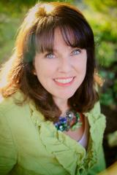
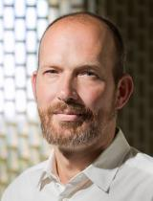
Assistant Professor
I have been teaching online and blended courses for the past 10 years. Before I came to CSU Fullerton, my main responsibility was the deliver the content rather than develop the vehicle in which the content is delivered. My experience with the quality assurance project has changed my focus as I continue to develop courses. User and accessibility friendly courses are as important as the content. I will continue to improve the my online and blended courses in hopes to certify each as they are developed.
Associate Professor
I completed one day workshops on QM as well as on Cal State's own QOLT rubric early in the semester and have learned a lot about the flaws of my own assumptions in course design. I was able to make significant improvements both in my subsequent online courses AS WELL AS my on-campus seminars where a well-designed course website and online resources are just as much part of students' expectations. I shared my own QM lessons with my department and offered tips on how to use QM as a self-assessment tool, an application my colleagues embraced wholeheartedly.

Slide 28

Fall 2015-Spring 2016
Engaging 15 additional QM Leaders and instructional designers, representing 7 of the Colleges in taking the Quality Matters "Applying the QM Rubric" courses, and
Surveying students after online course changes consistent with QM occur.
Continue to hold monthly networking meetings for faculty and instructional designer QM Leaders that involve the previous QM Leader group from AY 2014-2015.
Co-hosting an APPQMR course at another CSU-system campus therefore providing cross-campus networking.
Maintain a Dropbox repository of QM materials and online learning topics.
Participating in the pilot QM-subscriber-managed course reviews.

Slide 29

Building a QM Network:
Start with current “champions”
Build across-campus involvement
Promote regular interaction and networking
Share the work at campus events
Reward the participants with recognition (and a stipend when available)

Slide 30

Background on the campus...
~ 27,000 students
~ 500
6 miles east of Downtown Los Angeles
Moving from Quarters to Semesters in Fall 2016
Very few online/hybrid courses when QA program began in 2013

Slide 31

Initial Goals of QA Programming...
Increase awareness of QM rubric and online best practices – to a variety of audiences
Provide training to redesign to flipped, hybrid, online formats
Infuse best practices into our “technology” workshops
Offer QM workshop stipends to faculty
Create resources and templates to help faculty save time

Slide 32

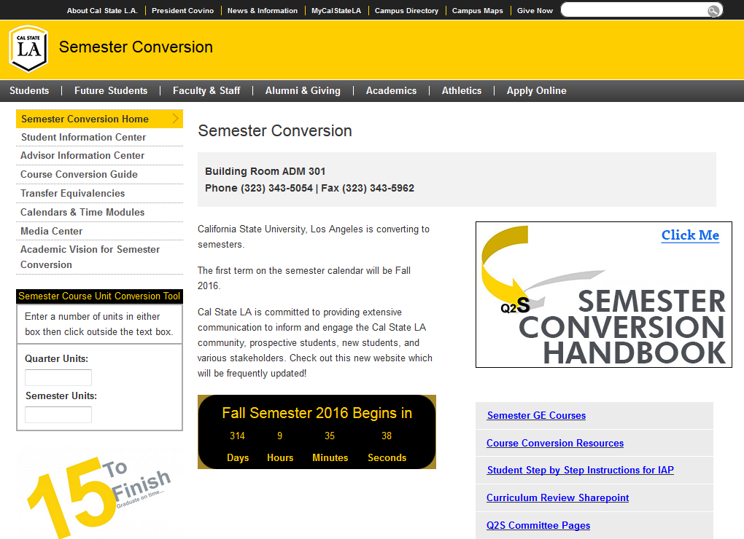


Capitalize on what is happening

Slide 33
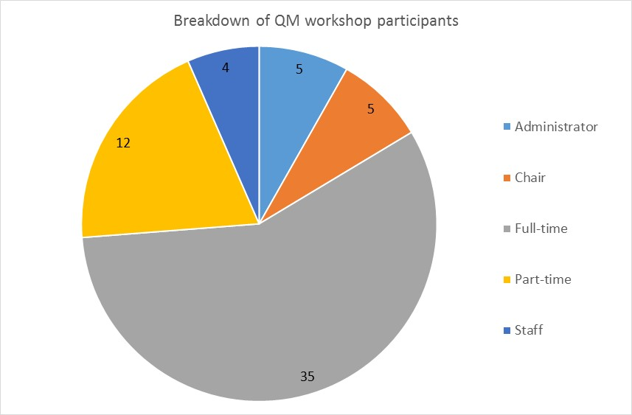
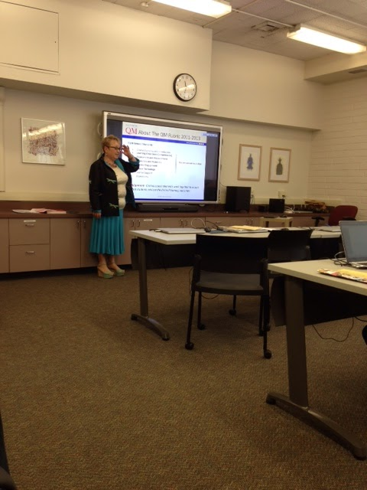


Get administrator buy-in

Slide 34
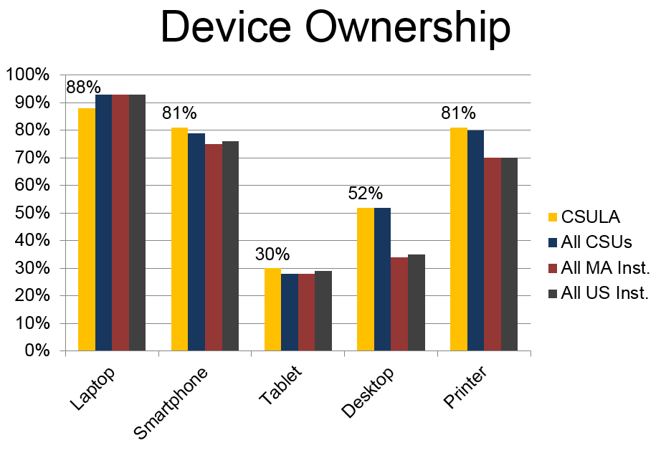
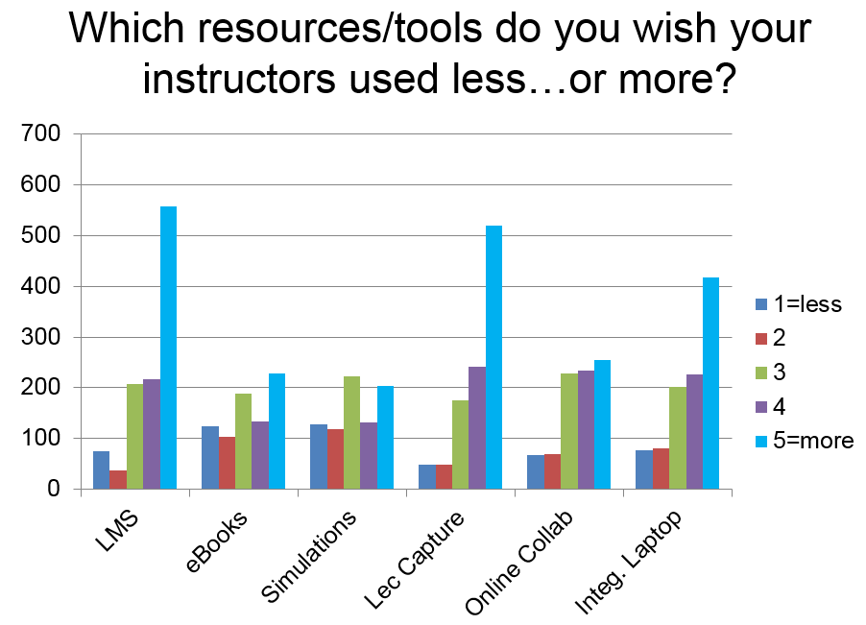



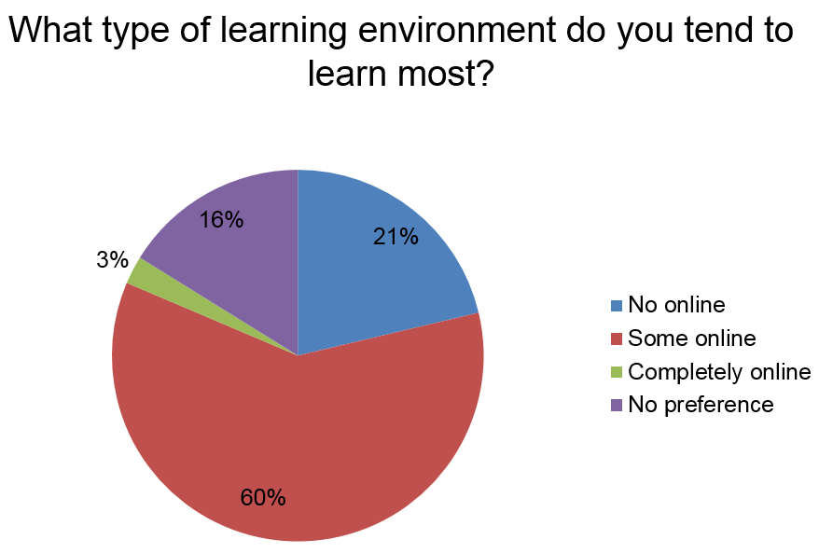
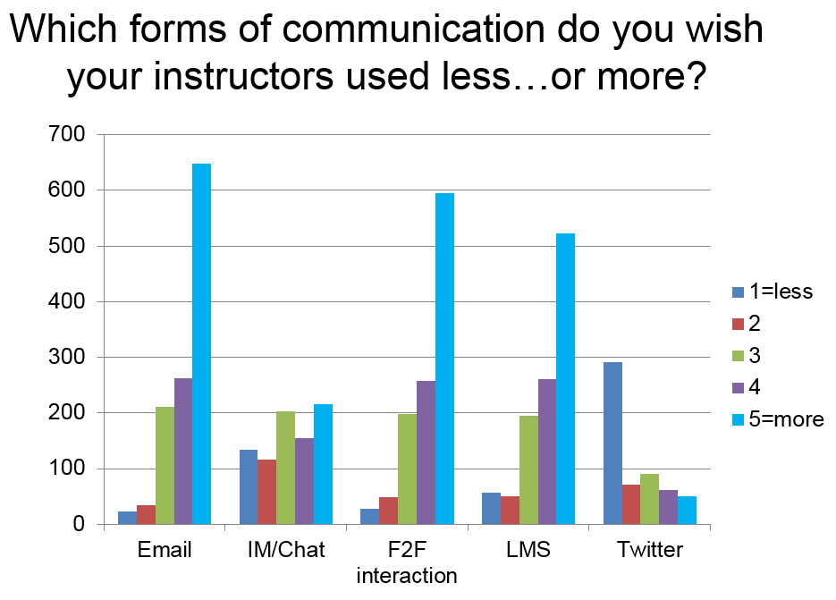

Leverage what already exists

Slide 35
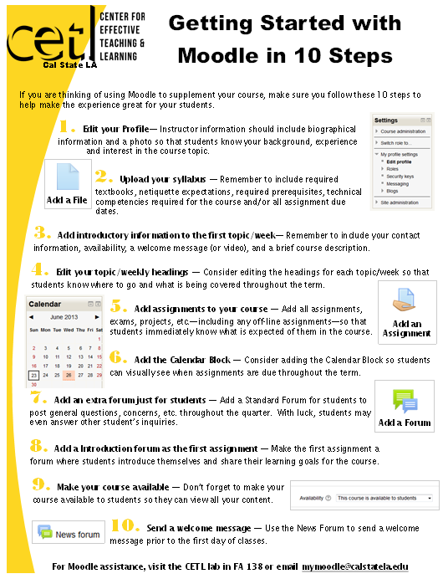
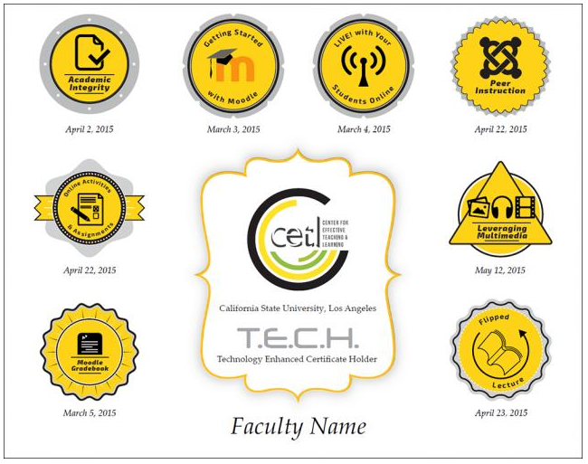
Be sneaky
Placeholder for LA slides

Slide 36



Lessons Learned

Slide 37
2015-2016 Next Steps
Hybrid Development Program
Goal: Assist 75 faculty to redesign from F2F to hybrid by Fall 2016 (Q2S) - 25 faculty/quarter
Take QM DYBC
Attend 2 CETL F2F meetings on alignment (10 hrs total)
Must attend 5 CETL workshops
Turn in course planning sheets for all modules
Populate their Moodle template for course
Finalize all materials (14 week total timeline)

Slide 38
Discussion & Contacts
Ashley Skylar, Chancellor’s Office, Quality Assurance Manager askylar@calstate.edu
Emily Magruder, Director, Institute for Teaching & Learning
formerly Co-Director, Faculty Development Center, CSU Dominguez Hills
  emagruder@calstate.edu
Marsha Orr, Cal State Fullerton, Faculty Liaison, Distance Education
marshaorr@exchange.fullerton.edu
  Beverly Bondad-Brown, Cal State Los Angeles, Associate Director,
  Center for Effective Teaching & Learning
  bbondad@calstatela.edu
  qa.csuprojects.org

