Slide 1
Our Sneaky QM Implementation
Moving Past Posting Their Syllabus Online
Maria Fernandez & Jeff Suarez-Grant, Instructional Designers
California State University Los Angeles

Slide 2

California state university los Angeles
23,000 to 24,000 Students
500 Faculty Members
Urban Campus,
East Los Angeles

Slide 3

Faculty Development center
Director and Assoc. Director
LMS Specialist
Two Student Assistants
Two Instructional Designers

Slide 4
The Center also handles Ed Tech as well as our LMS, Moodle.

Slide 5
Few, hardly any online courses
or some online courses
flying under the radar.

Slide 6
Little, if any institutional support for quality assurance in online course design/development.

Slide 7
Overall, faculty are not beating a path to our door to get help designing/ developing online courses.

Slide 8
How do we jumpstart a quality assurance initiative?

Slide 9
Who do we serve and where are the opportunities for quality assurance?

Slide 10
Self-Selected
LMS Support
Unknown
Notes:
Main Overview

Slide 11
Self-Selected
Notes:
Main Overview

Slide 12
Self-Selected
LMS Support
Unknown
Notes:
Main Overview

Slide 13
Unknown
Notes:
Main Overview

Slide 14
Self-Selected
LMS Support
Unknown
Notes:
Main Overview

Slide 15
LMS Support
Notes:
Main Overview

Slide 16
Our most frequent customers.
Want assistance but not with online course design.
Notes:
They usually come looking for assistance with one thing.
Gradebook, collecting assignments electronically, Turnitin, one facet of online learning like discussion boards, lecture capture.
At first these folks don’t seem like eager adopters of QA.

Slide 17
This is a promising group for QA.
Notes:
This is where it gets sneaky.
We don’t want to be too pushy with this group. We can’t insist they use QA.
Talking to them about QM at this point wouldn’t make sense to them. Just too much.

Slide 18
Train faculty to employ QA best practices even before they’ve thought to teach online.

Slide 19
Infuse QA best practices in
any and all support, training, and development provided to faculty.
Notes:
And this has two primary benefits.
First, when they do decide to teach online, they’ve already been exposed to QA.
Second, it also has a positive impact on traditional f2f courses, since faculty seeking our assistance with the LMS are looking for LMS support of their traditional courses.

Slide 20
Short Workshops
Online Activities
Flip a Lecture
Turnitin
Gradebook
Getting Started
LIVE!
Leveraging Multimedia
General LMS/Ed Tech
Course Design/Redesign
Online Course Consultation
Notes:
Talking Points:
Folks seeking LMS support typically take advantage of these workshops.
This is the main entry point into the QA pipeline.
All workshops demonstrate/model various QM Standards

Slide 21
What’s the incentive?
Notes:
Incentive for those new and self-selected the Badges brag sheet or RTP file (Retention Tenor Professor)

Slide 22
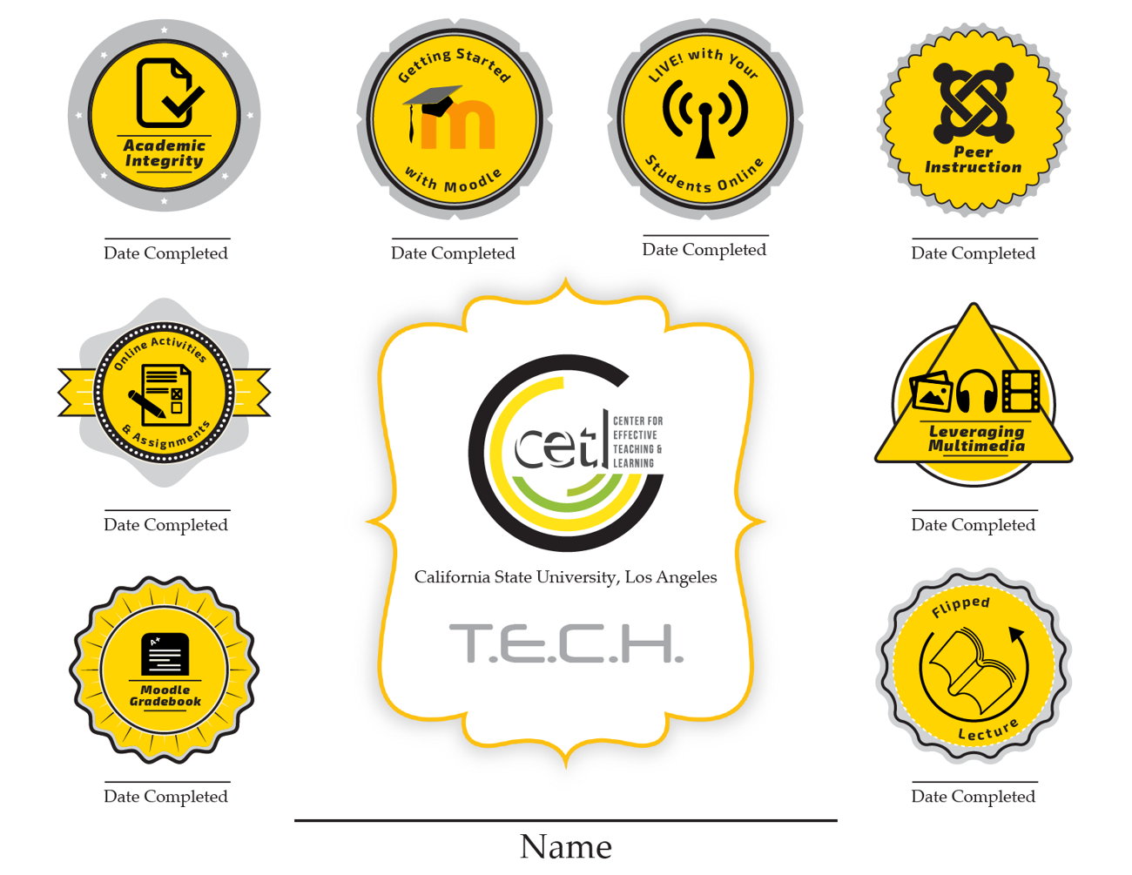
Notes:
Talking Points:
Market our workshops weekly on site calendar where they can register

Slide 23
Getting Started with Moodle infuses QM Standards
Course Overview & Introduction
Course Activities & Learner Interactions
Notes:
At this point, we’re not even talking about QM, and they’ve already been exposed to two standards.

Slide 24
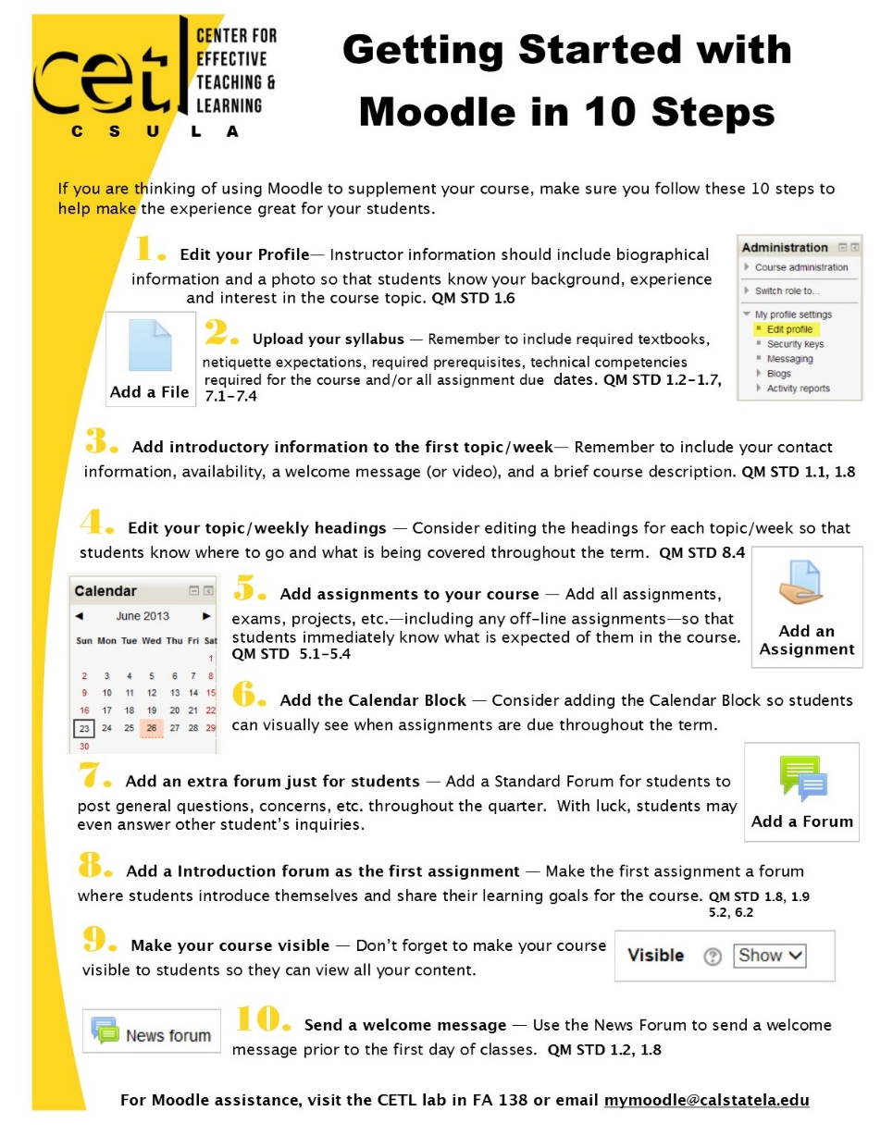
Notes:
Talking Points:
Getting Started with Moodle – In Ten Steps, very concrete, easy to walk away with something to implement.
Best practices on getting course materials in Moodle..
This first workshop – helps to market the others– they get hooked.

Slide 25
Online Activities - Moodle
Meets QM STD:
Glossary – 5.2 (Course Activities and Learner Interaction)
Wiki – 6.2 (Course Technology)
Assignment – 5.2 (Course Activities and Learner Interaction)
Rubrics – 3.5 (Assessment and Measurement)
Choice – 6.2 (Course Technology)
Feedback – 3.5 (Assessment and Measurement)
Notes:
Talking Points - Online Activities workshop
Best practices on creating active learning/engaging online assignments or activities within Moodle
Templates are shared & QM standards are met
FYI…
Assessment and Measurement
3.5 The course provides learners with multiple opportunities to track their learning progress.
Course Activities and Learner Interaction
5.2 Learning activities provide opportunities for interaction that support active learning.
Course Technology
6.2 Course tools promote learner engagement and active learning.

Slide 26
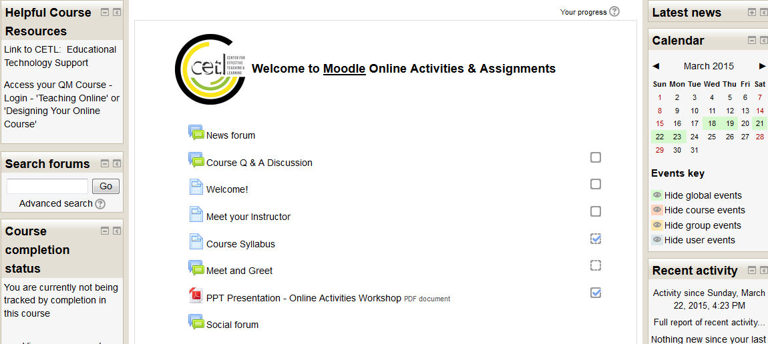
Notes:
Talking Points - Online Activities workshop
Best practices on creating active learning/engaging online assignments or activities within Moodle
Templates are shared & QM standards are met
FYI…
Assessment and Measurement
3.5 The course provides learners with multiple opportunities to track their learning progress.
Course Activities and Learner Interaction
5.2 Learning activities provide opportunities for interaction that support active learning.
Course Technology
6.2 Course tools promote learner engagement and active learning.

Slide 27
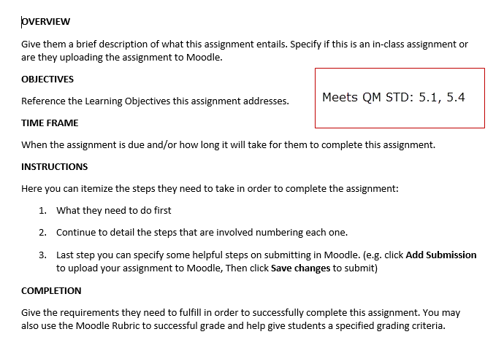
Notes:
Templates are shared:
designing assignment description that indicate to the students the learning objectives and requirements
Our template is shared and is well received
Course Activities and Learner Interaction
5.1 The learning activities promote the achievement of the stated learning objectives or competencies.
5.4 The requirements for learner interaction are clearly stated.
Again, super concrete, lots of takeaways, things to implement right away.
We know this is working since they ask somewhat panicked if they’ll lose access to the shell.

Slide 28
Live! With your Students Online. Best Practices using Adobe Connect
Notes:
Talking Points: Our Message

Slide 29
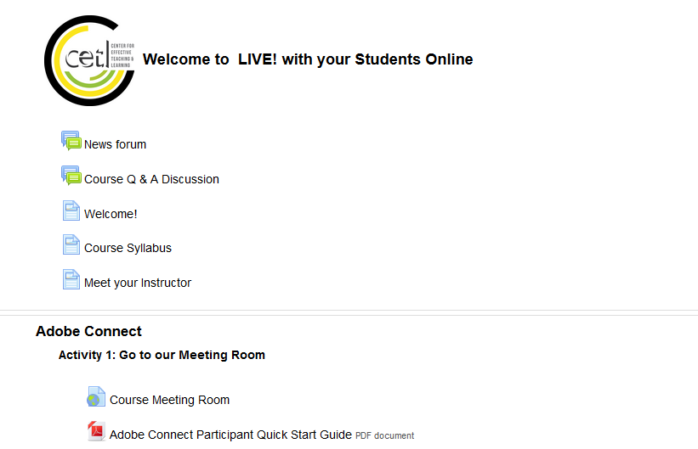
Notes:
Talking Points: Modeling
Our short workshops have shells
They are enrolled
Have access to all our templates
Model how to use our templates in their courses
Our workshop courses are Filled with resources
They come into this workshop and want to know how to mimic this course structure and format.

Slide 30
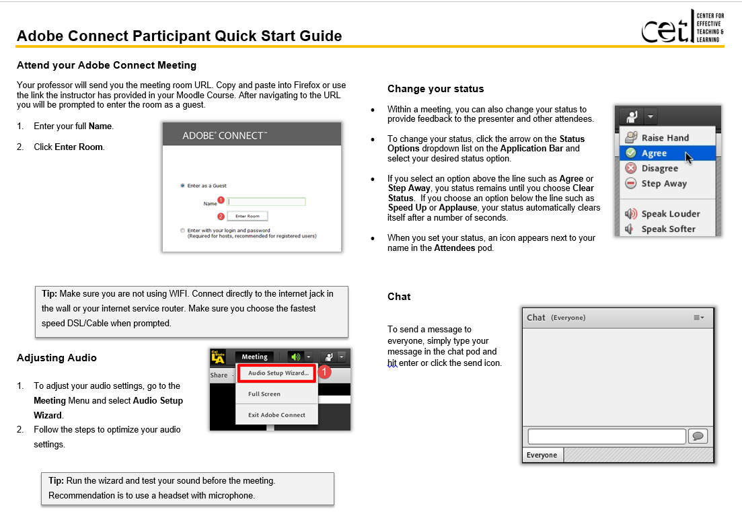
Notes:
Talking Points:
Education Technology Tools
Adobe Connect: Best Practices – supplement office hours, chat or connect for group projects, quick review before an exam, use to connect with experts in the field off campus
We have all the helpful guides for faculty and students

Slide 31
Meets QM Standards Course Technology as well as Course Activities & Learner Interaction
Notes:
Talking Points: Our Message

Slide 32
Flip a Lecture &
Leveraging Multimedia
Notes:
Talking Points: Our Message
Simplify content/lectures and record using Camtasia
Publishing and captioning using YoutubeGuides

Slide 33
Emphasizes QM Standards
Instructional Materials &
Course Technology
Notes:
Talking Points: Our Message

Slide 34
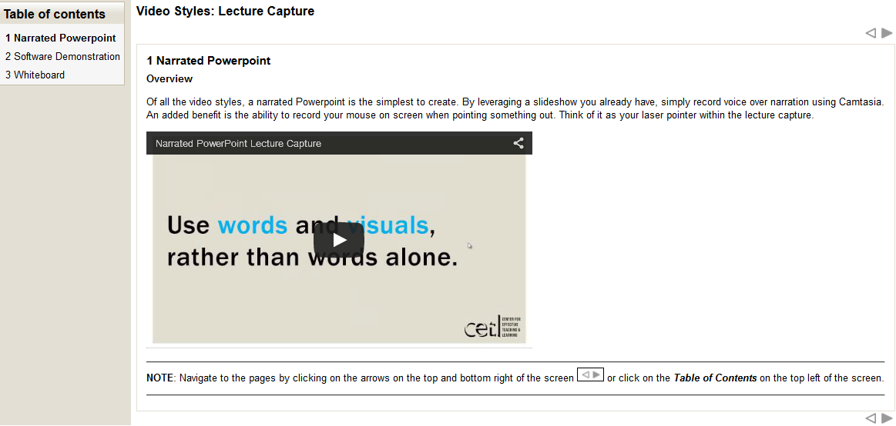
Notes:
Talking Points: E-Learning Design Principles
We model benefits of flipping a lecture with this workshop. They watch online video and must prepare 5-7 slides prior to workshop day. They must come prepared to record during workshop

Slide 35
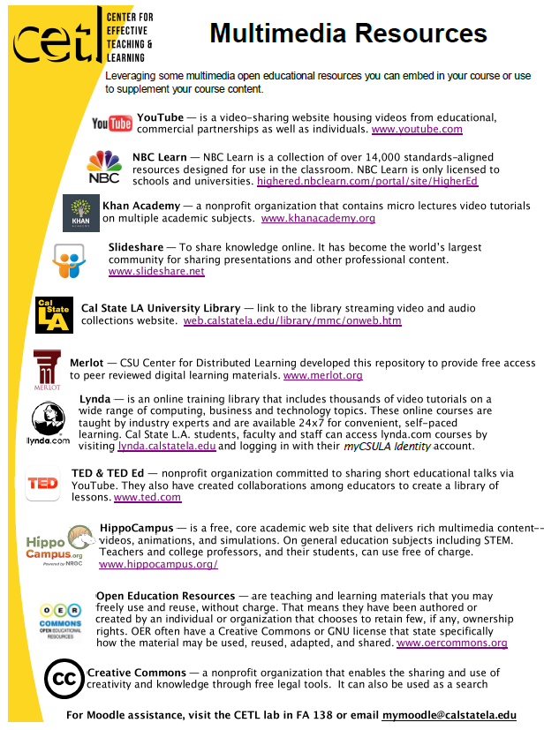
Notes:
Talking Points: Open Education Resources
Share resources
Illustrate best practices in embedding OE
Address Copyright & Accessibility
FYI….
Instructional Materials
4.1 The instructional materials contribute to the achievement of the stated course and module/unit learning objectives or competencies.
4.2 Both the purpose of instructional materials and how the materials are to be used for learning activities are clearly explained.
4.3 All instructional materials used in the course are appropriately cited.
4.4 The instructional materials are current.
4.5 A variety of instructional materials is used in the course.
4.6 The distinction between required and optional materials is clearly explained.
Course Technology
6.2 Course tools promote learner engagement and active learning.
6.3 Technologies required in the course are readily obtainable.
6.4 The course technologies are current.
6.5 Links are provided to privacy policies for all external tools required in the course.

Slide 36
Multi-Day Training
QA Self Review
Quality Matters Workshops
Online, Flipped, Blended Institute
Review Debrief
General LMS/Ed Tech
Course Design/Redesign
Online Course Consultation
Notes:
LMS support folks and Self-Select take advantage of more intense multi-day training that features more prominently QA.
We’ve established buy in at this point, so we can stress it more.
Talking Points:
These are Multiday PD opportunities that require more commitment and time. Usually run for 4 days
In these sessions candidates are more motivated, therefore it allows us to convey QM in more depth. Promote more of the QM workshops, Self review of their courses
Promote the QOLT self review –
ID as their consultants will Debrief with them
QM Workshops grants

Slide 37
More intense multi-day training that features more prominently QA after buy-in is established.

Slide 38
Online Course Development
Course Template
Checklist
Syllabus
Worksheets
How to Build an Online Course
General LMS/Ed Tech
Course Design/Redesign
Online Course Consultation
Notes:
Now they’re ready to get to work on their online course.
These are all of the support pieces, some are intended for 1 on 1 consultation, others more for independent work on course development.

Slide 39
How to Build your Online Course

Slide 40
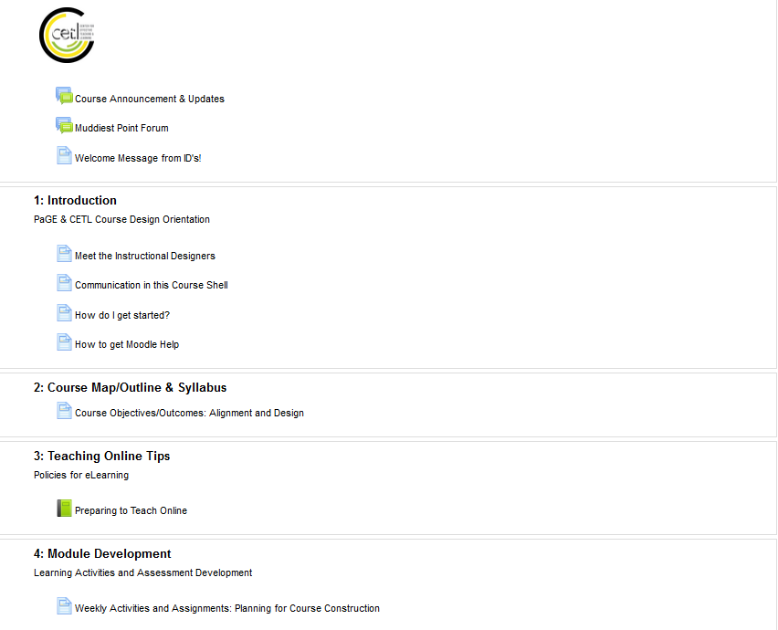
Notes:
Talking Points:
Online Course Design Shell used for those self-selected (RFP, OI, QOLT self-review, QM Grant Workshops)
These faculty are placed in this course shell and are assisted by ID to design their online courses
This shell contains all our templates, Worksheets, and tutorials that are excerpts from our Workshops
It is designed to take them through the step by step process of designing a Quality Assured Online Course

Slide 41
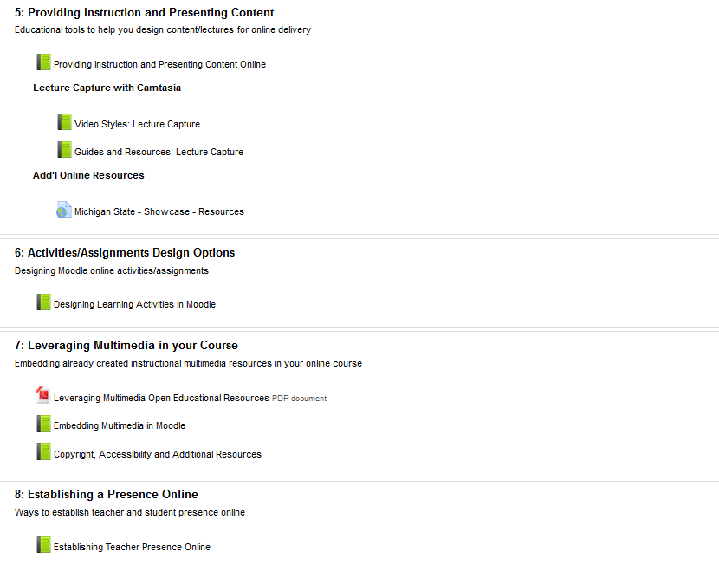
Notes:
Purpose to go through the 8 QM rubric standards

Slide 42
Sharing Syllabus Template

Slide 43
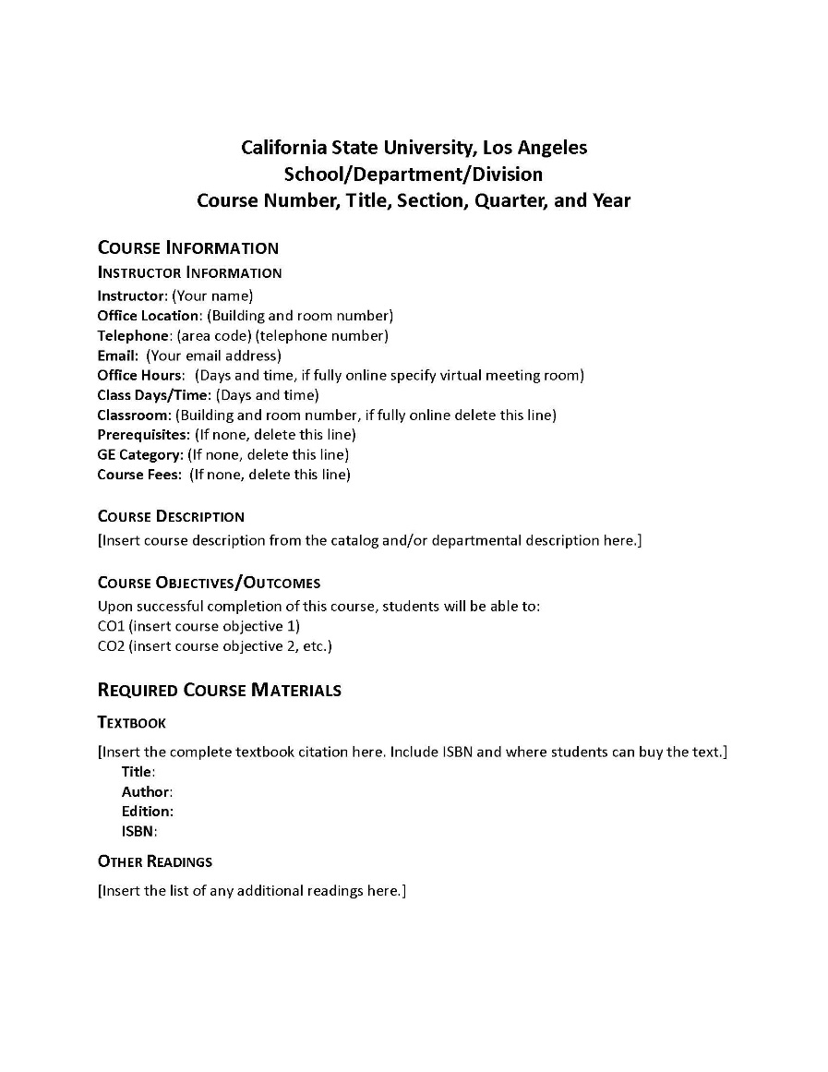
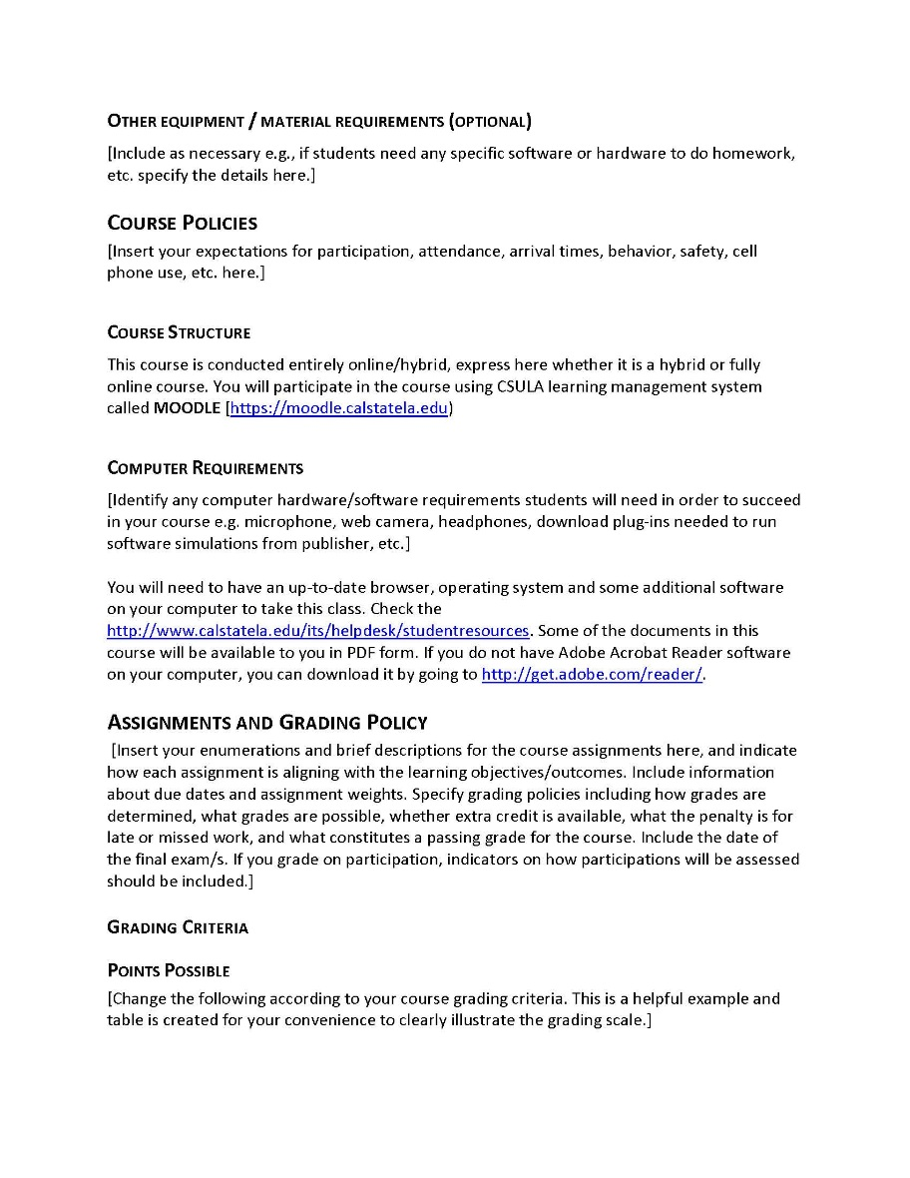
Notes:
Talking Points:
Template designed using QM Standards and meets the University requirements
Meets Accessibility standards as well

Slide 44
Provide Syllabus Checklist

Slide 45
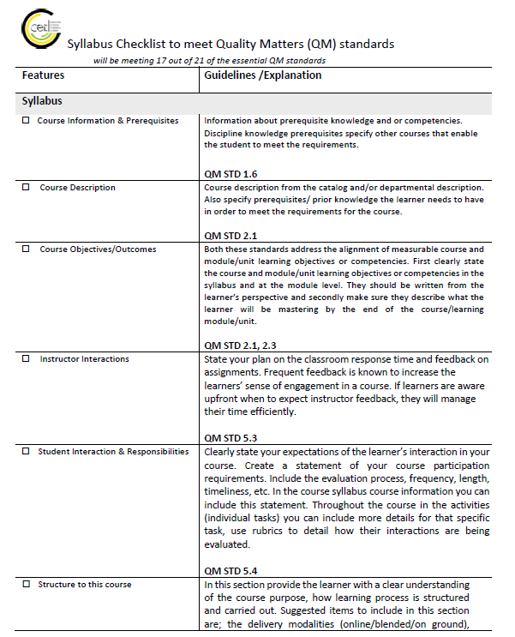
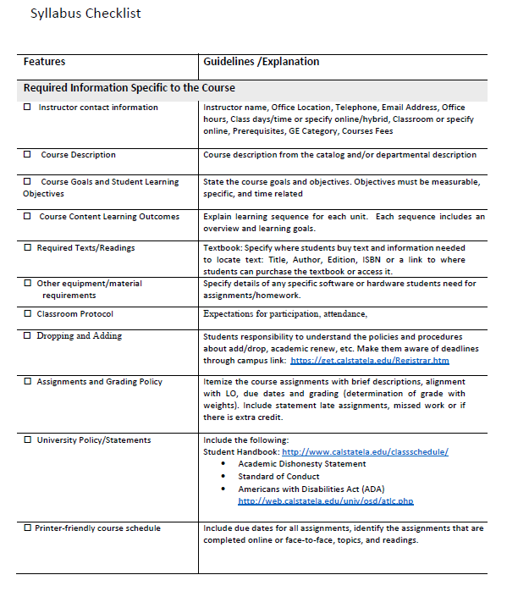
Notes:
Talking Points:
Those who prefer their version recommend checklist
One checklist includes descriptions and reference to QM Standards for those who are ready to get course ready for QM review

Slide 46
Work alongside ID to align their Course Level Objectives to their lesson level objectives…

Slide 47
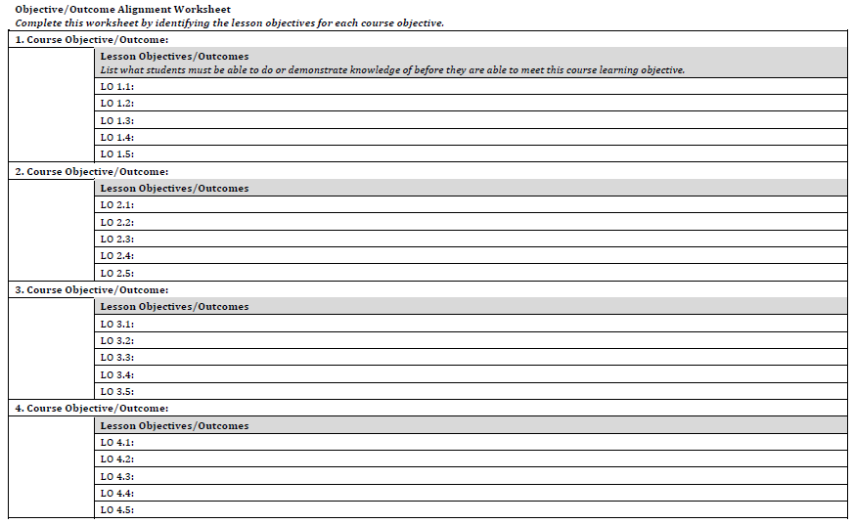
Notes:
Talking Points: Online Design
Worksheets designed to work with faculty in building their online course. ID as a consultant
Course Level Objectives alignment to Lesson Level Objectives, consults with ID and makes sure they are measurable.

Slide 48
Work with ID to design their course blueprint by aligning each week lesson level objective with assessments, activities, content and assignments….

Slide 49
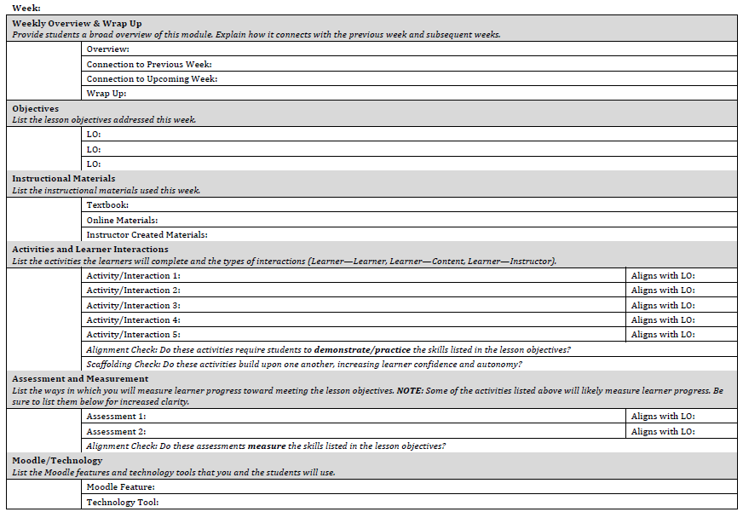
Notes:
Talking Points: Online Design
Once course level objectives are approved by ID then the second work sheet is a weekly Lesson Level Objective guideline. It helps faculty create a blueprint of their course and ensure that all assignments/activities are interactive and aligns with the course level.

Slide 50
Provide a course template that follows QM standards to those interested faculty.

Slide 51
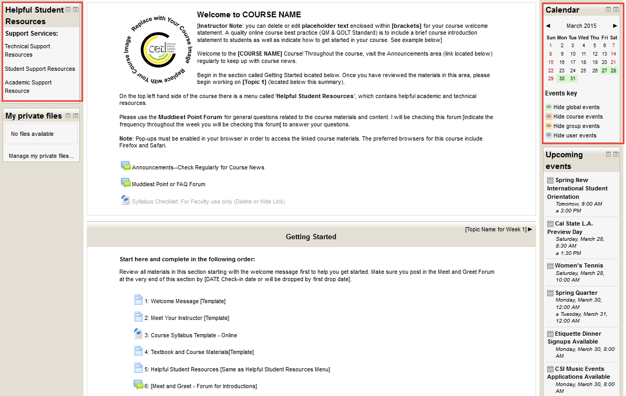
Notes:
Talking Points:
Course Template that contains templates to use that meet QM Standards
We import to those faculty who would like to benefit of this type of formatting

Slide 52
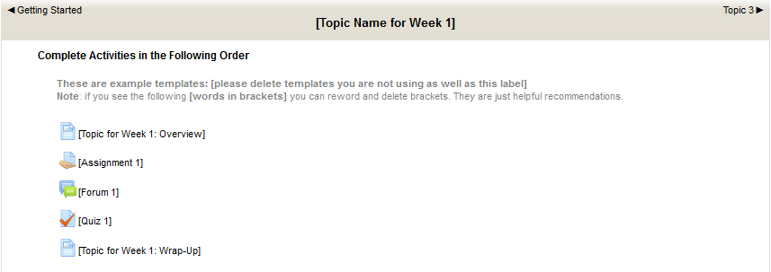
Notes:
Contains boiler plate wording for instruction/direction structure to students for overview, assignment, forum, quiz and wrap up

