Slide 1

Social Media Marketing and Communication Strategies for
QM Implementation
Melissa White

Slide 2
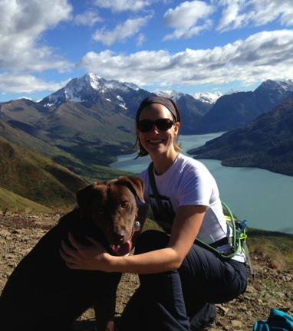
Melissa White
Instructional Designer
Adjunct Faculty
QM Coordinator
APPQMR Facilitator
Moki

Slide 3
“Social Order”
Without speaking line up in order of the number of social media networks/outlets you use on a regular basis (both professional and personal).

Slide 4
Introductions
Share your name
Institution
How do you share with faculty, staff and colleagues?

Slide 5

Email
Door knocking
Plea
Personal invitations

Slide 6


Slide 7
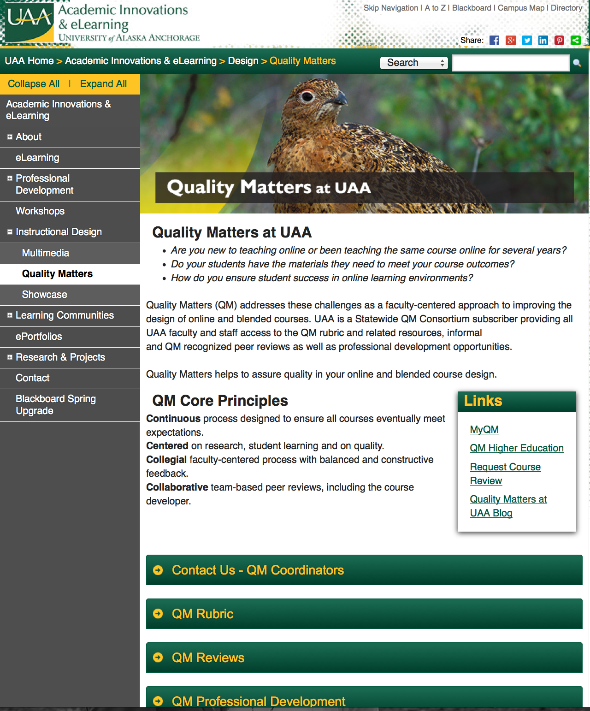
UAA CMS
Part of the official UAA website.
Landing page for Quality Matters.
Connects with additional information.

Slide 8
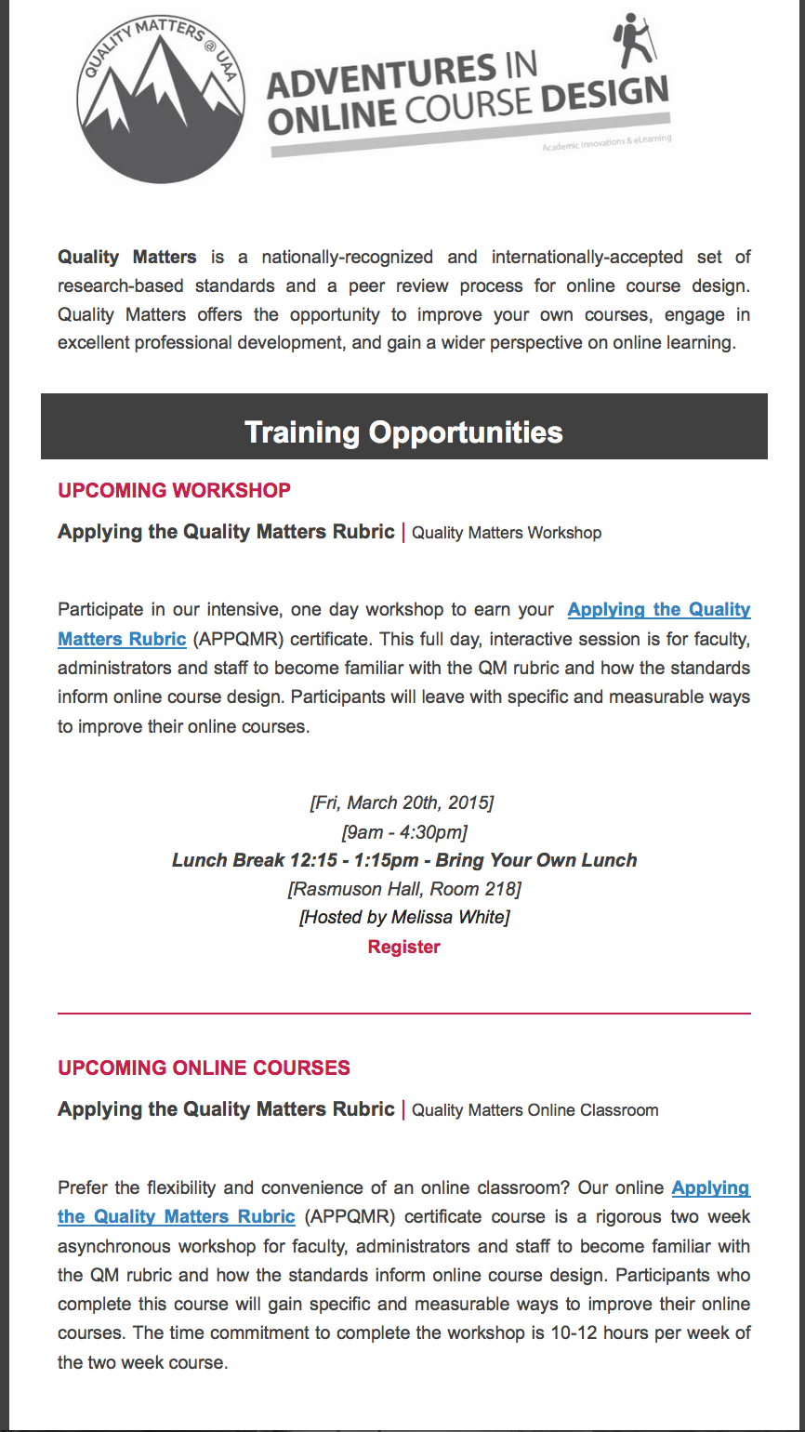
eFlyer
Sent to the Faculty listserv and newsletter subscribers.
T, W, or R leading up to workshop.

Slide 9
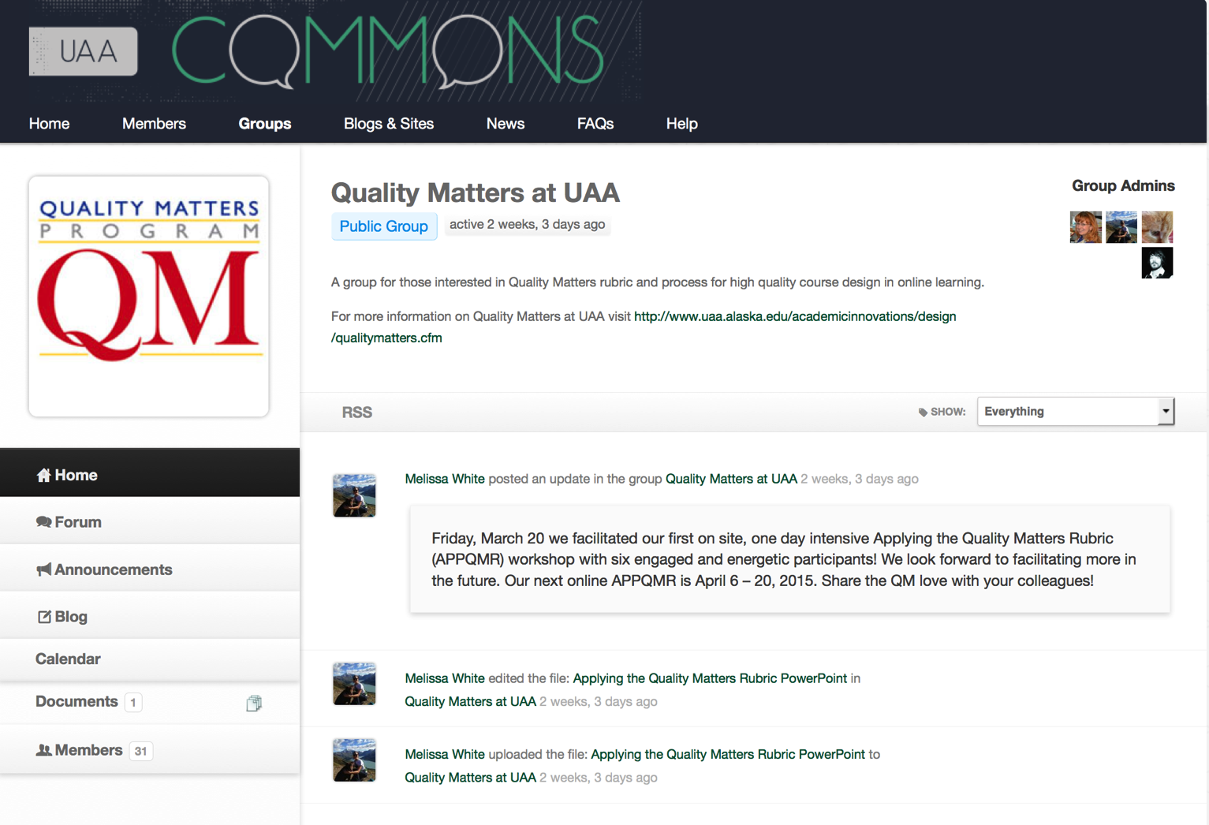
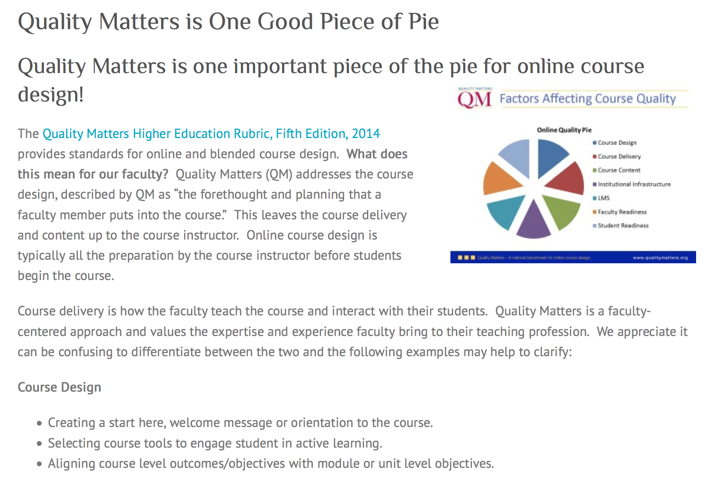

Slide 10
ROI
APPQMR Workshop eflyer
  25% open rate. 107 opened, 11 clicks
  23 % open rate, 96 opened, 10 clicks
  30.3% open rate, 125 opened 5 clicks
Invitation to join Commons (APPQMR participants)
  35.0% open rate, 14 opened, 1 click
Email invitations?

Slide 11
Successes…and “learning opportunities”
34 APPQMR Certificates…38 incomplete
11 Peer Reviewer Courses…9 Certified Peer Reviewers…2 incomplete…2 CPE Reviewers
4 of 5 informal peer reviews as part of cohort.
31 members of the Commons group

Slide 12
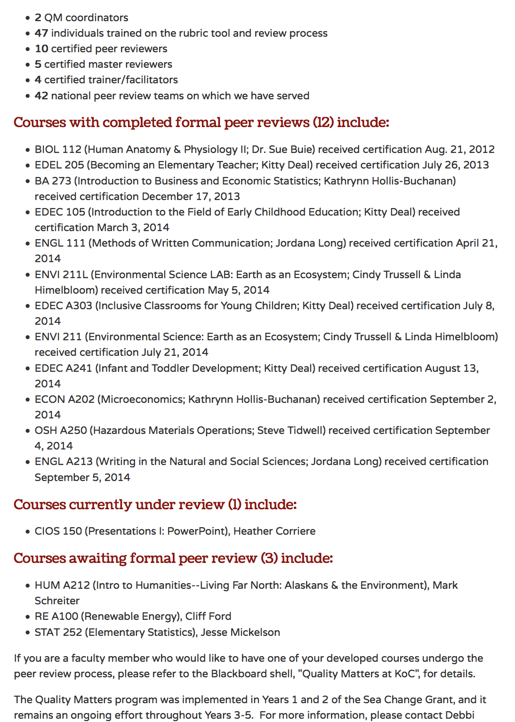
Upcoming
Celebrate APPQMR certificates, Certified Peer Reviewers and Course Reviews.
Faculty leadership. QM is faculty-centered!
Kodiak College

Slide 13
Friday Social Hour
In groups discuss the strengths and challenges of this social networking and communication strategy.
Share how your institution uses social media and marketing.
Come up with an innovative approach!

Slide 14
Twitterpated
Take a photo with a new connection, or a highlight from this session.
Tweet “to” @EdgeUAA with “re:” #QMCONFNW
Will you take my photo? A group photo?

Slide 15

Thank You!

Slide 16
Links
mbwhite3@uaa.alaska.edu
http://www.uaa.alaska.edu/academicinnovations/design/qualitymatters.cfm
http://commons.uaa.alaska.edu/groups/quality-matters-at-uaa/
http://qualitymatters.commons.uaa.alaska.edu/
Twitter: melissabee49, @banker_melissa

