Slide 1
Standardized Templates
Improve Accessibility & Usability Enhancing Transfer of Learning
Macarena Aspillaga, Ph.D.
Course Designer
QM Coordinator
Norfolk State University

Slide 2
Importance of Standardization
Provides consistency to documents & screen
How does standardization help students?
  Provides one set of rules
  Decreases frustration
  Increases enrollment
How does standardization help faculty?
  Provides standard templates & tools-based on QM
  Reduces work time
How its it related to Accessibility?
  Perceivable
  Operable
  Provides mental models
  Organizes content
  Decreases frustration
  Understandable
  Robust
Notes:
By standardizing information, we facilitate the learning process, since we make all that is NOT relevant to the course such as navigation consistent and intuitive; thus, less prominent.
Once students learn where to go to find a specific type of information they will NOT have to relearn these rules when taking a different course

Slide 3
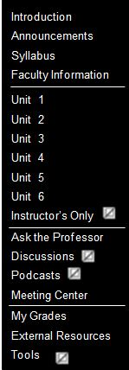

Navigational Design (S.8.1)
Created different templates
  Modules
  Units
Grouped according to Functionality (S 8.1)
  Course
  Content
  Access & Interaction
  Assessment & Resources
All templates have
  Content Items
  Assessment Items
  Tools

Slide 4
Advantages of Standardized Templates
  Provides organizational structure—Form mental patterns
Provides reliability, allowing to
  Learn rules only once (S 8.1)
  Make predictions on where things are located (S 8.1)
  Make inferences as to what path to take when searching
Helps St with disabilities to learn
the menu structure (S 8.1; 8.3; 8.4)
Course
Content
Access &
Interaction
Assessment
& Resources
Notes:
Standardization provides consistency in the search for information, location of items, and search
for patterns.
Once students learn where to go to find a specific type of information, according to purpose
and functionality they will NOT have to relearn these rules
The use of templates reduces system complexity, improving reliability and reducing Cognitive Load
Each menu is composed of four main sections, which guide the user in the search; depending
on the need is where the user will go to find information. This design reduces the extraneous CL,
(i.e., presented information that interferes with schema acquisition) leaving more room for an increase
in germane CL (those variables that enhance working memory capacity,)
Consistency allows students to make inferences and predictions as to what path to take when searching for a known type of information or pattern.

Slide 5
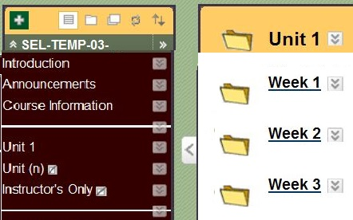
Standardized Templates
Allows you to ease nav. by grouping content into (S.8.1)
  Topics
  Lessons
Develop objectives according to topics & lessons
  Present your content as a integrated unit or module
  Allow students review prior topics or lessons
Each lesson is a complete package; includes its own
  Introduction
  Objectives
  Readings
  Activities
  Assessments
Notes:
Blackboard Templates
Here we will see, how we will divide our content and how this will be available to the student.
Templates allow you to group your content by categories or themes. Once you have your categories you divide them into lessons
Grouping things make sense not only because when we present them separately, students incorporate them as singular items and cannot create schemas, but also when we present all steps as a unit we create a schema, which will allow students to store effectively into short-term memory (STM) and find that info when required.
Develop objectives according to Categories and lessons (more specific)
Allows students to go back and review prior material—when needed
Each lesson is complete, including objectives, activities and assessments for those objectives

Slide 6
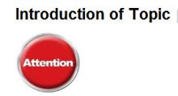
Template Design
  Sections (content items) have their own Standardized Icons (S 8.1; 8.3)
  Students can relate with section icons
  Ease the search
  Direct attention
Help Navigation Design by Keeping it Consistent
  Never alter menu structure
  Never modify section icons
  Never modify section titles
  Standardization Creates Schemas, which Aids (S 8.1; 8.3)
  Navigation
  Memory Storage & Search

Slide 7
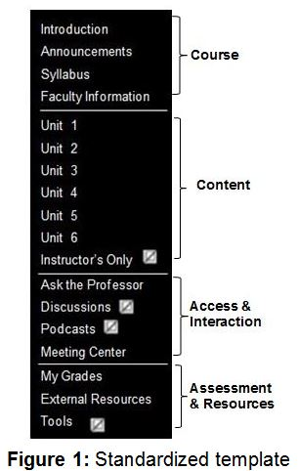
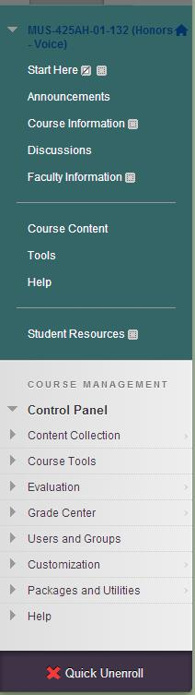
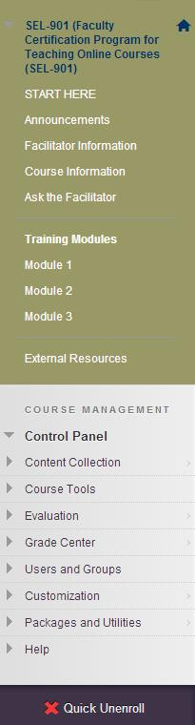
Clear Navigation
  Navigation should be intuitive (S 8.1)
  Self-Evident
  No conflict when selecting menu items
No more that 3 clicks

Slide 8
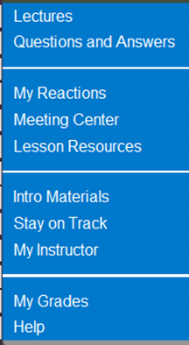
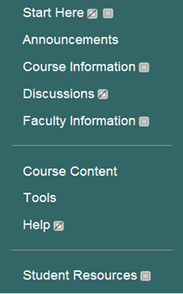
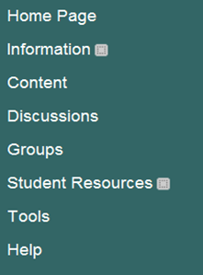
Effects of Inconsistency
What if all classes look different?
  St on class # 3 would NOT know how to reach the instructor
  St on classes # 1 & # 3 would NOT know
  where to look for announcements
Class 1
Class 2
Class 3
Notes:
Standardization provides consistency in the search for information, location of items, and search
for patterns.
Once students learn where to go to find a specific type of information, according to purpose
and functionality they will NOT have to relearn these rules
The use of templates reduces system complexity, improving reliability and reducing Cognitive Load
Each menu is composed of four main sections, which guide the user in the search; depending
on the need is where the user will go to find information. This design reduces the extraneous CL,
(i.e., presented information that interferes with schema acquisition) leaving more room for an increase
in germane CL (those variables that enhance working memory capacity,)
Consistency allows students to make inferences and predictions as to what path to take when searching for a known type of information or pattern.

Slide 9
Effects of Inconsistency (Contd.)
If I go from one class to another class
  Is Lectures the same as Course information?
  OR is Course information the same as Content?
  Is Lesson Resources same as St. Resources?
Class 1
Class 2
Class 3
Notes:
Standardization provides consistency in the search for information, location of items, and search
for patterns.
Once students learn where to go to find a specific type of information, according to purpose
and functionality they will NOT have to relearn these rules
The use of templates reduces system complexity, improving reliability and reducing Cognitive Load
Each menu is composed of four main sections, which guide the user in the search; depending
on the need is where the user will go to find information. This design reduces the extraneous CL,
(i.e., presented information that interferes with schema acquisition) leaving more room for an increase
in germane CL (those variables that enhance working memory capacity,)
Consistency allows students to make inferences and predictions as to what path to take when searching for a known type of information or pattern.

Slide 10

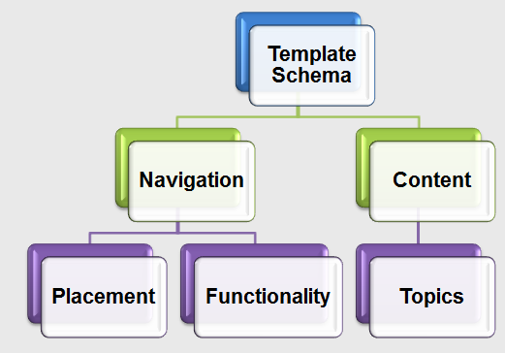
Effects of Standardized Templates
Step 1
Step 2
How do standardized templates affect students?
  Allow schema acquisition
  Schema activation keeps out
  non-essential components
  Decreases St cognitive load
How do s. templates help faculty?
  Provides a framework delivery
  Reduces development time
Step 3
Step 1
Step 2
Step 3
Notes:
The use of templates, allow schema acquisition, these schemas will guide students where to look
for a specific type of information when needed. This is important since working memory only allows students to hold ONLY a few interactions at the same time, whereas schemas are stored in long-term memory.
The automation of these schemas can be processed unconsciously reducing student’s cognitive load.
This is important because, the more elements a student has on the screen at the same time, the more overwhelmed his sensory systems becomes and the higher his Cognitive Load.
Standardization through schema activation allows students to find information efficiently and effectively by keeping out non-essential components.

Slide 11



Schema Creation
How does standardization affect others situations?
  Creates schemas through standardized symbols
  Activates schema
How does it helps people in various other contexts?
  Provides urgent information in seconds
  Recalls an entire process through images
  Reduces processing time
Notes:
The use of templates, allow schema acquisition, these schemas will guide students where to look
for a specific type of information when needed. This is important since working memory only allows students to hold ONLY a few interactions at the same time, whereas schemas are stored in long-term memory.
The automation of these schemas can be processed unconsciously reducing student’s cognitive load.
This is important because, the more elements a student has on the screen at the same time, the more overwhelmed his sensory systems becomes and the higher his Cognitive Load.
Standardization through schema activation allows students to find information efficiently and effectively by keeping out non-essential components.

Slide 12





Schema Utilization
How Schema creation helps us in our daily life?
  Lessens the amount of info needed to remember
  Activates schema & thought processes
How does it helps people in various other contexts?
  Provides important information in seconds
  Recalls an entire process through images
  Reduces processing time
Notes:
The use of templates, allow schema acquisition, these schemas will guide students where to look
for a specific type of information when needed. This is important since working memory only allows students to hold ONLY a few interactions at the same time, whereas schemas are stored in long-term memory.
The automation of these schemas can be processed unconsciously reducing student’s cognitive load.
This is important because, the more elements a student has on the screen at the same time, the more overwhelmed his sensory systems becomes and the higher his Cognitive Load.
Standardization through schema activation allows students to find information efficiently and effectively by keeping out non-essential components.

Slide 13
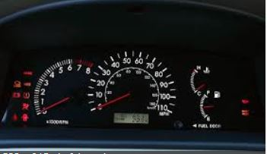
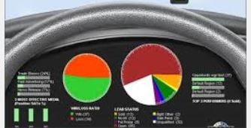
Schema Generalization
Schemas are involved in procedures like driving
Dashboard elements
  Speedometer
  Fuel
What if you suddenly got this?
  Do you know how fast you are going?
  Do you know if you need to refuel?
  How could you make decisions?
Notes:
The use of templates, allow schema acquisition, these schemas will guide students where to look
for a specific type of information when needed. This is important since working memory only allows students to hold ONLY a few interactions at the same time, whereas schemas are stored in long-term memory.
The automation of these schemas can be processed unconsciously reducing student’s cognitive load.
This is important because, the more elements a student has on the screen at the same time, the more overwhelmed his sensory systems becomes and the higher his Cognitive Load.
Standardization through schema activation allows students to find information efficiently and effectively by keeping out non-essential components.

Slide 14
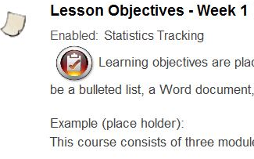
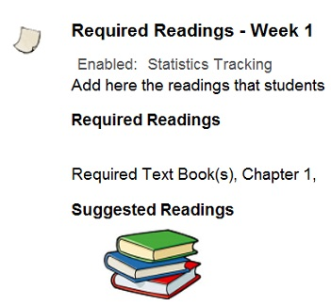
Templates & Standardization
Templates allow you to standardize courses by
  Being consistent and clear in your presentation (S 8.4)
Assisting in the search
Placing materials on the same location
  Introduction of Topic
  Content Instruction
  Lesson Objectives
  Required Reading
Notes:
It is important that your text always be readable and your presentation be a clear and concise message. To accomplish this, have a standardized and consistent “look and feel.”
A readable course allow students to focus on the content as opposed to focusing on the distractions. It makes content clearer by adding extra space and stating only that which is relevant to the conversation. An easier to ready course becomes more accessible to a wider population.

Slide 15
Templates & QM Standards
Templates allow you to standardize courses by
Following Quality Matters standards 1, 2, & 8.
Grouping content according to type of material
Introduction (Addresses QM sections 1, 2, 6, 7, & 8.)
  Course Orientation
    Intro. to Course
    Purpose and Structure (QM Standard 1.2)
    Course Objectives
    Prerequisites (QM Standard 2.1)
    Video
  University Resources (QM sections 6, 7, and 8.)
  Technical Resources (QM sections 6 and 7.)
Notes:
It is important that your text always be readable and your presentation be a clear and concise message. To accomplish this, have a standardized and consistent “look and feel.”
A readable course allow students to focus on the content as opposed to focusing on the distractions. It makes content clearer by adding extra space and stating only that which is relevant to the conversation. An easier to ready course becomes more accessible to a wider population.

Slide 16
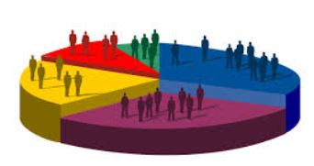
Standardization & Readability (S8.4)
Standardized courses
Allows you to have a consistent presentation
NON-essential content make it consistent
and less prominent
Make your course readable (S8.4)
  Allow St to focus on content
  Makes content clear & understandable
  Makes courses accessible to a wider population (S8.3)
    Add scripts
    Make sure videos have accurate CC
Notes:
It is important that your text always be readable and your presentation be a clear and concise message. To accomplish this, have a standardized and consistent “look and feel.”
A readable course allow students to focus on the content as opposed to focusing on the distractions. It makes content clearer by adding extra space and stating only that which is relevant to the conversation. An easier to ready course becomes more accessible to a wider population.

Slide 17
Readability & Accessibility (S8.4)
Standardized patterns
Allows you to have a consistent “look and feel”
  Makes your text clear (S 8.4)
  What is extraneous to content make consistent
  Making your course readable & Varied (S 8.3; 8.4)
  Content clear & more understandable (S 8.4)
  Courses accessible to a diverse population (S 8.3)
  St can focus on the content
Notes:
Readability and Accessibility
When you standardized your content and the presentation of your material, you are encouraging students to develop mental patterns. Humans search information through patterns; thus, we make it easier for students when we help internalize this patterns since we do NOT have to search every word, just the pattern itself. Once we arrive at the section or pattern we are looking for, then we get into the details.
To make these patterns stand out, we need to make those aspects that are NOT very important to the content itself less notorious and salient; we make them consistent and standardize them, so students do NOT have to spend time in these components (e.g., navigation) and concentrate on the content.
Readability: When your text is easy to decipher, students can focus on the content instead of trying to guess what each word means, because they cannot read the fonts.
Readability allows ALL students to read easily, no matter if they are near sided or far sided.
A readable course allow students to focus on the content as opposed to focusing on the distractions. It makes content clearer by adding extra space and stating only that, which is relevant to the conversation.
An easier to ready course becomes more accessible to a wider population.
.

Slide 18
Standardizing Courses (S 8.4)
To standardize your courses
Select a consistent font, style, & size, for all
your titles, subtitles, as well as content
The font should provide students information regarding
  Importance
  Relevance of the content
For online text use Sanserif (e.g. Arial, Franklin G.)
NEVER use decorative fonts (e.g., fancy, fonts, Good Luck)
Notes:
Standardizing your Course
To achieve readability, give your text a standard look. We are providing information with our message, NOT only with the words, but with the emphasis we give to the fonts we select, with the font style and font size.
Because out text has its own message design, we should keep it consistent; we should standardize what we mean when we use specific fonts and specific font sizes. This way, your students will know your intent, before they read the rest of the message.
Fonts should provide the student information regarding importance, and relevance of the content (especially in headings), which will make your courses more readable; thus easy to decipher and interpret when students want to access the written material. Make it such that, students will learn which font size and style means what level of importance it refers to.
When students encounter that particular font size and style, they will always know whether it is a title, subtitle, or part of the body of text no matter the unit or module they are working on. If you keep changing your font standards for each class, the student will have to relearn the rules each time.
For online text use san serifs. Serifs are the lines found in fonts such as New time Romans, that when place online vibrate and makes it difficult for the eye to read. On the other hand, New time Romans are very good for printed materials, but NOT online. San serifs are Arial Franklin G.
Never use decorative Fonts (e.g., Showcard Gothic, Snap ITC, Sybil Green,) for they are hard to read, preventing interpretation and understanding of the material. These fonts make us have to decipher each character separately and then focus on the word. This is NOT the way human memory works since we read in chunks of information at-a-time and it is more confusing for us to follow this character by character process.
When we have a fancy font in front of us, we have to read character by character and once we have deciphered each character we then have to form the entire word. So you have to go through and entire process before you can complete a word. And then we have to attach the meaning to the word.
It may look great to you as an artistic component, but as a learning strategy it is very hard and detracts from the learning process. So use simple words and use a bold strategy; you can use underline, or you can use italics, but be consistent in the use of font styles such as bold and italics.

Slide 19


Readability—Fonts (S 8.4)
Caps Vs. Lowercase
The combination of upper and lower case facilitates learning through their specific word shape
Word shapes increases readability and minimizes involuntary pauses.
Avoid ALL CAPS, they interfere with ease of reading
Word shape
made by ascenders and descenders
Loss of word shape
when written in uppercase
Notes:
Fonts
As we said, fonts are very important in the learning process, since we learn by patterns. The font selection and its combination will help us store our content into Long-term memory (LTM).
The combination of upper and lower case provide a specific wordshape that facilitates learning, since humans read in chucks and NOT character by character; the wordshape becomes a pattern in our mind for that specific concept.
When writing in all caps, the unique information that each character provides to the reader is lost.
Avoid ALL CAPS, since these interfere with ease of reading. (Look at the words ALL CAPs and see that they do NOT produce a shape. They are only a rectangle that changes in size according to the length of the word; imagine an entire paragraph like that...
Students will have to start reading character by character to decipher the meaning of the content instead of reading by chunks, which goes contrary to what humans do.
For example here the words AT and UP; both of their shapes look exactly the same, but the words are NOT the same. If they are written in lower case, each one has a unique wordshape given by the ascenders like the lines on the “t or h” and the descenders, which are the lines on letters such as “p or q”. So, when you are reading chunk by chunk you internalize that unique wordshape pattern.
When you are writing in upper case you do NOT give the reader the benefit of that pattern. When you want to enhance readability and increase learning, you have to allow that pattern to be salient for the student.

Slide 20
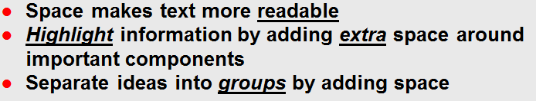
Readability—Use of Space (S 8.4)
Space makes text more readable
Highlight information by adding extra space around important components
Separate ideas into groups by adding space
  Enough space to seem connected
  Excessive space reduces sense of belonging
Notes:
Use of Space
Space is another important attribute.
Use space as a means to highlight and emphasize information. When information is crowded, people lose interest in the material and tend NOT to read it. Online documentation needs extra space, which it is free to achieve readability.
This is accomplished by allowing the ascenders and descenders to become more noticeable which enhances the wordshape, which we discussed earlier.
Readability is very important not only for all online viewers but also for people with disabilities. We need to provide information that is NOT crowded an easy to perceive and to follow; extra space allows special features to stand out.
As we see in this example, the top part has extra space and the bottom does NOT; look how much more noticeable the top part is and how much easier to read it is. This is why extra space needs to be added to online text, even if you believe you do NOT have any student with any disability.
When presenting text online, divide your paragraph into two or three units of information. By adding space in-between ideas, it becomes easier for the viewer to read. This is because humans have a harder time reading online than on paper.
Even if you have a paragraph, that on paper is fluid; when placing it online divide it into segments—add space for the eyes to move from one piece of information to the next. Too much text online is harder to read!
Whatever amount of space you decide to add in-between ideas, or in-between titles and subtitles, it should be consistent and standard throughout your course, as space is an indication of hierarchy and importance as well as your font selection.
Like for example at the bottom of the screen, you have a section that is the top section followed by two subsections; they all seem to belong to same section.
Then you start with another section similar to the top section. We know this, because there is a larger amount of space between the next section that does NOT belong to the top group.
Clearly distinct units are easier to read and remember; extra space makes chunks of information more prominent and your message more memorable.
Ragged margins (aligned text on the left) are easier to perceive and read than justified margins (those perfectly aligned on both sides); the irregular edge provides the viewer with visual hints as to where they find themselves within the page.
The bottom part of the screen has ragged edges, it shows the viewer “I am here” at this point of the page. When you are writing whether on paper or online, use ragged margins for it increases readability.

Slide 21
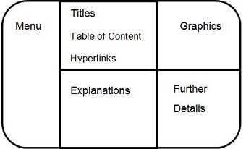
Location of information (S 8.4)
Always assign the same space within the screen for important messages
Students will learn where to look for essential material
Keep location consistent throughout your course
Notes:
We will look at location of information
Consistency should be part of every online screen or page design. Your course design tells students not only what is written on the page, but gives clues as to the importance of the content and the relevance of the material by where it is located within the page.
Always assign the same space within the screen for important messages so students will learn where to look for essential material.
You can assign various tasks to different locations like the locations shown on the screen, or assign a location for specific purposes within the screen, or even within specific pages such as the announcement page.
Whatever space you select for a given information, standardized it throughout your course.
Like for example in this figure you have your menu on the left side and your graphics on your right. So if someone selects that graphic, you would have the explanation of the graphic on the bottom.
Keep it consistent, so when you have a second graphic, the explanation of the graphic will also be at the bottom of the graphic, and so forth.
Keep location consistent throughout your course. Consistency in itself is a message.

Slide 22
Readability— Use of Color (S 8.4)
How to use color
Use 1 color font throughout entire course
Select same color & font style for importance
  Have a 2nd attribute —to match colored fonts
Highlighting — only important words or ideas
Overusing color:
More detrimental at aiming for student’s attention
NEVER highlight more than 2 separate words or ideas on the same page
NEVER color-code w/o having a 2nd way to indicate relevance of color
Notes:
Use of Color
The use of Color is something we have to keep in mind for several reasons:
Use color to attract the student’s attention to a specific area or word. However, overusing color on the screen is more detrimental than your initial intention in trying to focus the student’s attention.
By adding too many colors, you overwhelm the memory system. When everything competes for your attention, nothing attracts your attention!
Only use one color font — For instance, on your announcements use a colored font on important dates. After that specific date has past, delete the date or colored it black so it no will longer be competing for attention with a new important date.
Select the same color and font style to indicate importance (e.g. red, bold and italics) throughout your entire course, so students will relate that color and style with importance.
+++ Whenever you use color to indicate importance you should add a second attribute such as bold, underline, or an asterisk*, for those who are unable to detect that color.
If you are using 2 colors for importance, relevance, or color coding, always have a second attribute and have the same attribute for each color (e.g. bold for red and italics for green) You have to be consistent throughout your course.
Only use highlighting — for an important word or idea (NEVER highlight more than 2 separate words or ideas on the same page.) When the highlighted idea is no longer important, remove the highlight.
This is important because when you overuse something and you are trying to attract attention; when you have too many things to attract attention.
Nothing attracts attention when everything is competing for your attention!

Slide 23
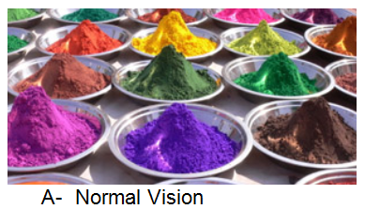
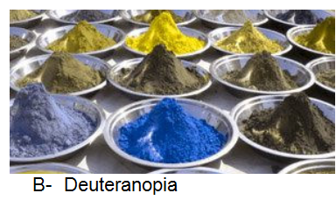
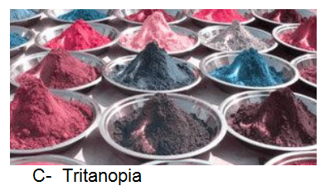
Accessibility (S 8.3; 8.4)
1 in 12 men (8%) and 1 in 200 women have a color deficiency
  Information indicated in Color must also
  be available without color
  There should be 2nd attribute for any color-coded information
Imagine you have a St. with normal vision and
1 St. with Tritanopia (c). Your directions say
“Select the Green Card”
Notes:
Here we have examples of color deficiencies. The normal vision followed by two deficiencies.
1 in every 12 men and 1 in every 200 women have a color deficiency. This is a great reason why we have to mention a second attribute in our lessons.
Imagine you have a student with Tritanopia (#3) and you tell them “select the green card.” That student will be unable to follow your directions and select the correct card, because they don’t see any green card.
What would you have to do? That is the challenge for you!

Slide 24
Accessibility Compliant (S.8.3; 8.4)
To make courses available for ALL users, means
  Courses are accessible to ALL audiences
  Having ADA 508 compliant courses
Making your courses accessible for all audiences
  Some St. will use readers to see your pictures
  Add alternative (ALT) Text to pictures
  Add audio to your presentations
Think of those who cannot read, see, hear, or type
  What do your activities need to have to open that door?
  How would need to present your material?
Notes:
Accessibility
To make your course Accessibility Compliant you need to make it available to all users and potential users; students you may not know.
This means you have to follow the Section 508 standards. Section 508 was created by the American with Disability Acts (ADA); your courses have to be ADA compliant. You have to have your courses accessible to all audiences.
In case you have pictures, you have to have Alternative text, (ALT) to make pictures available with words for your students; in case they cannot see it, they use a reader, assisted technology, and that reader will read the description that you wrote for that picture. So that picture has to be detailed by you stating what you have on that picture.
You have to add audio to your presentations so students who are legally blind or blind will be able to access your presentation.
The same with those who are hearing impaired or have other disability; by adding Notes to your presentations or add a second attribute for those students who have a color deficiency (give them a number or an arrow when using color coding on your presentations). This will allow other populations to have access to your courses and training.
Think of all those people who cannot see, hear or type or that have some sort of disability. How would you present this course? What sort of activities would you need to have for these students?
You do NOT need to have a second activity; it is just the way you present it; a second attribute: just add a number for that color! Or when presenting text in a color, underline it. When you are requesting something in one color that needs to be answered, add an asterisk.
The 508 standards will tell you exactly what to do, so follow these standards.

Slide 25
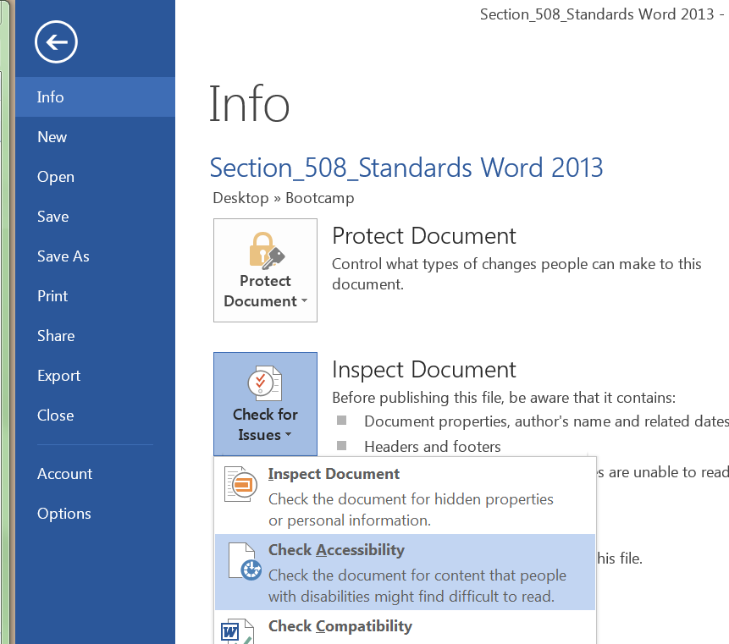
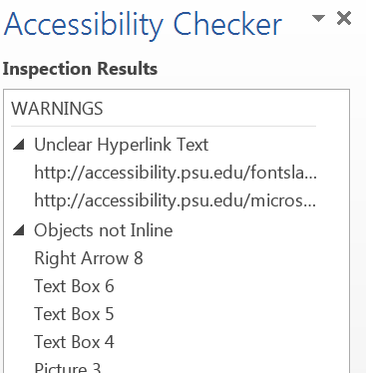
Documents on Accessibility (S.8.3; 8.4)
How to check your Word Documents for accessibility
  Open the Doc.
  Select file, Info (Check for issues)
Notes:
How to check your Word Documents (and PDF documents) for accessibility.
On your Word Documents you open your document and go to File, then Info and from the three options under Inspect Document, you select check accessibility.
If there is any problem you will see an Accessibility Checker on the right side of the document with all the issues and how to correct them.

Slide 26
Documents on Accessibility (S.8.3; 8.4)
For more information on how to correct accessibility,
For reviewing whether your documents or courses are compliant you can go to the 508 Compliance Resource,
a web site that provides tips and information:
http://www.508compliantresource.com/
It will help you check your
PDFs Documents
Audio
Word Documents
Websites
Notes:
For more information on accessibility, I want you to go back to Standard 8 on the Quality Matters’ Rubric.
Download the Section 508 Standards, which is a summary of the standards.
There is a series of websites called 508 compliance resources that will allow you to check whether your website, your Word documents and PDF’s documents are in compliance.
The web is http://www.508compliantresource.com/

Slide 27
Wrap-Up (S. Templates)
Allow you to form & activate Schemas
Reduce processing time—Learn Rules once
Reduce Cognitive Load
  Nonessential content is standard
  Same look & feel for all courses
Make your course readable and accessible
Check docs, videos, & websites for accessibility
Notes:
It is important that your text always be readable and your presentation be a clear and concise message. To accomplish this, have a standardized and consistent “look and feel.”
A readable course allow students to focus on the content as opposed to focusing on the distractions. It makes content clearer by adding extra space and stating only that which is relevant to the conversation. An easier to ready course becomes more accessible to a wider population.

