Slide 1

Using Quality Matters™ (QM) to Design and Assess
Online Courses
Mr. Jason Skinner
Dr. Frances Mc Donald
SW Regional: The Landscape of Quality
Friday, April 25, 2014
Santa Fe, NM

Slide 2







Introduction
Present historical overview of Northern Virginia Community College (NOVA).
Discuss implementation of QM at Extended Learning Institute (ELI).
Discuss best practices of QM at ELI.
Conduct Q&A.

Slide 3
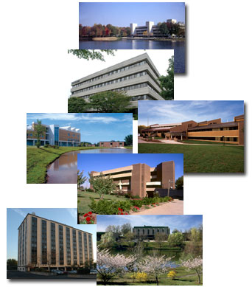
Historical Overview of NOVA
Member of Virginia Community College System (VCCS).
Largest educational institution in VA; 2nd largest community college in the US.
  Six campuses and four education centers.
  2,600 Faculty and staff.
  160 Degrees and Certificates.
Distance learning at Extended Learning Institute (ELI).

Slide 4
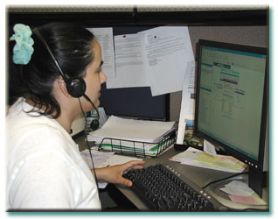
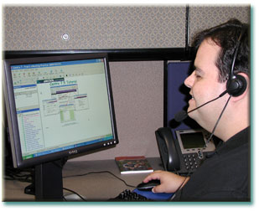
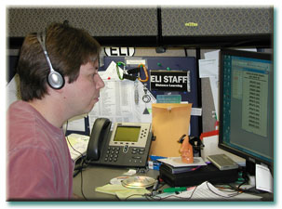
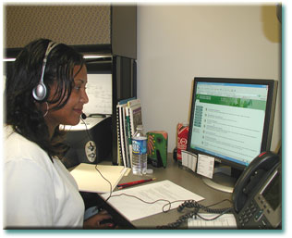
Overview of ELI
67 Staff members.
For SP2014, approximately –
  24,152 Student enrollments.
  588 Full-time and adjunct faculty.
  450 Courses offered in 16, 12, 8, and 6-week formats.
  1,228 Course sections with monthly start dates.
  Entire associate degrees/certificates completed online.

Slide 5
Implementation of QM at ELI
NOVA/ELI - QM Subscriber.
Instructional Design Staff QM Certified –
  Applying the QM Rubric.
  Peer Reviewer Course.
  Online Facilitator Certification.
Types of QM Reviews.
  External review of selected courses.
  Internal Peer Review Process.

Slide 6
Best Practices - QM Standards
Encouraging faculty to enroll in QM Workshops.
Training Faculty – Peer Reviewers.
  Completing QM APP Workshop required.
  Completing internal Course Review Workshop (CRW) required.
  Peer Reviewer Pool – 40 faculty
  Beginning internal peer reviews soon.
Working with campus deans and other stakeholders to define curriculum review process.

Slide 7
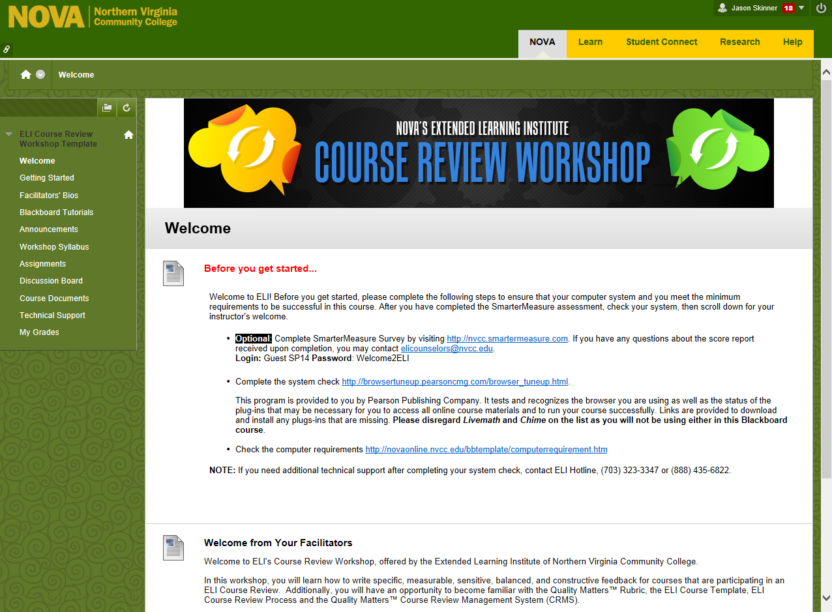

Slide 8

Q&A

