Slide 1
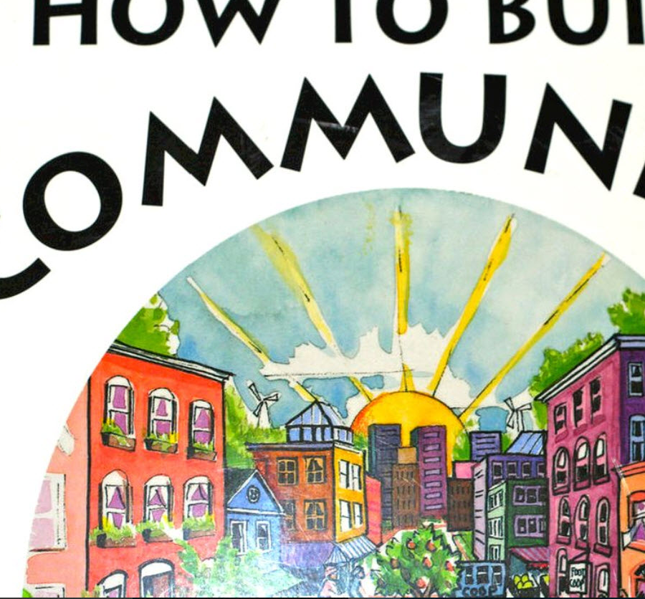
QM, a Faculty Learning Community, and Quality Assurance in the Dept. of History
(or): Taking the Tools to the Builders: Introducing QM via Faculty Learning Communities
Assistant Prof. Kevin Kaatz
California State University, East Bay Campus
History Department

Slide 2
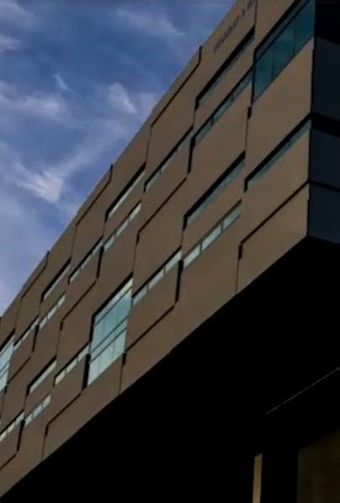
Faculty Learning Communities at CSU East Bay
Anything from “Writing a Scholarly Project” to “Teaching with Technology”
Faculty are paid for their involvement

Slide 3

I’ve taken:
Using Team-Based Learning
Teaching with Technology
I’ve led two FLCs as the Faculty in Residence
*Peer Evaluation for Online Teaching (2014-2105)
*Transforming Your Online Course to Semesters (2015-2016)

Slide 4
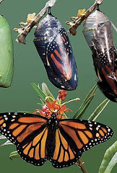
What is Transformation?
“Connections between your course outcomes, relevant course activities, assignments and assessment strategies”
(source: CSU East Bay)

Slide 5
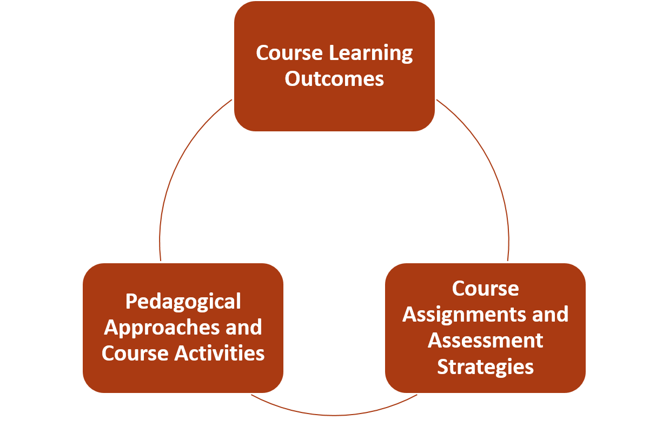
Making Connections Among the Elements
(source: CSU East Bay)

Slide 6
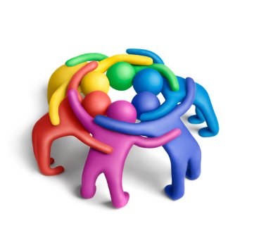
We were a small team
2 from History
1 from Construction Management
1 from English
1 from Kinesiology
(only one was familiar with the QM Rubric)

Slide 7
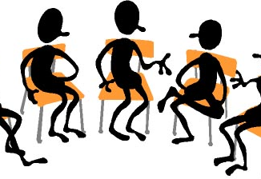
How Did We Do This?
*(11) 2-Hour meetings
*Used the QM and the Quality Online Learning and Teaching Rubrics
Jan 29 Go over the link between alignment and assessment; strategies for doing this. Bring syllabus (if you have one) of the course you want to transform. We will begin the process (having a fully transformed syllabus is a requirement for the FLC).
Feb. 12 Work on Standard 1 in QM and QOLT 1 in our new courses; share how we have fulfilled these.
Feb 26 Work on Standard 2 in QM and QOLT 2 in our new courses; share how we have fulfilled these.

Slide 8

Each meeting was a workshop:
I went over the particular standard we were working on
Gave my own examples
Had the team brainstorm on how to fulfill the standard
The rest of the time was spent on design
Sharing at the end
Notes:
http://blogs.teradata.com/data-points/wp-content/uploads/2014/02/Open-Your-Mind-to-All-The-Data3.jpg

Slide 9
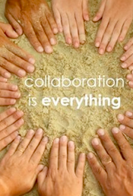
Our “Product” or Outcome of the FLC
We decided to create a website with examples on how we fulfilled the various standards:
http://ke2518.wixsite.com/transform

Slide 10

Pros of Using the Rubrics
It was nice to have a list of things to follow in terms of designing the courses
Seeing the Annotations

Slide 11

Cons
Alignment was difficult for some
Lots of time spent discussing Accessibility (some wanted specific examples)
Not enough time to work on transforming our courses

Slide 12
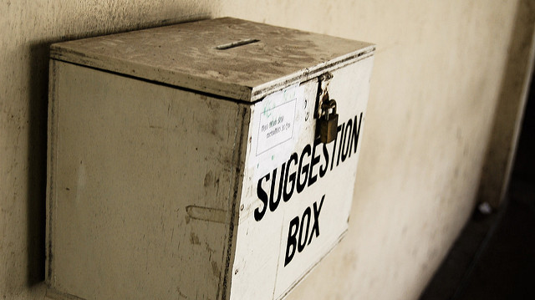
Suggestion for QM
It would have been nice to have a central QM website showing specific examples from real courses

Slide 13
Work in the Dept. of History
From the Transformation Handbook:
“Assessment of online and hybrid courses. (Discuss how your department will assess the quality of the online and/or hybrid instruction to ensure it is equal or superior to your on-ground instruction.)
Note: Assessment of learning is NOT addressed through student evaluations.”
The Solution:
Faculty will be provided with the Quality Online Learning and Teaching rubric and the Quality Matters rubric. Faculty will ‘self-assess’ their courses with either rubric
Then meet with the Online/Hybrid Quality Assurance Committee to go over the course design together.

Slide 14

Questions?

