Slide 1
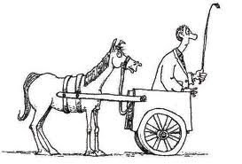
The Buggy Before the Horse
How the QM Rubric influenced institutional curriculum revision

Slide 2
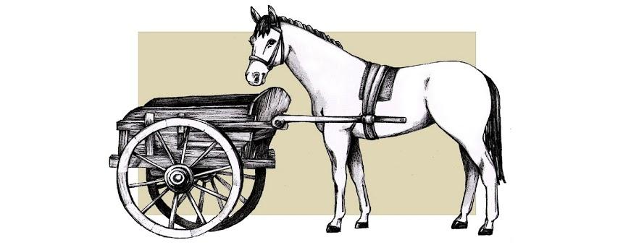
What we had
Backward plan
Isolated standard focus
Misunderstandings
Missing essential elements

Slide 3
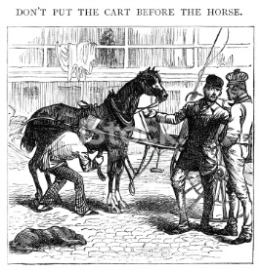
What was needed
Re-education of administration
Needs analysis
Practical plan

Slide 4
What we are doing
Prioritizing the standards
Developing timelines

Slide 5
Picking the standards
Alignment: “Critical course elements working together to ensure that students achieve the desired learning outcomes” (QM Rubric, 2014, p. 6).
General Standard 2
  “Learning objectives or competencies describe what learners will be able to do upon completion of the course” (QM Rubric, 2014, p. 12).
General Standard 3
  3.1- “The assessments measure the stated learning objectives or competencies” (QM Rubric, 2014, p. 16).

Slide 6
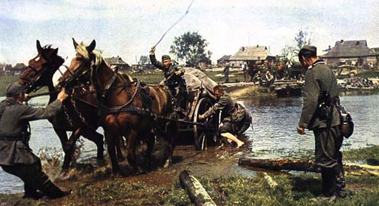
Developing Timelines
Standard 2
  One year/ 3 faculty in-service days (2014-2015)
Standard 3
  One year/3 faculty in-service days (2015-2016)

Slide 7
Into the Future
  Apply standards 4-6 (2016)
    Completes f2f course revision
  Apply the QM rubric comprehensively to online courses (Standards 1-8) (2017)
    Bulk of standards 2-6 completed previously at this point

Slide 8
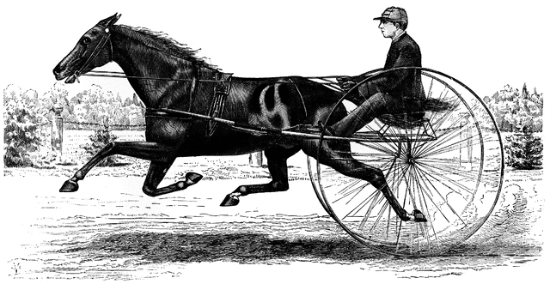
Alignment
Consistency between f2f and online courses
The Horse & Buggy are aligned!!

