Slide 1


Implementing a Quality Matters
Internal Review process
Jean A. Wisuri, MA
Director, Distance Education
Cincinnati State Technical &
Community College

Slide 2
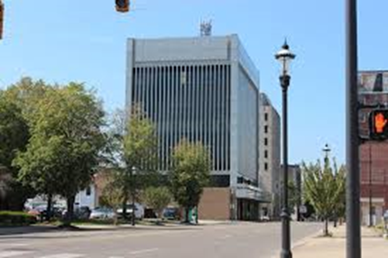





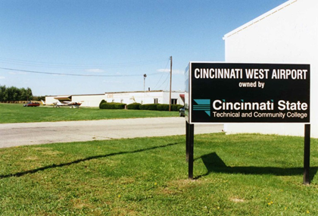
About the College

Slide 3





About the College

Slide 4



Our Students
80%
Need remediation:

Slide 5


Our Faculty
Adjunct!
Adjunct!
Adjunct!
Notes:
204 full-time faculty and like most colleges, our adjuncts greatly out distance our full-time we have - Over 600 adjunct

Slide 6


Distance Education
240 developed courses
13 online associate degrees
4 certificate programs

Slide 7
Question
What about your college?
Is distance education Centralized or
Not Centralized at your college?

Slide 8


Our Need
Decentralized
No consistency
No training, professional development
No checks for quality
Notes:
Cincinnati State had been offering distance education courses since the late 1990s. The first online course was developed out of the Center for Innovative Technologies. But there was no central connection between the divisions…each division doing their own thing in their own way…there was no consistency with the way the courses were laid out, no training – outside Blackboard – no assessment
Everything was haphazard

Slide 9



The Opportunity
Notes:
In 2008, then Governor Strickland announced that all state-assisted colleges and universities follow the same academic calendar, more cooperation is possible—leading to more effective use of resources. Cincinnati State was challenged to changed to a semester system to meet the guidelines of Ohio’s Strategic Plan for Higher Education.
Before the transition, 90 percent of US colleges and universities used the semester system.
Cincinnati State was one of the 13 community colleges in Ohio that changed to semesters in Fall 2012; there were 4 Universities that made the change.
All online courses needed to be transitions from terms to semesters.
Faculty worked at determining how term courses would be transitioned
Combine courses
Build new courses
Contract was developed with AAUP as to how faculty would be paid for transitioning these courses to semester

Slide 10
Question
Describe your greatest challenge in one word

Slide 11
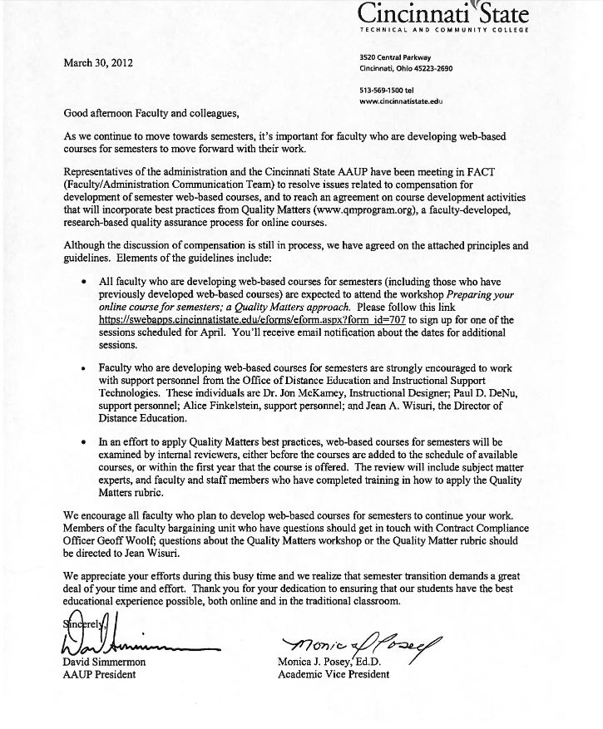
Opportunity
FACT – Faculty/Administration Communication Team
Payment for transition
Process that included QM Internal Reviews
Notes:
As

Slide 12
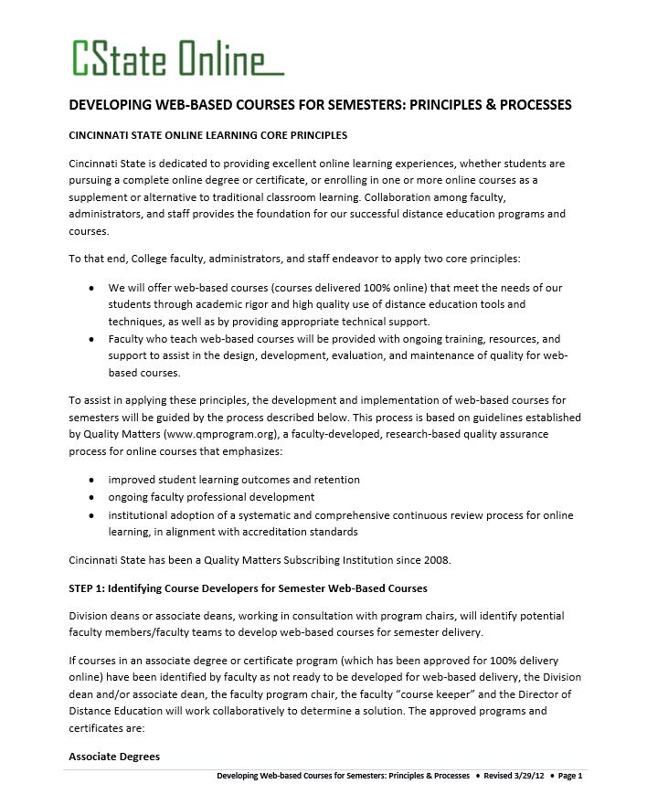
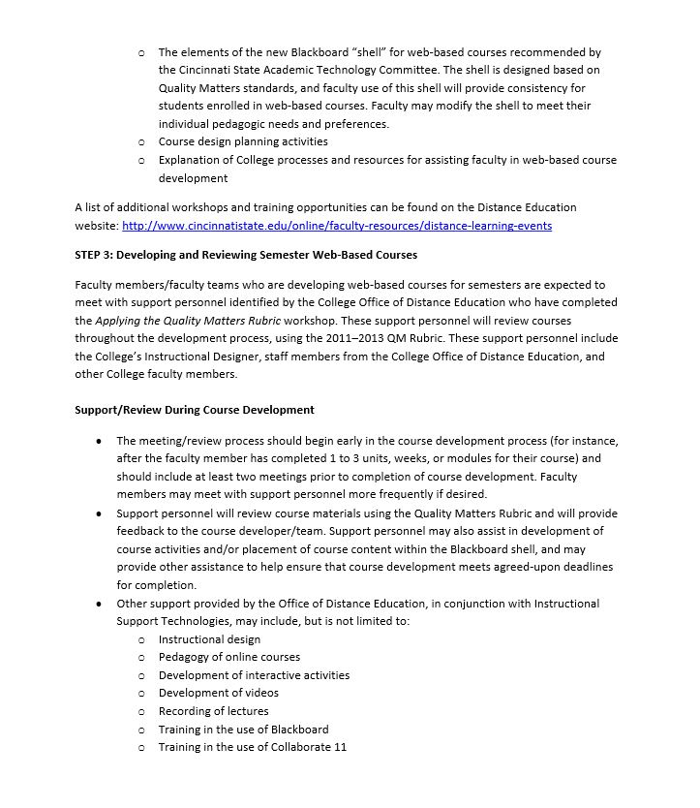
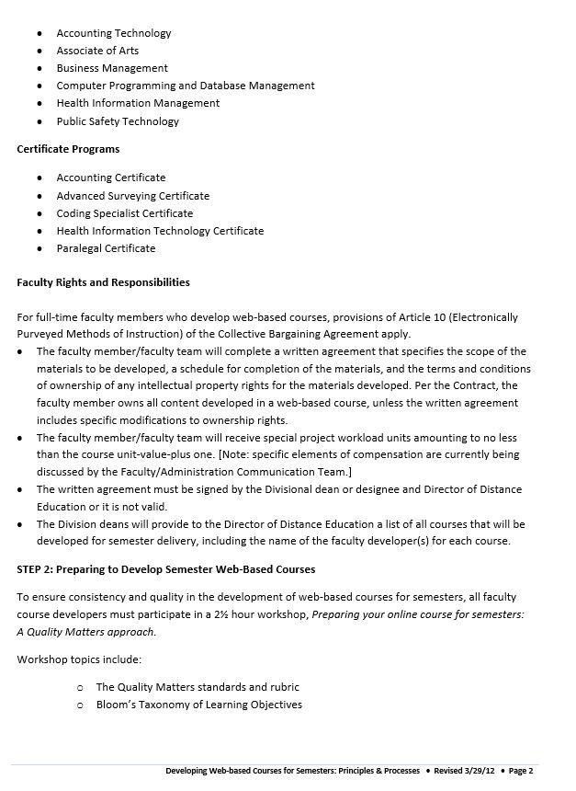
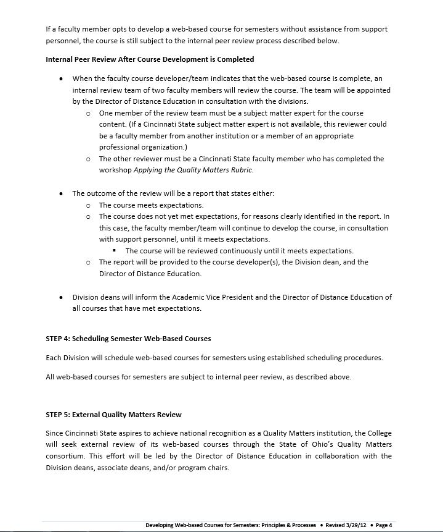
Outcome
Notes:
The document was developed in conjunction with AAUP and posted to the AAUP website where it still resides today.

Slide 13

Outcomes
Faculty will sign an agreement before they develop
Faculty will complete training
Courses will be subject to a Quality Matters Internal Review
College will submit courses for external review
2 Externally Reviewed Courses
Notes:
Highlights of the document include:
Contract
Training
Internal Quality Matter Review
Submission of courses for external review
Currently have two courses that have met standards for an external review.

Slide 14
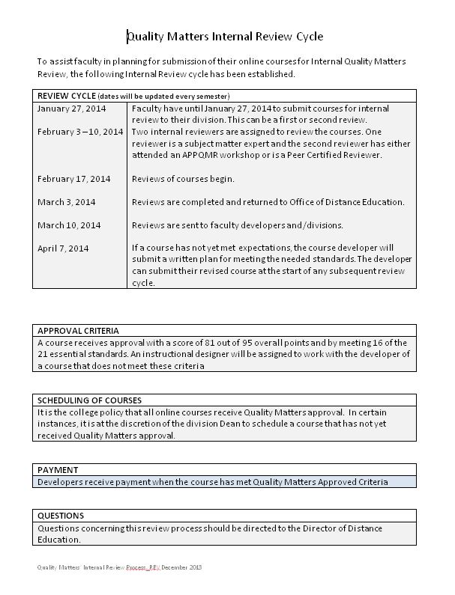
Evolution
Challenge
Reviewing courses at any time throughout the year
  Difficult to keep track
  Timeline issues
Solution
Review Cycle
  3 cycles per year
  Approval criteria
  Scheduling
  Payment

Slide 15
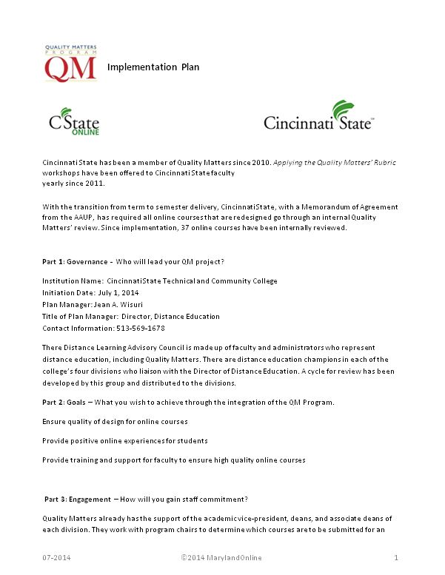
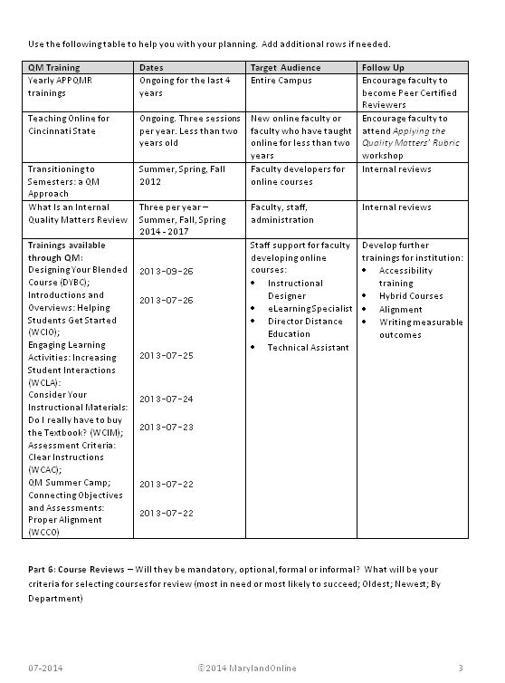
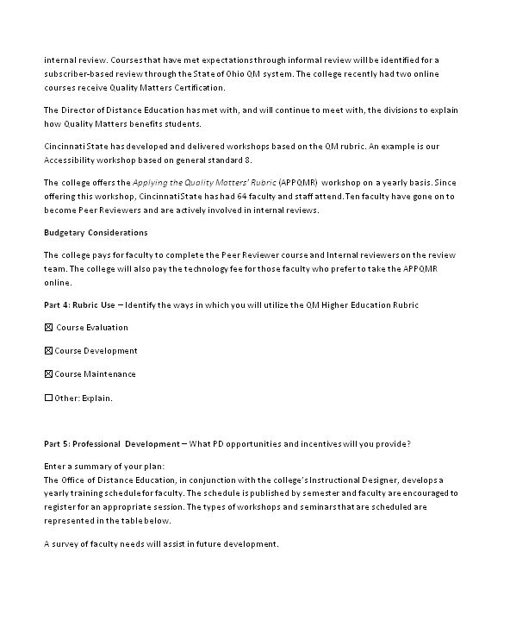
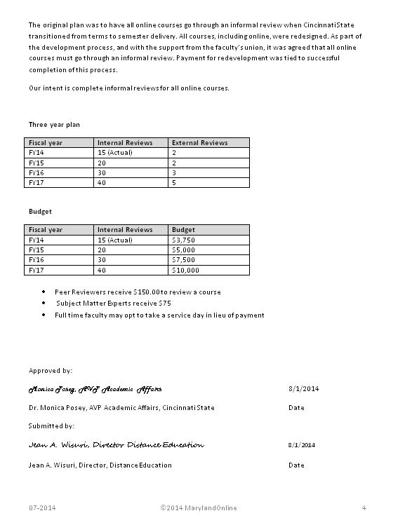
Implementation Plan
Notes:
Working with the distance learning advisory council, an implementation was developed and submitted to QM for approval. – June 2014 – received an email from QM asking if they could put the plan up for other colleges as an exemplary example of how to write an implementation report.
The plan covers
Governance
Goals
Engagement
Budgetary considerations
Rubric Use
Professional Development
Course Reviews
I am only going to cover a few of them I think are of particular note

Slide 16

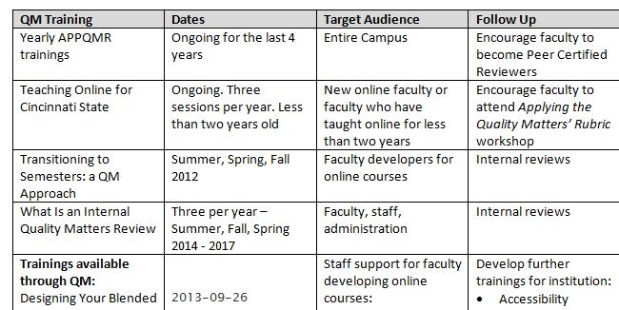
Implementation Plan
Notes:
Engagement – how will you gain staff commitment
We have offered the Applying the Quality Matters’ Rubric since I started 5 years ago – even before there were any real internal reviews going on. We’ve had approximately 64 faculty and staff go through this workshop and we will be offering another one this Friday, March 27th.
Our workshops range from the yearly APPQMR to lunch and learn about what a QM internal review is all about, blended and flip-it workshops. Also, my two employees and one instructional designer on campus have completed many of the QM offered workshops so we can provide additional workshops to the faculty.

Slide 17

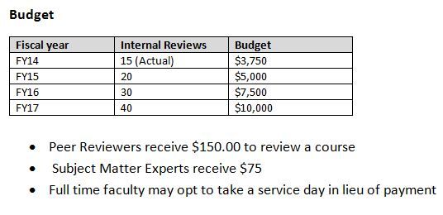
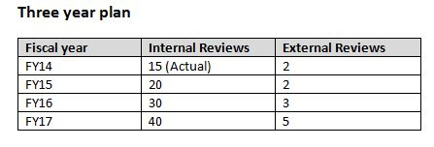
Implementation Plan
Notes:
Budgetary Considerations
Our internal reviews consist of 2 members – Subject Matter Expert and a Peer Certified Reviewer
SME gets paid $75 dollars to do a review – this individual may be a faculty member who has not gone through APPQMR
Peer Certified Reviewer gets $150

Slide 18
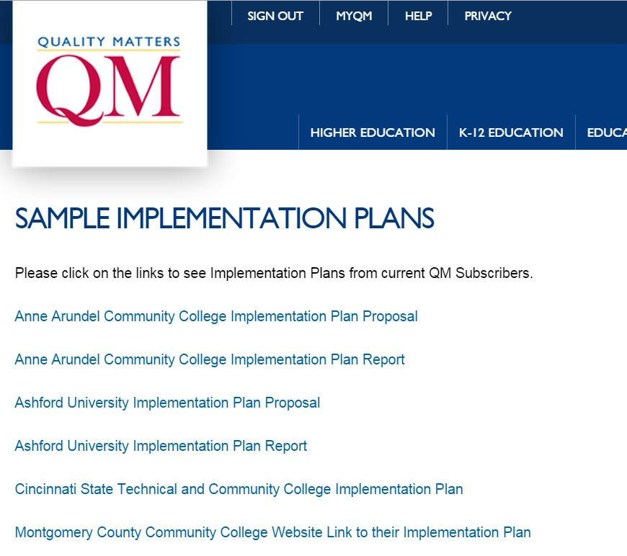
Implementation Plan
Notes:
It appears on the QM home page as a sample implementation plan….it was listed last June.

Slide 19
Question
What is your take-away from this presentation?

Slide 20

Q U E S
T
I
O
N
S
?

