Slide 1

The Road to Quality - A Panel Discussion on Campus Implementation
October 2015

Slide 2
Presenters
Elizabeth McMahon
  Instructor and QMC, Northland Community and Technical College
  Co-Coordinator, Minnesota Online Quality Initiative
  QM Certified Master Reviewer, Course Review Manager and Facilitator
Karen LaPlant
  Instructor and QMC, Hennepin Technical College
  QM Certified Master Reviewer
Julie Reginek
  Instructor and QMC, Ridgewater College
  QM Certified Peer Reviewer
Robin O’Callaghan
  Instructional Designer and QMC, Winona State University
  Co-coordinator, Minnesota Online Quality Initiative
  QM Certified Peer Reviewer and Facilitator

Slide 3
The Road to Quality - A Panel Discussion on Campus Implementation
Elizabeth McMahon
  Instructor and QMC, Northland Community and Technical College
  Co-Coordinator, Minnesota Online Quality Initiative
  QM Certified Master Reviewer, Course Review Manager and Facilitator

Slide 5




Minnesota Online Quality Initiative
“The Minnesota Online Quality Initiative provides faculty and staff from participating institutions information and resources to promote quality course design and provides opportunities to build collaborative relationships and shared expertise through statewide collaboration. The primary goal is to improve the quality of courses and learning experiences for students in online and blended courses.”
~ http://Minnesota.qualitymatters.org
Minnesota State College and University System
  435,000 + students/ 54 campuses
  2 Faculty Unions
University of Minnesota
  70,000 students/ 5 campuses
Participation is voluntary for individuals & institutions
Higher Ed Systems collaborate for professional development and course reviews
Joint subscribers since 2008

Slide 6

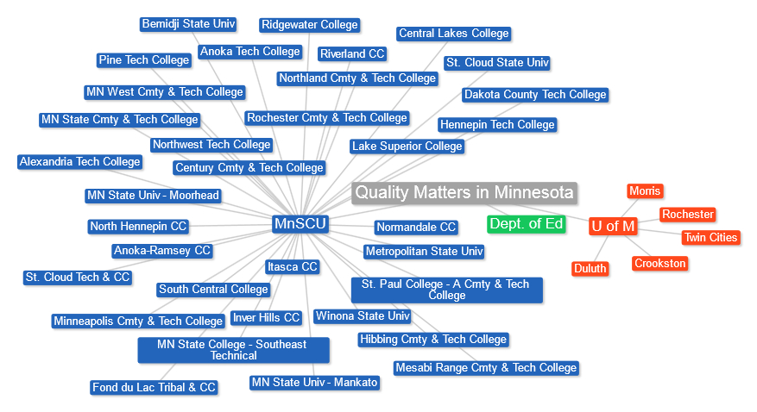
QM Affiliate Institutions in Minnesota
Notes:
Current as of 9/25/13

Slide 7
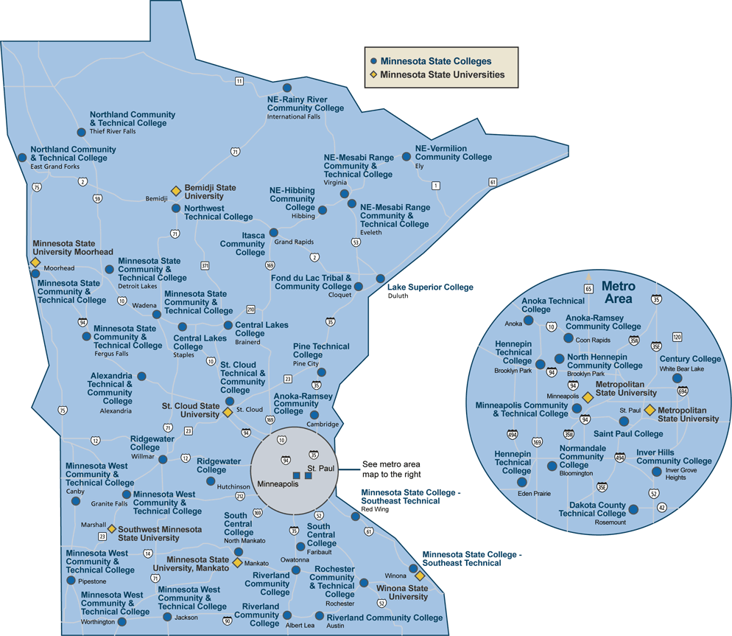

Inter-institutional collaboration increases course quality and builds a network of shared expertise. Each institution chooses own implementation plan.

Slide 8
Goals of Collaboration
For Learners
Improved learning experience
For Institutions
For System/s
Nationally recognized statewide implementation plan
Increased satisfaction
Trained faculty
Implementation Plans
Improved courses
High quality online courses
Notes:
For Learners
Significant positive impact on learner satisfaction, retention and achievement in online courses in Minnesota through the development and delivery of online courses that meet high standards of course design.
For Institutions
Provision of significant, course development support for administrators, faculty and staff developing and delivering online courses and an effective and sustainable way for each to demonstrate its commitment to offering high quality online courses and programs.
For the MnSCU System
Provision of effective, coordinated assistance in building statewide access to sustained, continuous training, online course development support and the ability to demonstrate institutional and statewide support for high quality online learning in Minnesota.
Intentional and strategic

Slide 9
The Road to Quality - A Panel Discussion on Campus Implementation
Karen LaPlant
Quality Matters Master Reviewer and Coordinator
Information Technology Faculty
Hennepin Technical College

Slide 10
Hennepin Technical College
Introducing Quality Matters on campus
Gaining acceptance or buy-in
Establishment of a training program
Procedures for faculty to have courses reviewed
Lessons learned

Slide 11
Online courses
1886 D2L "courses" using D2L for Fall (20153)
This is the break down.
294 = Courses in Development
120= Committees, training, clubs etc.
1159 = Face to Face courses
203 = Blended
110 = Totally Online

Slide 12
IntroducTiON
Created a flyer after initial QM announcement
Sessions for faculty to stop and ask questions
Offer training in various ways: online and in-person
Offer groups or networks of faculty training together
Collaborated with 2 other local colleges in metro area

Slide 13
ACCEPTANCE
First year received basically no budget
Convinced administration to create budget for years 2-4
Gained acceptance or buy-in by communication
Incorporated QM Best Practices when training in D2L
Convinced faculty that design NOT content is reviewed!
Faculty may now choose to self- assess if not formally

Slide 14
ESTABLISHMENT
Established a QM work group within eLearning Committee
Created a QM Presence Online through a new webpage
Created a monthly newsletter to highlight training and accomplishments (In The Q) and sent by e-mail blast
State wide group in known as MOQI (Minnesota Online Quality Initiative) is very helpful and has a website and offers training
  Promoting Quality Course Design Through Statewide Collaboration

Slide 15
PROCEDURES
Active QM Coordinator
  Helpful to be a Peer Reviewer or Master Reviewer like myself
Procedures for faculty to have their courses reviewed
  Where to go and what to do
  Volunteer at my college with no stipend or release-time attached
Set-up a priority list
Develop peer mentors to guide faculty

Slide 16
LESSONS LEARNED
Create a committee to meet and discuss
Develop trained mentors
Find early adopters to help motivate other faculty
Spread excitement by word of mouth
Personal pride by announcing certification college-wide

Slide 17

QM Recognition AT HTC
2012 - 2 Courses
2013 - 12 Courses
2014 - 12 Courses
Expecting more
Notes:
MnSCU started with QM 2009. WSU 2012

Slide 18
SUMMARY
Need administration support and commitment (budget)
Need committee support of faculty, trainers, instructional designers, curriculum specialists, etc.
Need an internal process
Need a priority list
Success for us this past year was 12 courses in 12 months!

Slide 19
The Road to Quality - A Panel Discussion on Campus Implementation
Julie Reginek MS, ACC, EDU, CDP
MEPAP and Activity Director Program Instructor
Health Support Specialist (HSS)
Online Curriculum Specialist/D2L Trainer
Ridgewater College

Slide 20
Ridgewater College
Creating a Quality Matters Culture
  Systems Portfolio
  AQIP project focus
  College 5 year work plan

Slide 21

Ridgewater College creating a QM Culture
Faculty Support
  Summer Bootcamp
  Desire2Learn Tools
  Instructional Design to support Quality Matters Standards

Slide 22
Ridgewater College creating a QM Culture
Administration Support
  Financial Support
  Institutional subscription
  Institutional Representative
  QM training for faculty
  QM conference participation
  Inservice Day
  Dean’s Council

Slide 23
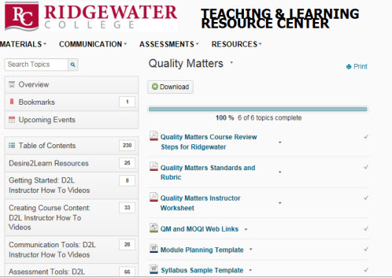

Ridgewater College
Teaching and Learning Center

Slide 24
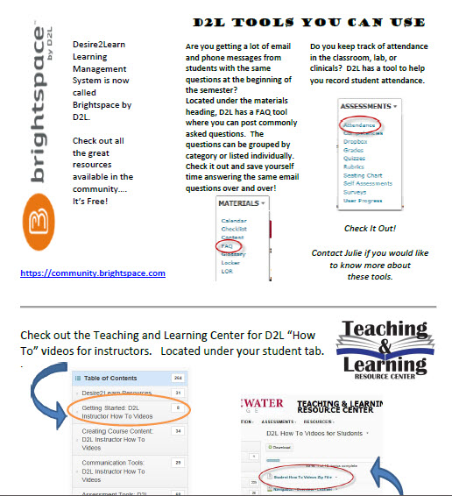
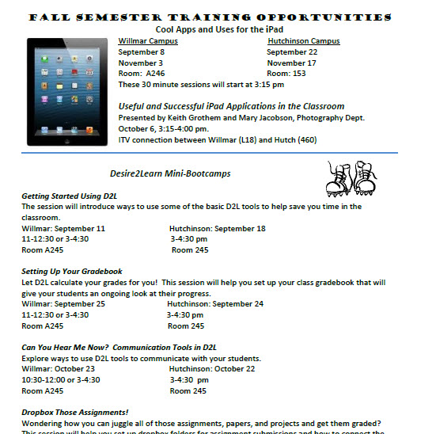
Ridgewater College
Creating a QM Culture
Marketing

Slide 25
Ridgewater College
Creating a QM Culture
Where do I start and what do I do?
  Meet with me
  QM Starter Kit
  Informal review
  Toot your horn!

Slide 26
The Road to Quality - A Panel Discussion on Campus Implementation
Robin O’Callaghan
Quality Matters Peer Reviewer, F2F Facilitator & QM Lead Coordinator
Senior Instructional Designer
Faculty
Winona State University

Slide 27
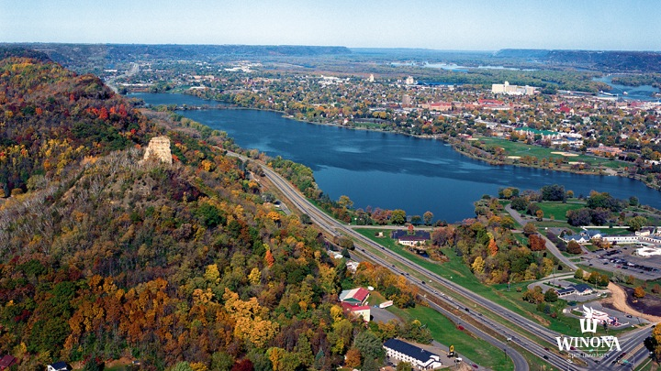

Slide 28
WSU Online Courses and programs
3 Undergraduate Programs
4 Graduate Programs
3 blended/hybrid programs
50-75 courses are offered online during the academic year
120 Summer courses are online

Slide 29
WETeach Program FOUNDATIONS
Module 1 Charting your course
Module 2 Quality Matters Overview
Module 3 Connecting with Online Student Services
Module 4 Communicating and Collaborating with your Online Students
Module 5 Learning Objectives & Course Design
Module 6 Online Assessment & Feedback
Module 7 Instructional Materials
Format: One hour virtual meetings with online topical content. Learning Goals/Objectives aligned with Assignments.

Slide 30
WETeach Program ADVANCED
Module 0 Pre Course Information
Module 1 Learning Objectives
Module 2 Alignment
Module 3 Assessments
Module 4 Instructional Materials
Module 5 Peek Inside a QM Course
Format: Weekly one-hour meetings face-to-face. Divided into ½ discussion and ½ course design. Optional online materials.
After five weeks we move to 1:1 custom meetings with an instructional designer.

Slide 31
Different Pathways to Quality
Quality Matters Recognition
Bi-Weekly or Weekly
1:1 Meetings
Foundation/Advanced
Summer Cohort

Slide 32
Advantages & Disadvantages
Flexibility for instructors
Faculty workload
Collaboration
“Self-select” the instructional materials
Evidence of completion
More time to manage for facilitators
Alignment of all program
“Self-select” could miss key components
Not streamlined for those who need structure

Slide 33
Strategies for administration & Faculty buy-in
Offer the APPQMR course to faculty, deans and administrators
Communicate institutional and faculty benefits through workshops and virtual meetings
Communicate our professional development plan around QM and online teachings
Create strategic plan by college
  Track all 1:1 meeting with faculty. This would include notes and “level” of help.
  Track by college, course, QM reviews, QM Renewal and WeTeach Certificate
  Summary by college distributed every fall
  Faculty can use the data for the PDP and PDR

Slide 34
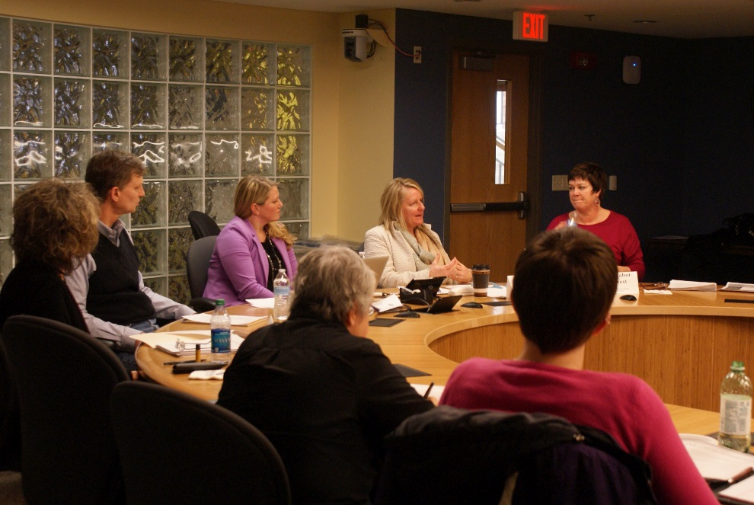
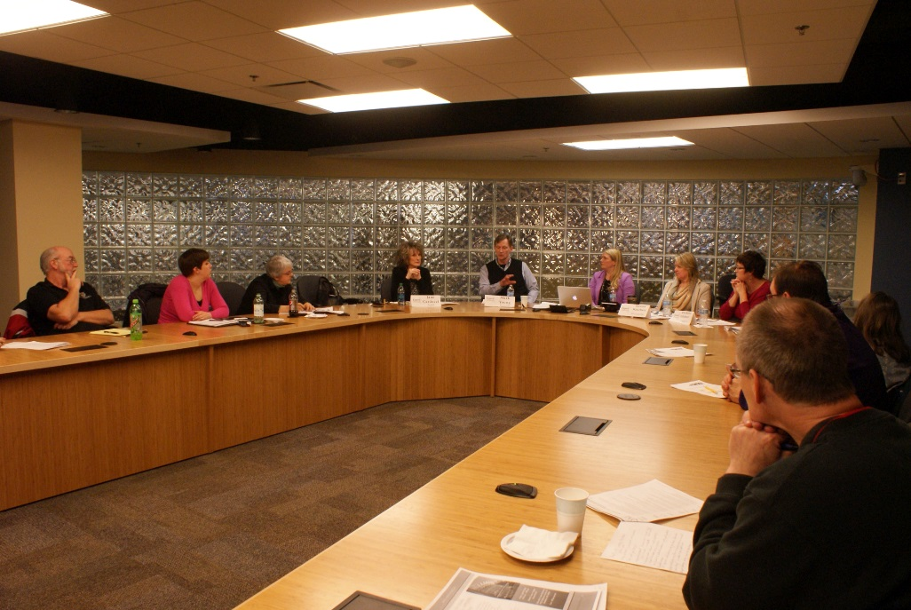
TLT Expert Showcase
TLT’s Expert Showcase brings faculty who have firsthand experience with instructional technologies and effective teaching methods.
Four panelists with a wide background in online teaching and QM.
5-10 minutes to showcase a course element

Slide 35
Questions?
Please feel free to contact any of us:
Elizabeth.McMahon@northlandcollege.edu
Karen.LaPlant@hennepintech.edu
Julie.Reginek@ridgewater.edu
ROCallaghan@winona.edu

