Slide 1
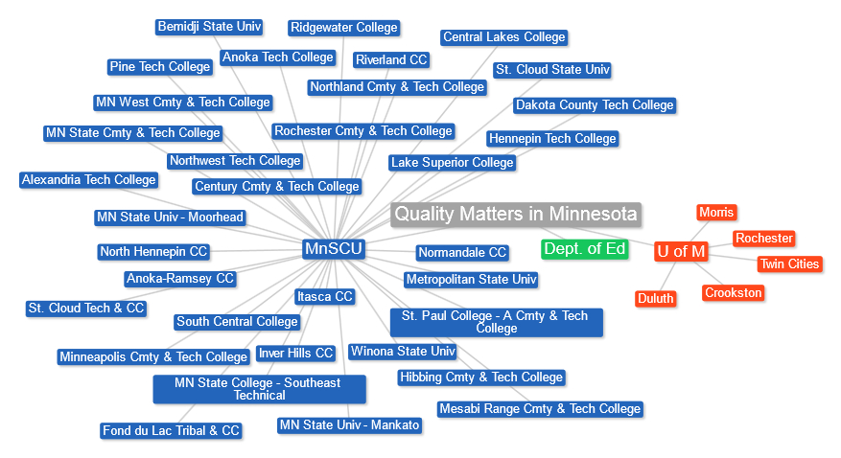



The Road to Quality - A Panel Discussion on Campus Implementation

Slide 2
The Road to Quality - A Panel Discussion on Campus Implementation
Karen LaPlant - Hennepin Technical College
Robin O’Callaghan – Winona State University
Julie Reginek – Ridgewater College

Slide 3
The Road to Quality - A Panel Discussion on Campus Implementation
Karen LaPlant
Quality Matters Master Reviewer and Coordinator
Information Technology Faculty
Hennepin Technical College

Slide 4
Hennepin Technical College
Introducing Quality Matters on campus
Gaining acceptance or buy-in
Establishment of a training program
Procedures for faculty to have courses reviewed
Lessons learned

Slide 5
Online courses
1886 D2L "courses" using D2L for Fall (20153)
This is the break down.
294 = Courses in Development
120= Committees, training, clubs etc.
1159 = Face to Face courses
203 = Blended
110 = Totally Online

Slide 6
IntroducTiON
Created a flyer after initial QM announcement
Sessions for faculty to stop and ask questions
Offer training in various ways: online and in-person
Offer groups or networks of faculty training together
Collaborated with 2 other local colleges in metro area

Slide 7
ACCEPTANCE
First year received basically no budget
Convinced administration to create budget for 2nd year
Gained acceptance or buy-in by communication
Incorporated QM Best Practices when training in D2L
Convinced faculty that design NOT content is reviewed!

Slide 8
ESTABLISHMENT
Established a QM committee within eLearning Committee
Created a monthly newsletter to highlight training and accomplishments (In The Q) and sent by e-mail blast
State wide group in known as MOQI (Minnesota Online Quality Initiative) is very helpful and has a website and offers training
  Promoting Quality Course Design Through Statewide Collaboration

Slide 9
PROCEDURES
Active QM Coordinator
  Helpful to be a Peer Reviewer or Master Reviewer like myself
Procedures for faculty to have their courses reviewed
  Where to go and what to do
  Volunteer at my college with no stipend or release-time attached
Set-up a priority list
Develop peer mentors to guide faculty

Slide 10
LESSONS LEARNED
Create a committee to meet and discuss
Develop mentors
Find early adopters to help motivate other faculty
Spread excitement by word of mouth
Personal pride by announcing certification college-wide

Slide 11
SUMMARY
Need administration support and commitment (budget)
Need committee support of faculty, trainers, instructional designers, curriculum specialists, etc.
Need an internal process
Need a priority list
Success for us this year was 13 courses in 13 months!

Slide 12
The Road to Quality - A Panel Discussion on Campus Implementation
Robin O’Callaghan
Quality Matters Peer Reviewer and F2F Facilitator
Senior Instructional Designer
Faculty
Winona State University

Slide 13
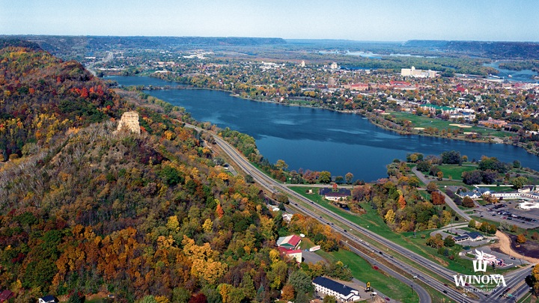
Notes:
----- Meeting Notes (8/14/14 12:15) -----
4 year institute in the MNSCU system
5 college
Laptop university-iPads
9,000 students

Slide 14
WSU Online Courses and programs
3 Undergraduate Programs
4 Graduate Programs
3 blended/hybrid programs
50-75 courses are offered online during the academic year
120 Summer courses are online

Slide 15

QM Recognition
2012 - Four Courses
2013 - Ten Courses
2014 – Expecting 20
Notes:
MnSCU started with QM 2009. WSU 2012

Slide 16
Getting administration & Faculty buy-in
Offer the APPQMR course to deans and administrators
1:1 meetings with all college deans twice a semester
Communicate institutional and faculty benefits
Communicate our professional development plan around QM and online teachings
Create strategic plan by college
  Track all 1:1 meeting with faculty. This would include notes and “level” of help.
  Track by college, course, QM reviews, QM Renewal and WeTeach
  Faculty can use the data for the PDP and PDR

Slide 17
Providing Training and Faculty support
20 e-Clinics on QM
Funding for QM training and reviews
  APPQMR
  Online Courses by QM
Financial support for summer course design or redesign
Majors or programs that focus on online courses
WeTeach Program

Slide 18
WETeach Program FOUNDATIONS
Module 1 Charting your course
Module 2 Quality Matters Overview
Module 3 Find, Buy, Build and Share Online Content
Module 4 Communicating and collaborating with your online students
Module 5 Online Assessment & Feedback
Module 6 Connecting your students to online resources at WSU
Module 7Creating a timeline for your online course

Slide 19
WETeach Program ADVANCED
Module 1 Situational Factors
Module 2 Creating Learning Objectives-course/module
Module 3 Alignment & Quality Course Design
Module 4 Integration and Roadmaps
Module 5 Teaching & Learning Activities
Module 6 Best Practices for Instructional Materials
Module 7 Course Structure and Calendar
Module 8 Syllabus and Welcome Video
Readings include Dr. Dee Fink’s Designing Courses for Significant Learning

Slide 20
Summer Co-hort module
Collaboration between TLT, Outreach and Continuing Education Department and Academic Affairs.
20 faculty members paid for course design or redesign
12 week program
2 hours a day
Objectives were to increase online course offerings for adult learners or general education courses
Notes:
Focus on online programs that served adult learners
Focus on licensure and certification programs (credit and non-credit)

Slide 21
Promote and Celebrate Successes
WSU Update–Used to promote and communicate all faculty members whose courses meet the QM standards, peer reviewer or master reviewer certificates.
An email is sent to the academic vice-president, dean of the college and chair of the department for any course that meets QM standards. Picture and story on homepage of TLT.
InFocus-Short video stories that focus on innovative teaching methods.
TLT Expert Showcase-focus on online teaching and QM

Slide 22
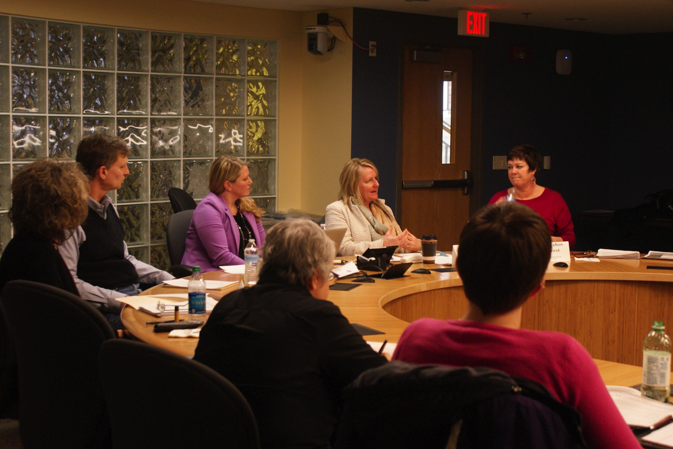
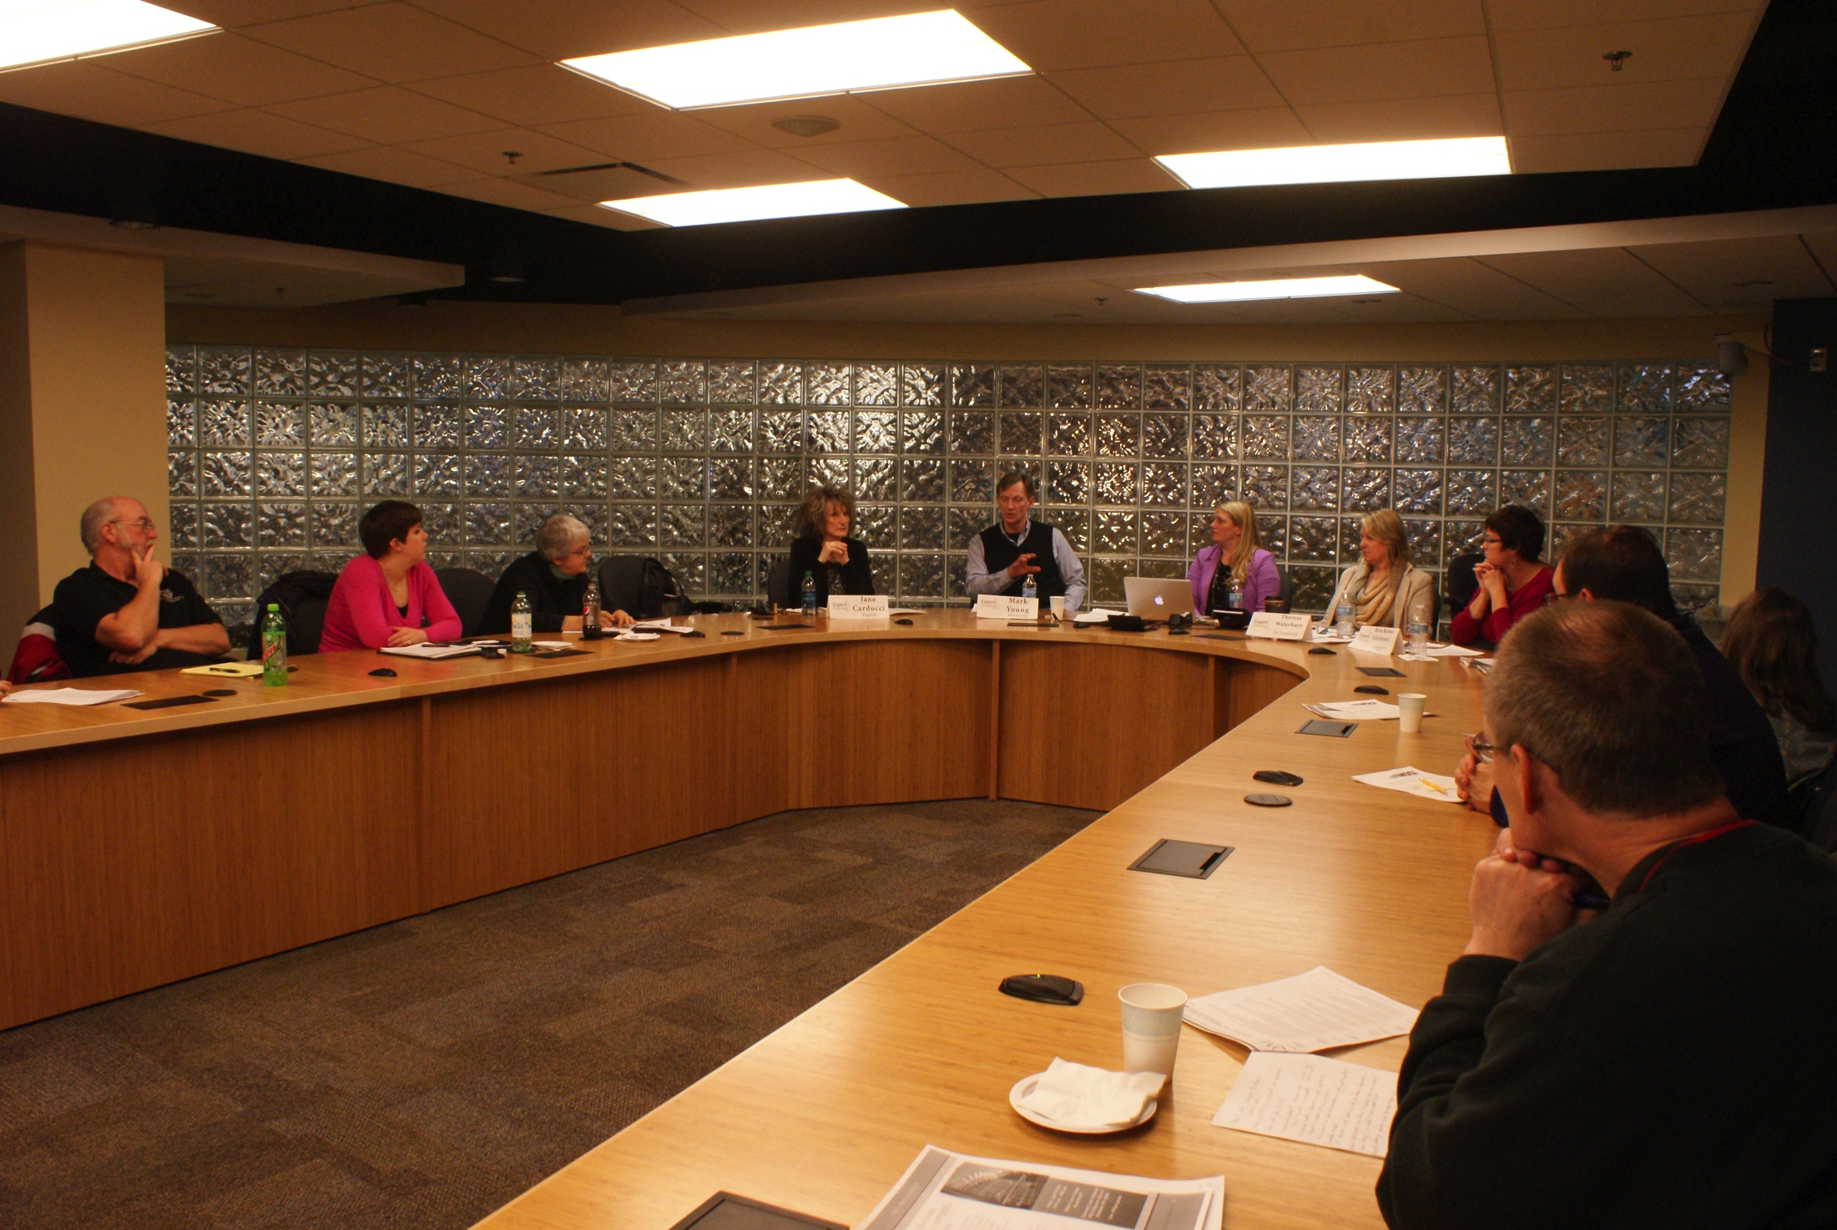
TLT Expert Showcase
TLT’s Expert Showcase brings faculty who have firsthand experience with instructional technologies and effective teaching methods.
Four panelists with a wide background in online teaching and QM.
Intro to QM
Q & A
1 hour panel format.

Slide 23
The Road to Quality - A Panel Discussion on Campus Implementation
Julie Reginek MS, ACC, EDU, CDP
MEPAP and Activity Director Program Instructor
Health Support Specialist (HSS)
Online Curriculum Specialist/D2L Trainer
Ridgewater College

Slide 24
Ridgewater College
Creating a Quality Matters Culture
  Systems Portfolio
  AQIP project focus
  College 5 year work plan

Slide 25

Ridgewater College creating a QM Culture
Faculty Support
  Summer Bootcamp
  Desire2Learn Tools
  Instructional Design to support Quality Matters Standards

Slide 26
Ridgewater College creating a QM Culture
Administration Support
  Institutional subscription
  Institutional Representative
  QM training for faculty
  Conference participation

Slide 27
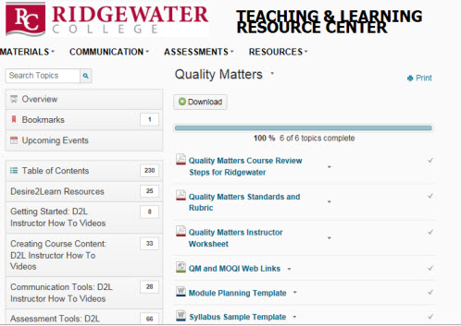

Ridgewater College
Teaching and Learning Center

Slide 28
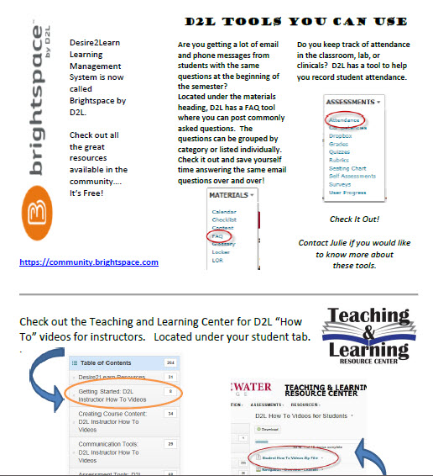
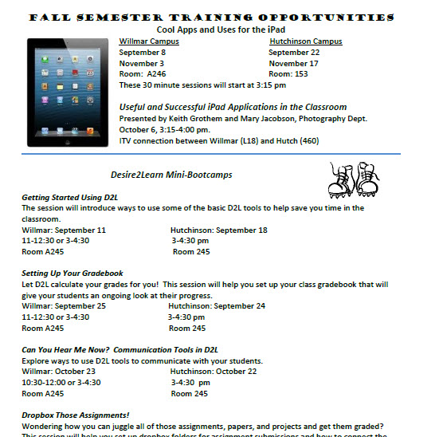
Ridgewater College
Creating a QM Culture
Marketing

