Slide 1

To “Understand” Measurable
Learning Objectives
Helping Faculty Meet Standards 2.1 and 2.2
Notes:
Howdy and thank you for joining our session To “Understand Measurable Learning Objectives, Helping Faculty Meet Specific Review Standards 2.1 and 2.2.

Slide 2
Who We Are
Sharon Gibson-Mainka
Queen Bee
Jennifer Maldonado-Castillo
Disney Frequenter and Expert
Jernaley Martin
Resident Prankster
Jeff Kurtz
Enthusiastic Aggie
Donna Mancuso
Butterfly Enthusiast
Wendy Moore
Crafty Event Planner Extraordinaire
Notes:
My name is Jernaley Martin, and I’m joined by my colleagues Sharon Mainka, Jeff Kurtz, Jennifer Castillo, Donna Mancuso, and Wendy Moore.
Oops. Wrong slide.

Slide 3
Who We Are
Sharon Gibson-Mainka
Information Technology Consultant
Jennifer Maldonado-Castillo
Instructional Designer
Jernaley Martin
Information Technology Consultant
Jeff Kurtz
Interim Assistant Director
Donna Mancuso
Distance Education Coordinator
Wendy Moore Clayton
Information Technology Consultant
Notes:
That’s better. We are with Texas A&M University and we’ll each be joining the group discussions that will take place today.

Slide 4
Session Objectives
Evaluate case studies based on real-life comments/questions from faculty regarding measurable learning objectives.
Discuss the actions that were taken and what could have been done to address the case studies.
Propose suggestions and/or share experiences writing or helping faculty write measurable learning objectives.
Notes:
The objectives for this session is to evaluate case studies based on real events, discuss actions for addressing the case studies, and share suggestions and experiences helping faculty write measurable learning objectives.

Slide 5
What’s My Take-away?
Network with your peer.
Share your experiences and expertise.
Gather new ideas for the workplace.
Notes:
There are quite a few objective-related sessions at this year’s QM Conference. I believe this is because QM and many instructional design practices place much emphasis on measurable learning objectives as the foundation of any course design. While we are aware of this, it’s always helpful to re-review and re-evaluate what it takes to ensure that courses are…
As with any conference event, this session allows you to network with others who share interests similar to yours. Sometimes participating in a group activity introduces you to someone you would not have spoken to otherwise.
This is also your opportunity to share your experiences and expertise with others.
Perhaps you will also be able to walk away with new ideas that you can take back to the workplace.

Slide 6
Meet Professor Hadnot
Notes:
So let’s meet Professor Hadnot in our first case study.

Slide 7
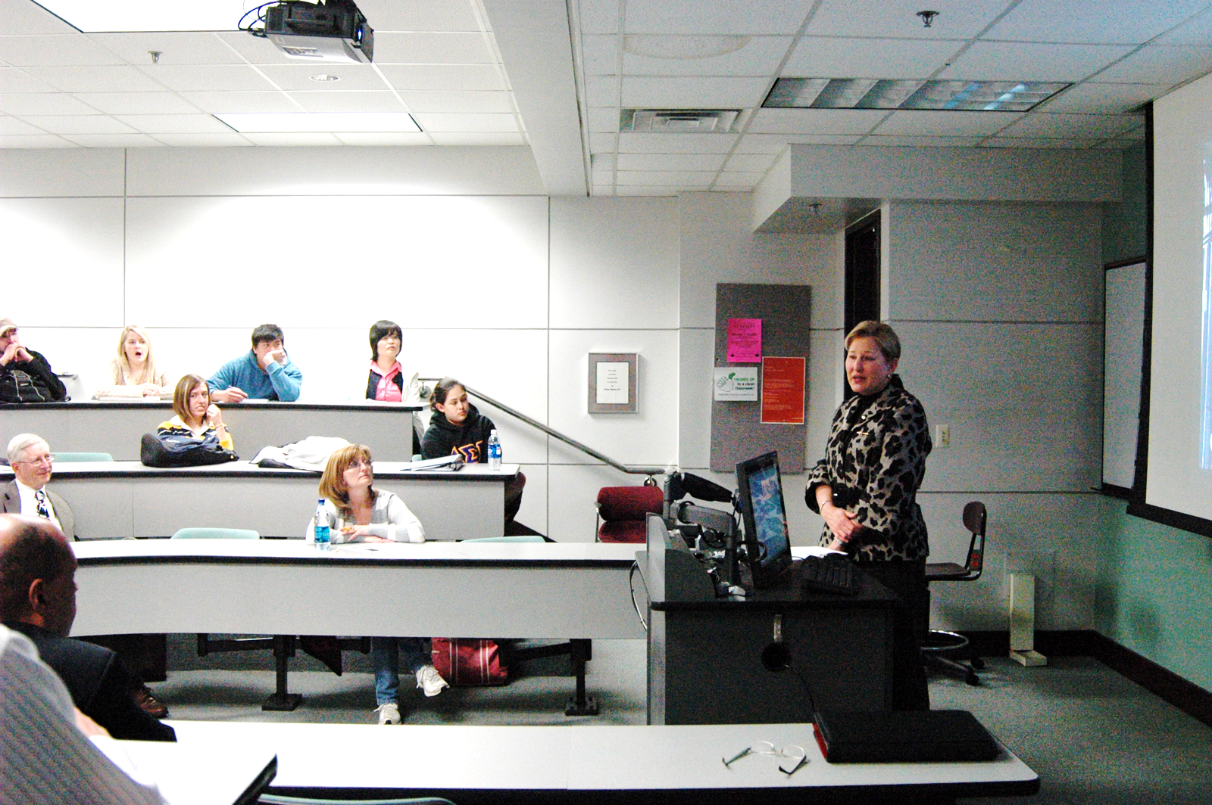
Case Study #1
Laney Hadnot
Assistant Professor, School of Business
Notes:
Professor Hadnot is a faculty member at your institution who is renowned on campus as a great researcher. While she has no formal education or training in facilitating online courses, Professor Hadnot knows she has taught a specific course successfully for over a year and has sought out your input on the course design before submitting her request for a formal QM review.
Image Source:
Mays Business School, Texas A&M University
https://www.flickr.com/photos/maysbusinessschool/4379982089/in/photolist-7F3y5z-7VuMtw-o9EmR2-o5QSqj-o7zRWB-q725vD-dYoYg7-j3d3Vx-nQpF4r-nQoAfU-fD3Qs3-fCjjZB-fCLggg-fucjDn-pEJH5L-fCjkHM-fD3R4G-8x31oc-9gSTcR-8xuLxR-9gGXkx-pEJEAs-j3bAKR-8xekGf-6rArgK-dNXhCH-9xCGUc-fCjh6H-bJ4T9M-fCAS9o-eFpBvf-fCjgr4-gFRAYm-fCjid6-yWJ8h3-nSPukP-8xekJE-duCBGu-o9PVGR-fD3Qxd-fCLh9i-fCjkEn-fCAUJU-8xaTqc-fCAUpq-fCLgc2-fCAUB1-fD3Rcw-fCLgnZ-eFt16a

Slide 8
Activity #1
Break-out into small groups.
Review the handout.
Recommend changes.
Discuss with your group.
Notes:
Break-out into pairs or small groups.
Review the sample objectives in the handout provided.
Recommend changes for improvements.
Discuss your insights with your group.

Slide 9
Suggestions / Tips
Provide an explanation. The term understand is…
Too broad
Vague and unclear
Not specific
Open to interpretation
Notes:
To help a faculty member understand why understand is not considered measurable, try providing an explanation. Let faculty know that it’s too broad, vague, not specific enough, and open for interpretation. In other words, people will assign a meaning to it to fill a void, and that meaning may not be correct. There’s a potential for miscommunication between what the faculty member wants students to know and what students think the faculty member wants them to know.

Slide 10
Suggestions / Tips
Give an example. What comes to mind?
Upon completion of this unit, you will be able to:
- Understand how to make a soufflé.
Notes:
Next, you can consider giving an example of how understand can be misinterpreted. Take the example about understanding how to make a soufflé. What is the first thing that comes to mind when you see this objective? [pause] Everyone here may have their own assumption. To me, it poses several questions.
Is this just a generalization? Will I only know the basic idea of what a soufflé consists of? Or will I actually be expected to make a soufflé?
What kind of soufflé will I understand how to make?
Use an example that may be relevant to the faculty member you are supporting.

Slide 11
Suggestions / Tips
Provide guidance and solutions. Ask yourself:
  What do I want students to know or do?
  What needs to be learned?
  What action do I want to observe?
  What other info will help students out?
Notes:
Sometimes it may be helpful to provide guidance and solutions in case they don’t know where to start. Consider these questions when writing or rewriting learning objectives.
First, what do you want students to know or be able to do? Determine what you want students to learn about.
Also, what needs to be learned? Decide what level of skill or knowledge you want students to walk away with. Refer to a Bloom’s Wheel for guidance on choosing the appropriate level.
What action do you want to observe? Choose a verb that describes the level of skill or knowledge.
Is there anything else? Optionally add additional information that will further specify how or when the outcome will be observed.

Slide 12
Difficult Faculty
Notes:
With the suggestions and tips you provided, and the few we just identified, most faculty would want to know why they should rewrite their objectives? What’s the point? However, the way they may ask these questions, or demand that you provide answers, may be a bit challenging to deal with.

Slide 13
Personalities / Behaviors
“The Willing”
Open to new ideas
Embraces/accepts change
Has initiative
Takes feedback
Notes:
There are several personalities, behaviors, or what some will call “types” of faculty. One type includes the “willing” faculty member. This person is open to new ideas, is driven, embraces change, and accepts constructive feedback well. This type of person is sometimes rare and easy-going to work with. A “go-with-the-flow” type of person.

Slide 14
Personalities / Behaviors
“The Complacent”
Pushed into doing something
Hidden agenda
Disinterested
Lack motivation
Notes:
“Complacent” faculty members may also “go-with-the-flow” when it comes to getting something done, although their reasons may be different from “willing” faculty. For one thing, they may be receiving push from a higher level to pursue a QM review. Perhaps there’s a hidden agenda such as a stipend for having a QM certified course. Then again, instead of “flowing” they may be disinterested and lack motivation to get things done. However, an explanation as to why having measurable learning objectives is important may motivate them enough to ensure standards 2.1 and 2.2 are met.

Slide 15
Personalities / Behaviors
“The Know-It-All”
Never wrong
Complains about problems
Intimidating
Questions your feedback
Notes:
There are also faculty members who have been experts in their fields for a long time. You may have heard some of them referred to as “know-it-alls” mainly because they give people the impression that they’re rarely wrong. Some “know-it-alls” may often complain or provide excuses about being inundated with problems, claiming that such problems are unsolvable because of other people or circumstances. They may even come across as intimidating and question your feedback or judgment. It doesn’t mean they won’t listen to what you have to say, but you may need to find another way to say it and earn their trust.

Slide 16
Meet Professor Wrigley
Notes:
As is the case with Professor Wrigley in our next case study.

Slide 17
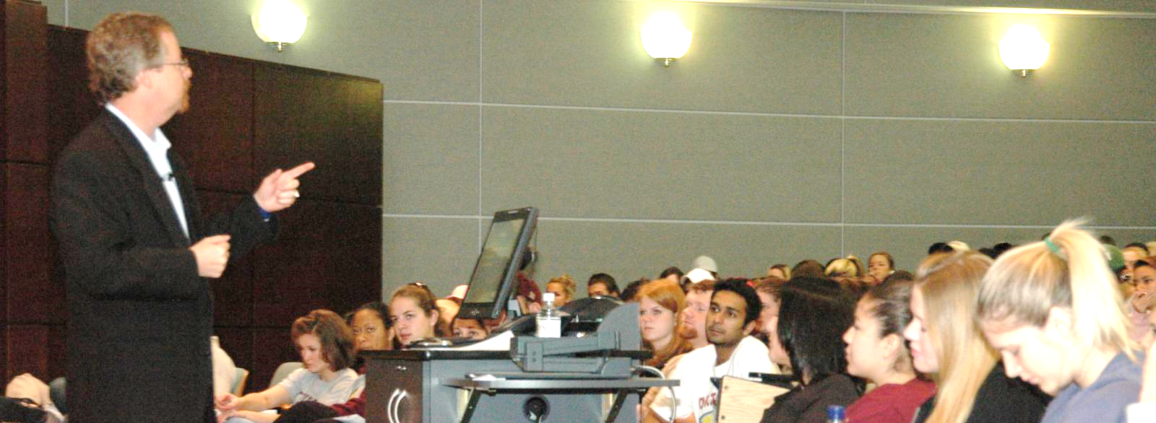
Case Study #2
Carl Wrigley
Assistant Professor, Animal Science
Notes:
While he appreciated the feedback you provided him about writing measurable learning outcomes, he argues that the term understand is acceptable. After all, he wants to know students understand the material. He will also be able to see whether they understand it by completing assessments. He presents you with several questions and comments regarding the use of this term.
How would you respond to his inquiry?
Image Source:
Mays Business School, Texas A&M University
https://www.flickr.com/photos/maysbusinessschool/4416814159/in/photolist-7JijYg-7F3y5z-8kM5Yt-8kQgLQ-8kQgJN-8kM61k-6nyMKy-6ntETD-zGf9x-zGdak-7H9tUt-7HdkfN-7PgiA2-7HdkiG-7KhKmo-7Hdki9-7Hdkgy-7JnGZu-7JnGWj-zGd1e-zGd3j-zGcUv-zGcXf-7ScFxd-99KYyA-v39Gc-EEevL-v3b6D-7MDZT9-35gYz3-duECPH-v3eka-99LdKJ-9eEq8P-b7sEkc-b7sDFg-b7sDZ2-7MDUZU-7MyYcc-7KhKmN-7MyP6k-35cq1v-7Pgei4-7MDZVL-7MA1br-7MA1cM-7MA1ba-7MDZTw-7MA1bM-35cq2B
*****
Doesn’t want to take the time to do it.
What’s the point?
Students don’t read it, understand it, or care.

Slide 18
Activity #2
Break-out into small groups.
Review the handout.
Provide feedback.
Discuss with your group.
Notes:
Break-out into pairs or small groups.
Review the questions and comments regarding understand (handout).
Provide answers and feedback.
Discuss your insights with your group.

Slide 19
Suggestions / Tips
Don’t take it personal.
Connect and communicate.
Focus on the goals; stay on task.
Notes:
We mention working with difficult faculty because sometimes you may encounter challenges or roadblocks along the way to helping them meet standards 2.1 and 2.2. I overheard a few of you share your own tips in the group conversations, and here are a few of our suggestions.
First and foremost, don’t take it personal and try not to get defensive. The first thing you need to realize when dealing with difficult faculty or challenging personalities is that it’s rarely personal. Often times the behavior is a reflection of what the faculty needs to know, such as why he or she should trust you.
So make an attempt to connect with the faculty member you’re supporting by establishing credibility. This will ideally help you earn their trust and build a relationship. Regular communication is key. The characteristics for writing helpful recommendations in a QM peer review are also beneficial for everyday communication, especially with a difficult faculty member.
Be sure to stay focused on your goal and the goal of the faculty member you’re supporting. In this case, focus on what it will take to meet specific review standards 2.1 and 2.2. Paraphrase the information and concerns you gather from the faculty for clarification and to ensure that you hear and acknowledge what they tell you.

Slide 20
Recap
Notes:
What I would like to do now is take a few minutes to recap and reflect on our discussions today. We can now put our stuff away and take a pop-quiz, or I can have three volunteers join me at the front of the room.

Slide 21
GAMESHOW
Are You Ready?
Notes:
[Game Show Theme Music B – sound effect]
It’s time for the GAME SHOW! Wendy, what are they playing for?
[Wendy] Well, Jernaley, they are playing for a chance to win a Metal Earth 3D laser cut model. Oh, and let’s not forget to mention a brand new car!!!!
[Heavy Applause – sound effect]

Slide 22
Game Show Board
GAMESHOW
Learning Objectives Tips | Types of Difficult Faculty | Dealing with Faculty Tips
100 | 100 | 100
200 | 200 | 200
Notes:
Alright! Here are the rules of the game. There are three categories on the board: LO Tips, Types of Difficult Faculty, and Dealing with Faculty Tips. Each category is related to a topic discussed during today’s session. I will select the first amount for the category. The first person to “buzz-in” gets to answer first. If the answer is incorrect, the next person to “buzz-in” gets to try. And so on.
Are You Ready?!
*****************
It’s still anybody’s game. The Bonus question determines who wins the big prize.

Slide 23
LO Tips 100
GAMESHOW
Learning Objectives Tips
(100 pts)
Give one reason why the term Understand is not measurable.

Slide 24
LO Tips 100 Answer
GAMESHOW
Answer(s):
Too broad
Vague and unclear
Not specific
Misinterpretation
Inaccurate assumptions

Slide 25
LO Tips 200
GAMESHOW
Learning Objectives Tips
(200 pts)
State at least two questions you can ask yourself when writing measurable learning objectives.

Slide 26
LO Tips 200 Answer
GAMESHOW
Answer(s):
      What do I want students to know or do?
      What needs to be learned?
      What action do I want to observe?
      What other info will help students out?

Slide 27
Types of Difficulty Faculty
GAMESHOW
Types of Difficult Faculty
(100 pts)
Name one type of faculty personality/behavior
discussed during today’s session.

Slide 28
Types of Difficulty Faculty Answer
GAMESHOW
Answer(s):
The Willing
The Complacent
The Know-it-all

Slide 29
Types of Difficulty Faculty
GAMESHOW
Types of Difficult Faculty
(200 pts)
State at least two characteristics of a “Know-it-all.”

Slide 30
Types of Difficulty Faculty Answer
GAMESHOW
Answer(s):
Rarely/never wrong
Complains about problems
Intimidating
Questions your feedback

Slide 31
Dealing with Difficult Faculty
GAMESHOW
Dealing with Difficult Faculty
(100 pts)
Name the first tip for dealing with difficult faculty.

Slide 32
Dealing with Difficult Faculty Answer
GAMESHOW
Answer(s):
Don’t take it personal.

Slide 33
Dealing with Difficult Faculty
GAMESHOW
Dealing with Difficult Faculty
(200 pts)
What does connecting and communicating
with faculty allow you to establish?

Slide 34
Dealing with Difficult Faculty Answer
GAMESHOW
Answer(s):
Establish credibility
Trust
Build relationship/raport

Slide 35
Bonus
GAMESHOW
BONUS!!!
What were the professors’ names used in the case studies?

Slide 36
Bonus Answer
GAMESHOW
Answer(s):
Professor Laney Hadnot
&
Professor Carl Wrigley

Slide 37
Congratulations to today’s winner!
GAMESHOW

Slide 38
Questions?

Slide 39
Questions? Thoughts?

Slide 40
Works Cited
Rapid eLearning Blog. Here’s an Easy Way to Create Learning Objectives.
Managing the Unmanageable Subject Matter Expert.
3 Most Common Types of SMEs and How to Deal with Them.
Handling Conflict with Difficult Faculty.

