Slide 1

Transition Lassoed by QM: Capitalizing on a New LMS by Integrating QM Principles in Training
Terry Pollard and Rebecca Butler
University of Mississippi Medical Center

Slide 2
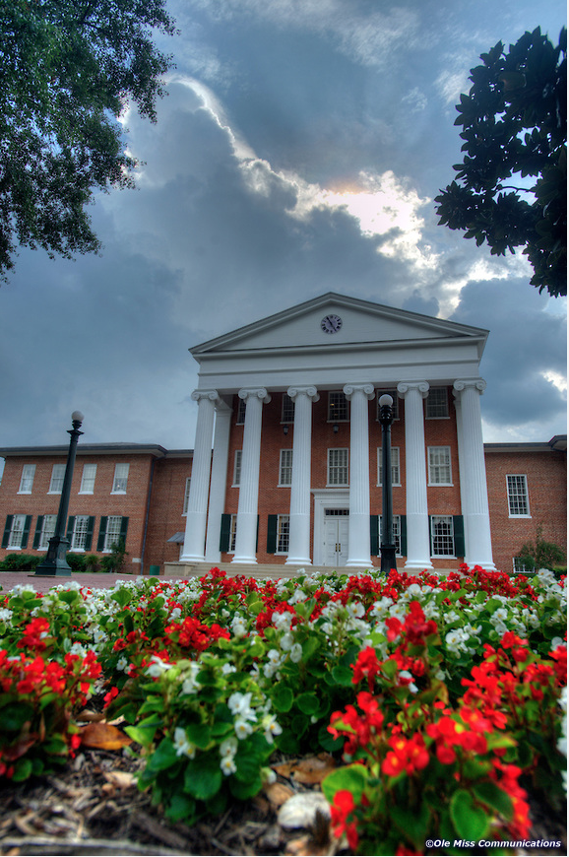
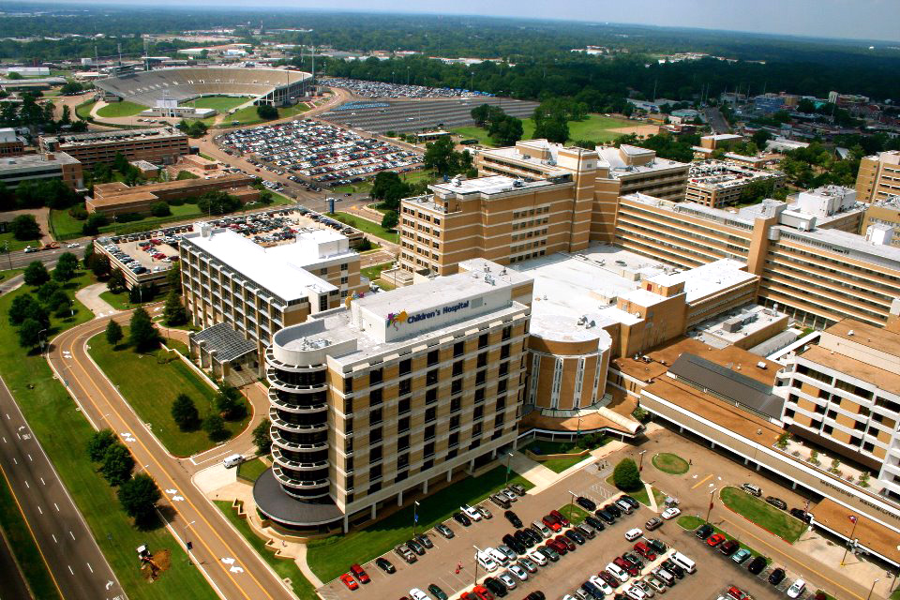
Institutional Background
+

Slide 3

Background Shaped the Project
Various roles in various settings
Saw opportunity to integrate QM principles into LMS training (secretly)

Slide 4
The Development
Designing the course
Terry – QM
Rebecca – Canvas
Self-paced check off format

Slide 5
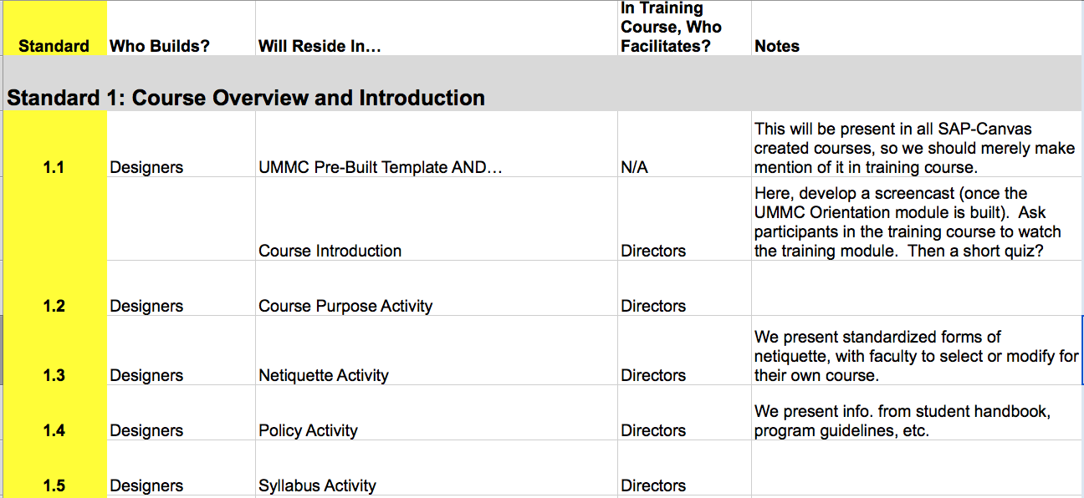
QM Standards Mapping Spreadsheet

Slide 6
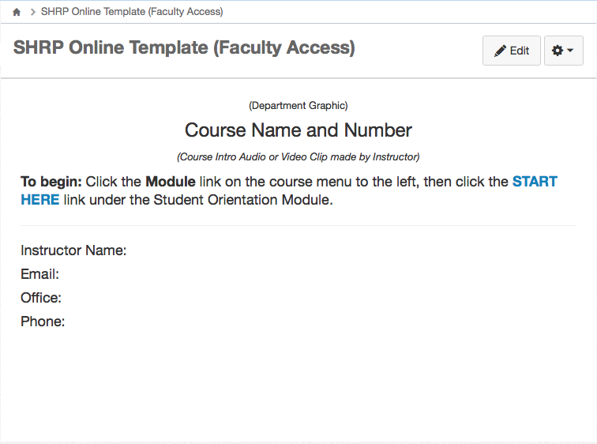
Course Template

Slide 7
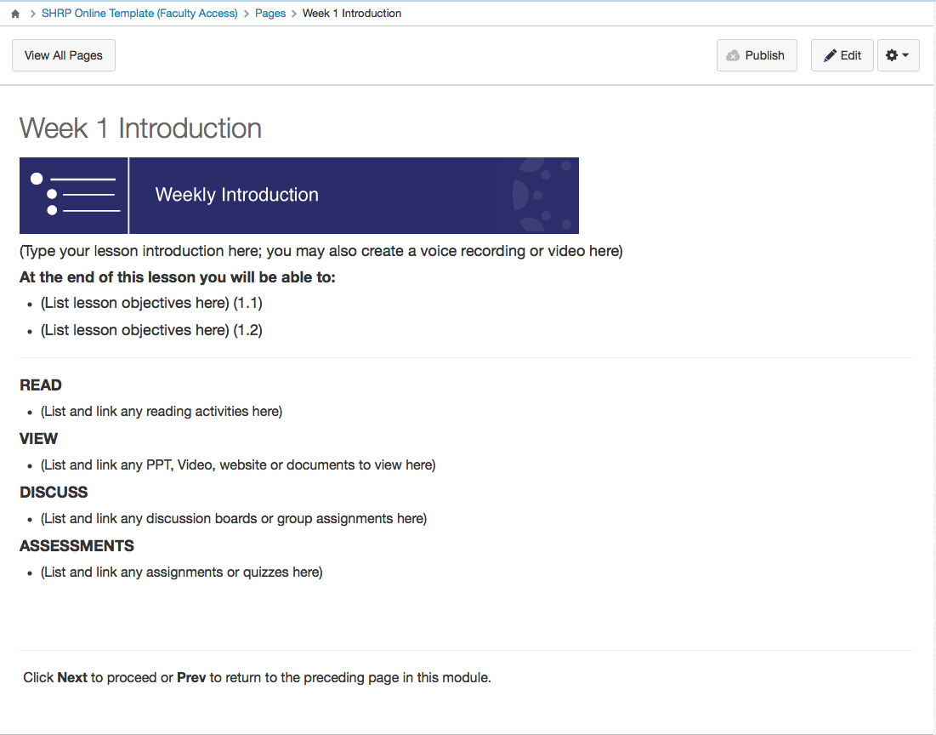
Templating the Module Introduction Page

Slide 8
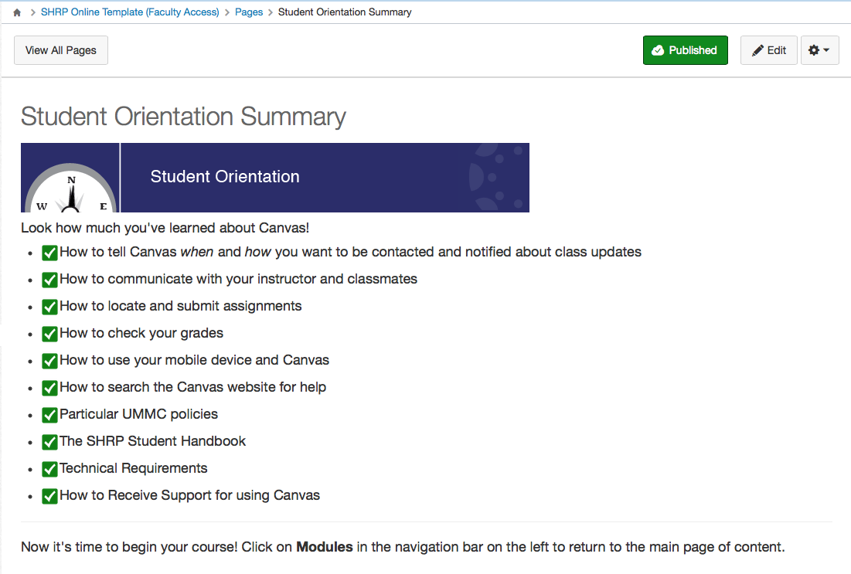
Student Orientation Snapshot

Slide 9
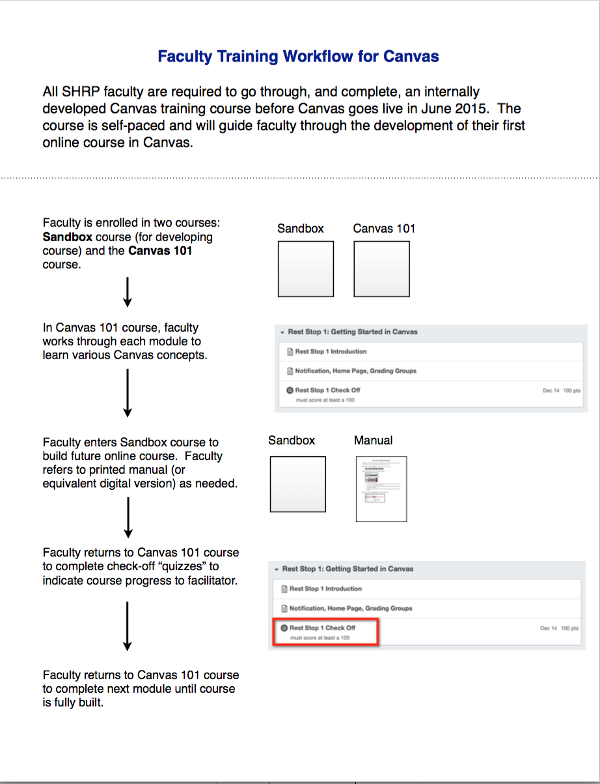

Slide 10
Faculty Encouragement Tip #1
Capitalizing on frustrations with current LMS
  Blackboard Gradebook was confusing -→ Canvas Gradebook simple
  Blackboard Calendar not functional -→ Canvas Calendar highly functional
  Blackboard clutter in program course design -→ New Canvas template coming

Slide 11
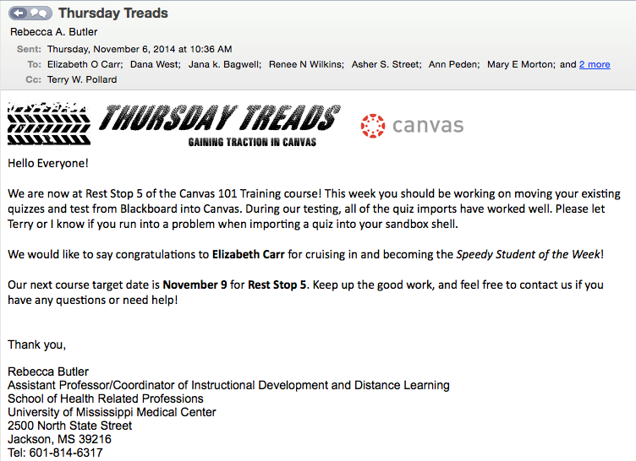
Faculty Encouragement Tip #2
Recognition of “speedy” faculty in Thursday Tread email.

Slide 12
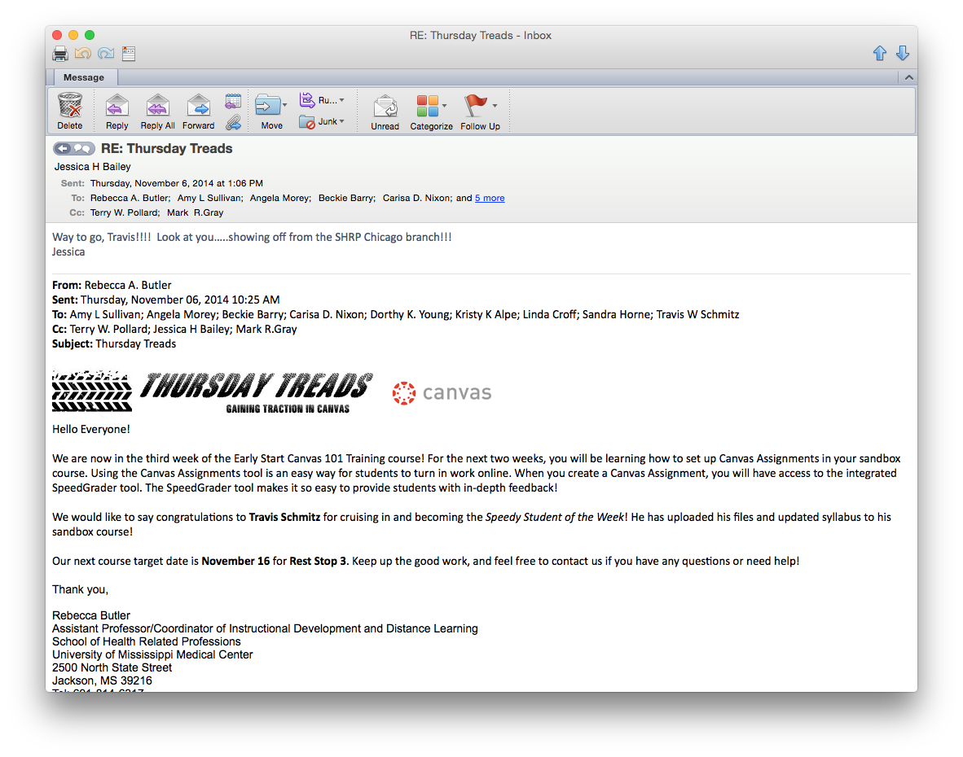
Faculty Encouragement Tip #3
Support from Administration

Slide 13
Faculty Encouragement Tip #4
Completion of Canvas 101 leads to QM review process.

Slide 14
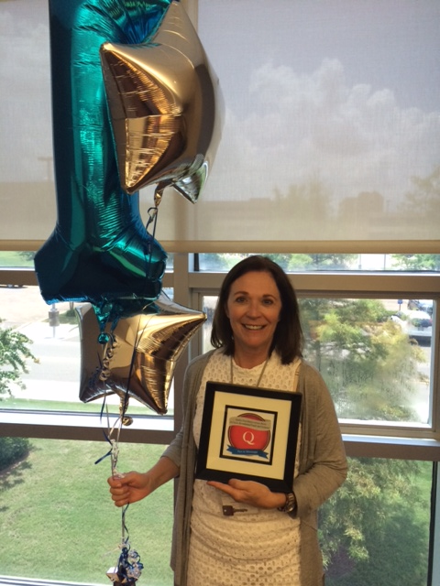
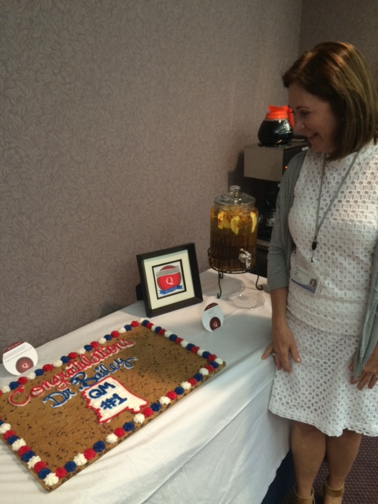
First QM Course Review

Slide 15
Sources
https://hdwallpapers.cat/faq_hd-wallpapers/
https://www.umc.edu/uploadedImages/UMCedu/Content/Business_Services/Public_Affairs/Image_Galleries/batson2.jpg
http://olemiss.photoshelter.com/gallery-image/Best-of-Ole-Miss/G0000b.1RsitY65o/I0000DZqsRJART3I
https://www.flickr.com/photos/nika/122095014

