Slide 1

True Confessions
5 Things I Did Wrong Managing Our QM Program
“Learn from the mistakes of others…you can’t possibly live long enough to make them all yourself!”
~ Samuel Levenson
Alissa Sells | #qmconf2016 | #qm5mistakes | @WAeLearning

Slide 2
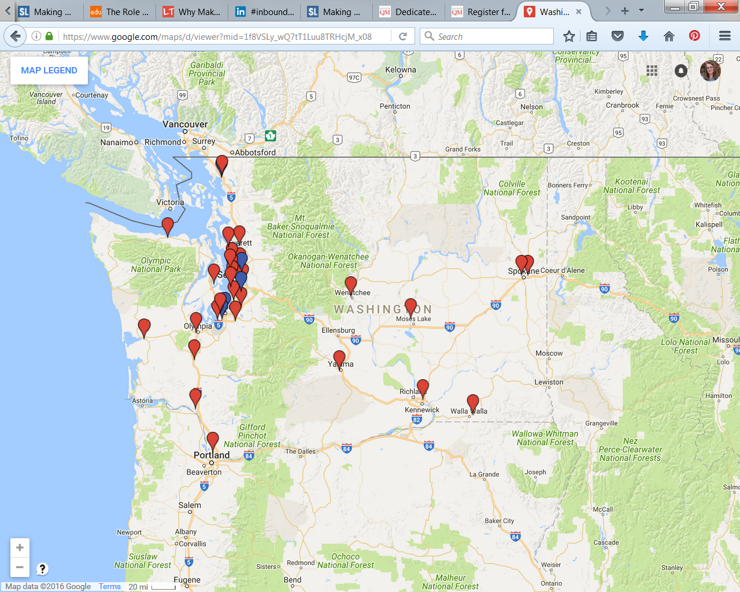
About my system
34 WA CTCs
Notes:
Who am I?
My name is Alissa Sells
I come from a system of 34 Community & Technical Colleges
I am a Program Administrator for the Office of eLearning & Open Ed at the Washington State Board for Community & Technical Colleges (WA SBCTC)
I am the System Lead QM Coordinator (QMC)
I am a QM peer reviewer
I am a former Instructional Technologist & eLearning Designer
I am a former campus QM Coordinator (QMC)
I am a former adjunct instructor

Slide 3
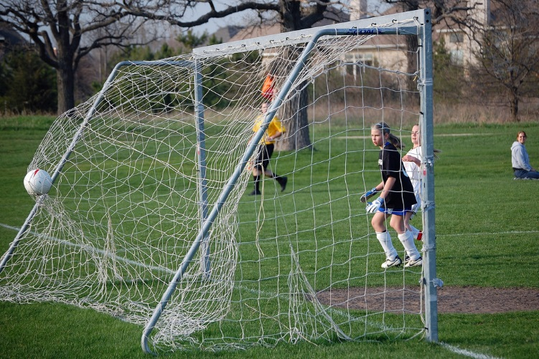
Session Objectives
Notes:
Embrace failure as a mechanism for success
Share program management challenges and lessons learned
Begin drafting an action plan
Today I’m going to share the mistakes I made managing our QM program and my strategies for correcting them
I’ll also ask you to share about some of the program management mistakes you may have made
And we’ll wrap up by having you start drafting an action plan of your own
If there is one thing I’ve learn from QM, it’s that there is always room for continued learning and improvement.

Slide 4

Failure is a Seed for Growth
Notes:
It helps you reset your perspective
It humbles you
It creates aha moments
It creates change
It creates opportunity for success

Slide 5
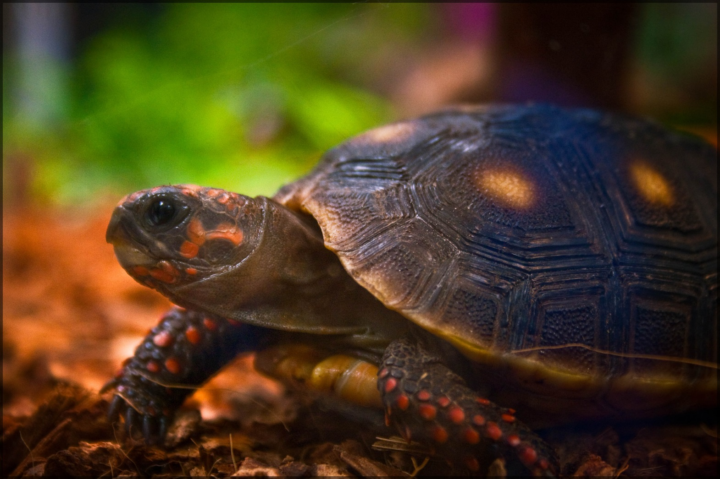
Mistake 1:
Being Slow to Engage
Notes:
I inherited our QM program from a colleague who had done great work launching it in 2008
I was new to my position & new to being a system level QMC
I had been a QMC before but had not accomplished much
I was given other high priority work that absolutely had to be put first

Slide 6

Solution:
Focus Yourself
Notes:
To get focused, ask yourself “what do I really want to accomplish”?
That question helped pinpoint my challenges
I had to admit that I was making mistakes and decide to learn from them

Slide 7
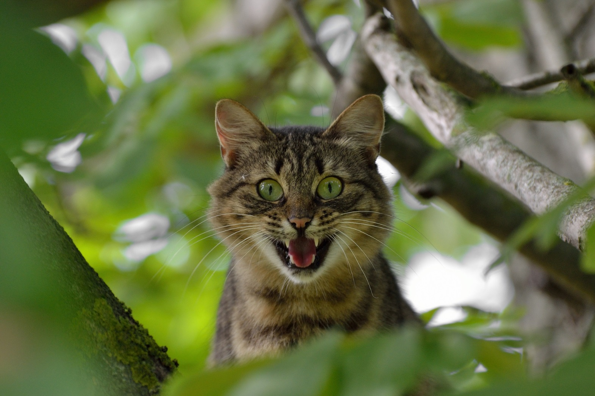
Mistake 2:
Fearing the Unknown
Notes:
Too many “what if’s” prevented me from taking action
You have to embrace the unknown
I finally realized that I didn’t have to have an answer for everything
There are some things you just have to learn and discover along the way
Doing nothing is a choice…if you venture nothing, you gain nothing

Slide 8
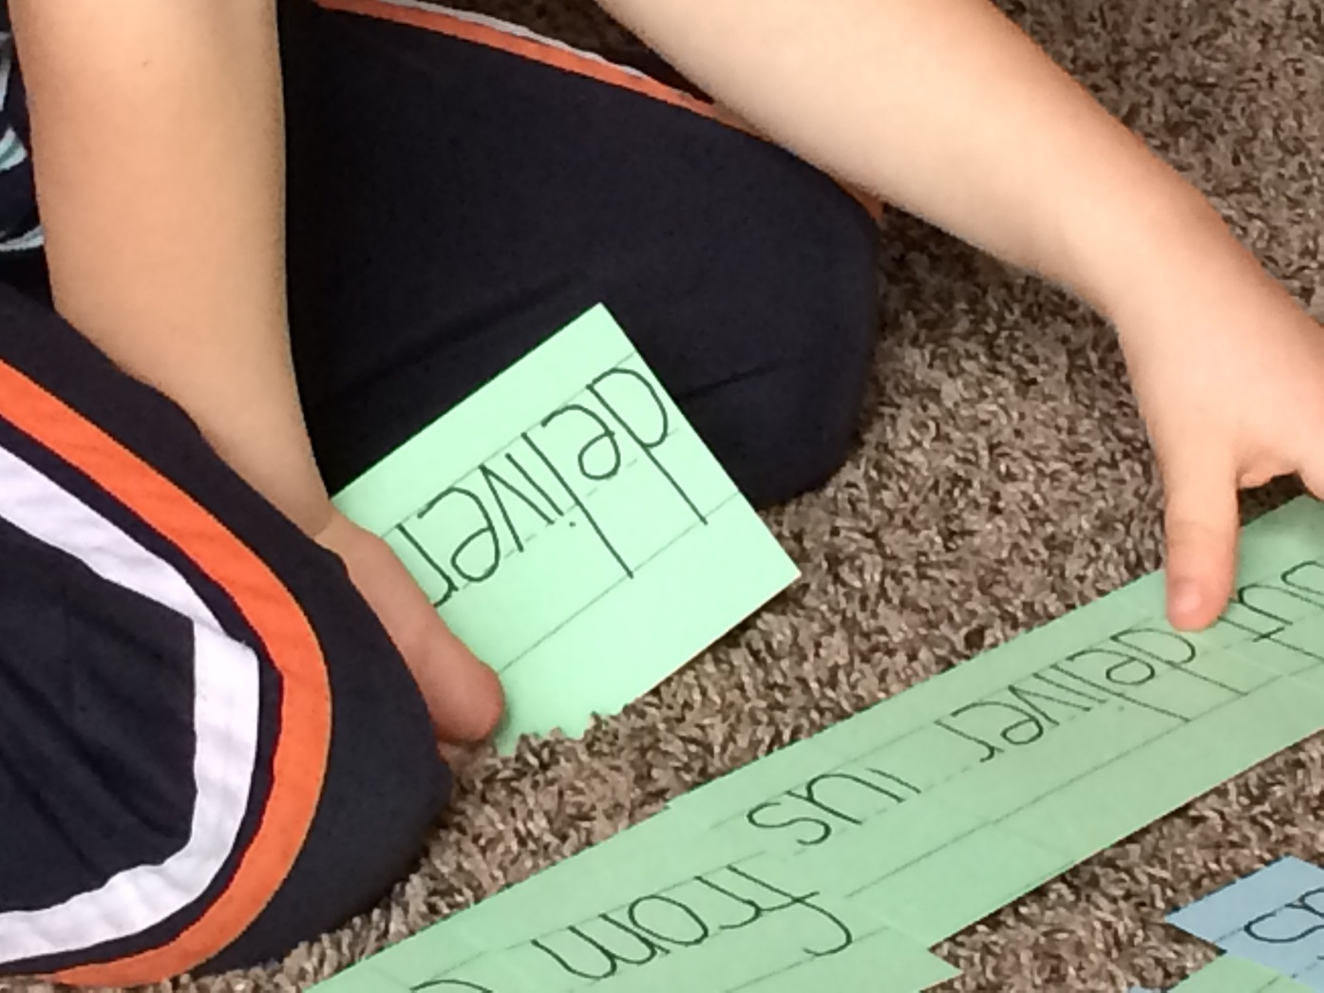
Solution:
Do your Homework
Notes:
Ask questions
Talk to people
Investigate what your system, colleges, or faculty need/want
This piece is a work in progress
We recently launched a system survey to help determine our needs
Identify and understand your audience
Who was I trying to reach…my QMCs, college leadership, faculty, staff???
Make comparisons
I looked for other QM systems or programs to use as models
Participate in QM training
Having first hand knowledge gave me expertise & helps me confidently answer questions

Slide 9

Solution:
Take action - just do it!
Notes:
Jump in with both feet
Recognize that is doesn’t matter so much what you do, just do something, ANYTHING to get yourself started
I asked myself, what can I do to get started?
I started by hosting regular QMC meetings…it was FREE, only took 1-2 hours of time per month and helped build our QMC community
After that, I asked myself, what can I do next?

Slide 10

Solution:
Embrace your Failures
Notes:
Realize it’s ok to make mistakes
Did you know that Edison repeatedly failed at inventing a successful incandescent lightbulb but he never gave up, saying "I have not failed. I've just found 10,000 ways that won't work.“
Stop fearing failure
If I had an idea, I shared it and then tried it…what was the worst that could happen…I’d fail…so what! And, if I failed, I’d try again
Resilience & learning from my mistakes are the keys to my success
To help you learn from your mistakes, ask yourself…
What was my mistake?
What did I do well?
What can I do better next time?
What did I learn from my mistake?
ACTIVITY
Let’s pause here for a quick activity.

Slide 11
MAKE A CONNECTION
Can you recall an unexpected success that resulted from a mistake (or mistakes!) you've made managing your own QM program or in another situation?
Think about what you did well, what you could have done better and what you learned from that mistake.
Share your “successful” mistake and what you learned with a partner.
Online participants please participate via the Collaborate chat.

Slide 12
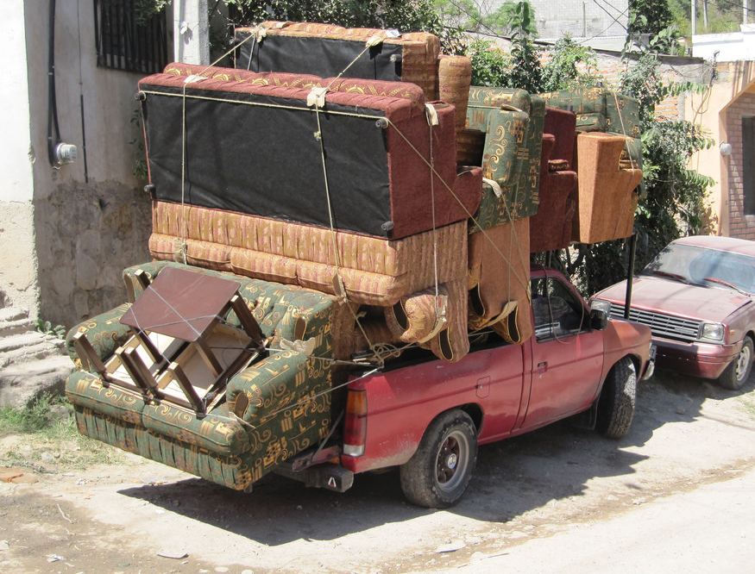
Mistake 3:
Overloading Myself
Notes:
I was overloaded with high-priority projects with aggressive deadlines and was completely overwhelmed by my workload
It took me a year and a half before I could do more than just keep our QM program afloat
I had to change my attitude and reprioritize my work…it was all important but lacked balance
I think I can... I think I can….

Slide 13
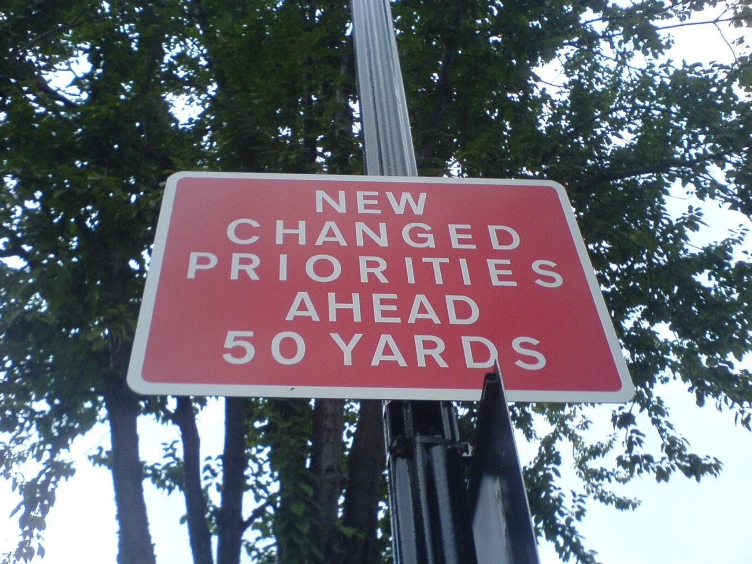
Solution:
Make it a Priority
Notes:
Evaluate your projects & work flow
I needed to create balance in my workload
I decided to set aside dedicated time & commit to getting things done
My biggest change was focusing long-term vs. short-term, QM was mine long-term but my other projects would come & go
Ask for help & delegate tasks
Are there areas where you can delegate to help free up time to do other things?
Is there anything that can wait?
Can you share the QMC role with a colleague?
I started thinking about ways others might be able to help

Slide 14
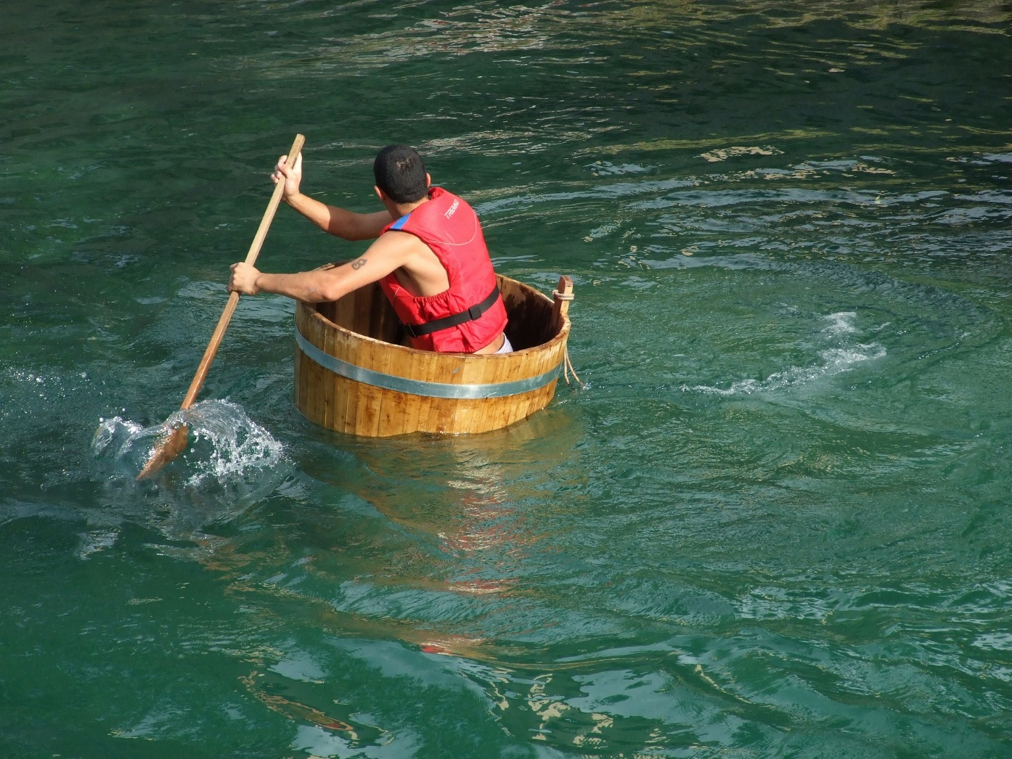
Mistake 4:
Working in Isolation
Notes:
I was spinning in circles trying to keep our program afloat

Slide 15
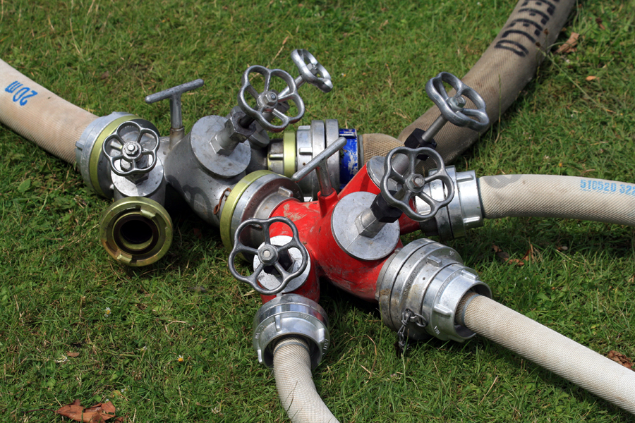
Solution:
Get Connected
Notes:
Go Places, See People, Network & Share
Attend a national QM conference
This is my second national conference
Present at a regional QM conference
I invited the people in my state to attend a System meeting at the NW Regional QM Conference
Present at local or system conferences to promote the work you’re doing
My group of IYOC facilitators traveled to two prominent in-state conferences and presented about our new system facilitated IYOC & APPQMR training
Connect your faculty, college or system…here are some things I did this year:
September 2015 I started hosting monthly QMC meetings
Meetings could be held quarterly instead or even as an annual retreat
I coordinated our system training efforts by purchasing an IYOC license & offering free IYOC & APPQMR training to our system…previously this had been done individually and randomly by each college
I began communicating regularly about QM training opportunities via our system listservs
I built a QM Coordinators classroom in our LMS where my QMCs could quickly access things they needed
I have started sending out orientation materials to new QMCs
We are hosting an optional Goodreads book review for our QMCs using the book Effective Online Teaching by Tina Stavredes, this is the same book QM is using for their new Teaching Online Certificate
I am considering hosting a QM focus group retreat this year
I think a newsletter would be a great idea too

Slide 16
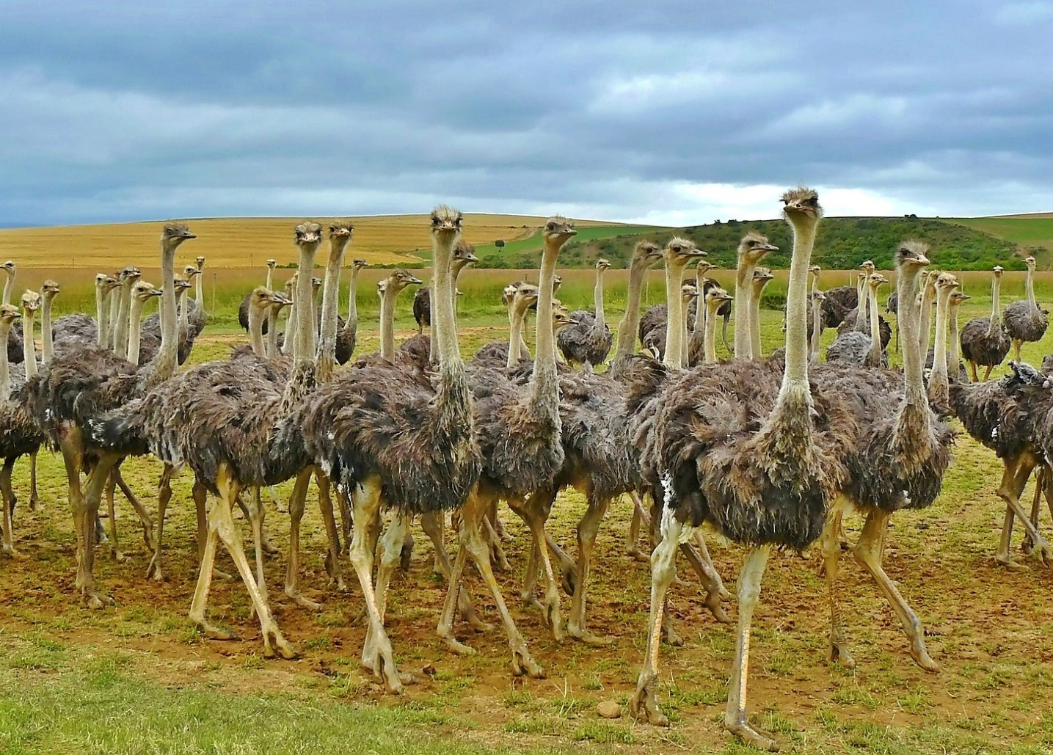
Solution:
Build a Community
Notes:
Identify your QM Enthusiasts
Look around and identify like-minded individuals & supporters
Align with people that have the right skills and vision…sometimes the right skill is simply being a support or being willing to lend a hand
Leverage your existing QM leaders and supporters
Include everyone you possibly can!
I am VERY lucky to have found a core group of enthusiasts to work with and I couldn’t have done any of this without them!

Slide 17
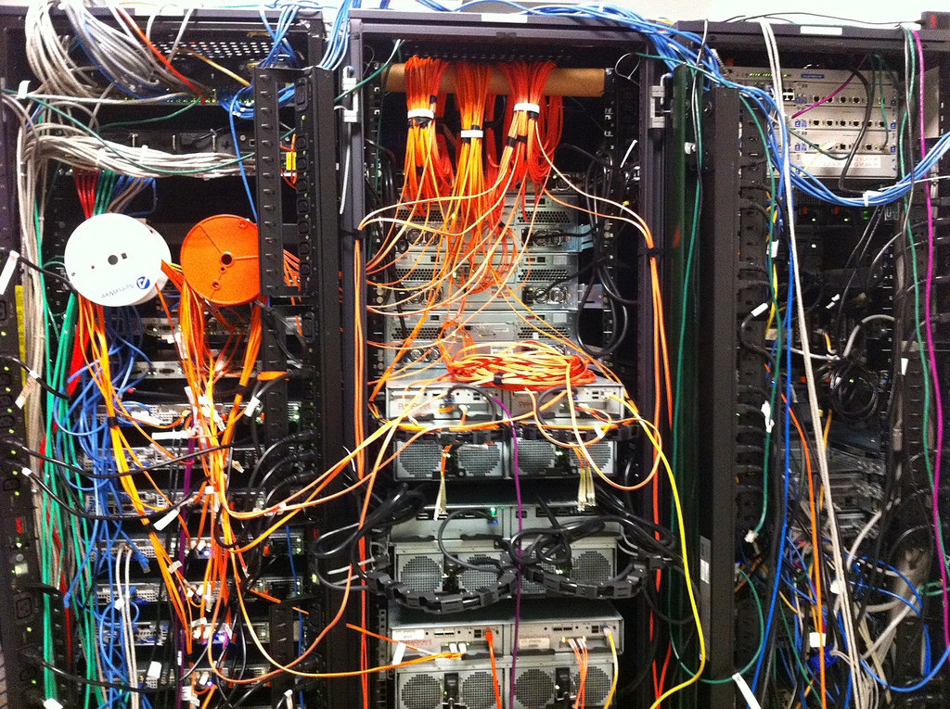
Solution:
Build a Network of QM Peers
Notes:
QMC Lead Retreats…this was the CATALYST & I cannot thank QM enough for hosting these!
I've attended 3 retreats…. (2014, 2015 & 2016)
Helped organized a QMC Dinner at the 7th Annual Conference (2015)
Helped organize a QMC Dinner at this conference (2016)
Keep in contact with your network between events
I extended invitations to other systems to present at our system QMC meetings
I extended invitations to QM to present at our system QMC meetings
I shared information by phone, email, Basecamp & our quarterly System Lead QMC meetings
Participate in QM events
I presented at our regional NW QM Conference
I served on the 8th Annual QM Conference Planning Committee
I chaired a Conference Planning Sub-committee
I participated in IYOC training
I participated in several official course reviews this year
I have been asked to serve as Co-Chair on the 9th Annual Conference Planning Committee

Slide 18

Mistake 5:
Lacking Direction
Notes:
I had some ideas but I had no defined QM goals and no direction
It was all open road with no destination
Hoping to arrive somewhere is not a strategy!

Slide 19

Solution:
Set Goals & Prioritize
Notes:
Look at the big picture & map your goals
Without goals, you have no direction
With too many goals you can lose focus
Identify your system, institutional and/or personal objectives
I wrote up a list of Growth Strategies for the year (yes, I’ll share it!)…writing this document helped me process what needed to get done and what I wanted to accomplish during the year
I just updated the document for the 2016-17 academic year (yes, I’ll share this one too!)

Slide 20
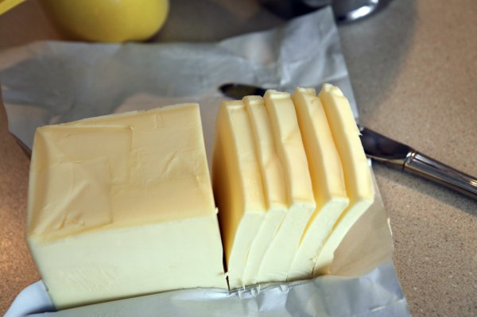
Solution:
Chunk it Down
Notes:
Break tasks down into manageable chunks or bite-sized pieces…what can you reasonably accomplish in the time you have?
I decided to start by hosting monthly QMC meetings to connect our QMC community
After that I started working on coordinating our training efforts…the next step was purchasing an IYOC license to offer system facilitated training
We’ve trained 300+ participants in our system facilitated IYOC & APPQMR workshops since January 2015
Small forward progress is better than no progress at all
Take baby steps & scaffold your achievements
Let momentum build by accomplishing many smaller tasks that add up to real change or real improvements over time
Create an action plan to organize & evaluate your tasks

Slide 21
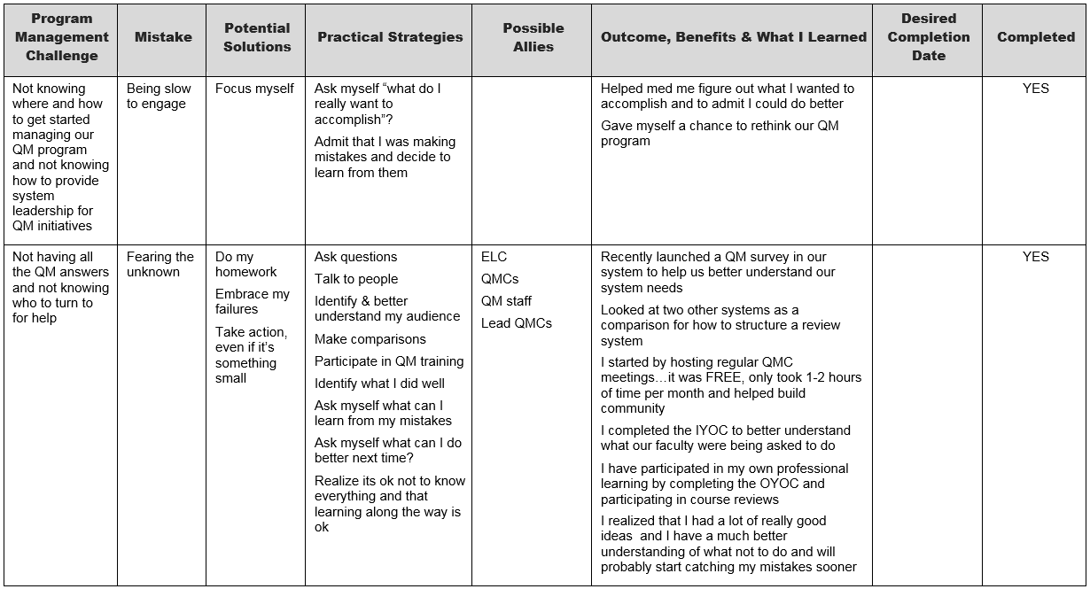
Action Plan Example
Notes:
Here’s an example of my action plan.
ACTIVITY
Let’s wrap up with a quick activity to get you started on drafting your own action plan.
Please note that all of my work is licensed under a Creative Commons 4.0 CC-BY so you may take it and adapt it to your own needs as long as you attribute me as your source.

Slide 22
MAKE A PLAN
Take a few minutes and consider what program management issues you may currently be facing. Think about any mistakes you might be making and brainstorm some possible solutions & strategies.
Using the handout provided, start drafting an action plan for one of the program management challenges you face.
Share your action plan with a partner.
Online participants please participate via the Collaborate chat.

Slide 23

Celebrate your success!
Notes:
Remember to celebrate your success no matter how big or small it is.

Slide 24

Thanks!

Slide 25

Alissa Sells asells@sbctc.edu
@WAeLearning
425.239.0456
Unless otherwise specified, this content is licensed under a Creative Commons Attribution 4.0 License.

Slide 26
Image Attributions (in slide order)
"This work" by bohed is in the Public Domain, CC0 (girl in hat)
“Google Map of 34 CTCs in Washington” (map)
"Goal" by Keith Miner is licensed under CC BY-SA 4.0 (soccer goal)
"Seedling" by US Department of Agriculture is licensed under CC BY 2.0 (seedling)
"Turtle" by Scott McCallum is licensed under CC BY-SA 2.0 (turtle)
"Day 077 - Photo365 - Glasses" by Makia Minich is licensed under CC BY-SA 2.0 (glasses)
"This work" by White8ManART is in the Public Domain, CC0 (fearful cat)
"This work" by organicmom30 is in the Public Domain, CC0 (homework)

Slide 27
Image Attributions (in slide order)
"More often than not" by Kreg Steppe is licensed under CC BY-SA 4.0 (lightbulb)
Activity Directions - No image
"This work" by 41st Field Artillery Brigade is licensed under CC BY 2.0 (splash)
"Overloaded" by Sam Leppanen is licensed under CC BY 2.0 (truck)
"Priorities" by Banalities is licensed under CC BY 2.0 (priorities)
"This work" by 99pixel is in the Public Domain, CC0 (barrel)
"This work" by Luekk is licensed under CC BY-SA 3.0 (hose splitter)
"This work" by cocoparisienne is in the Public Domain, CC0 (ostriches)

Slide 28
Image Attributions (in slide order)
"Servers" by Alex is licensed under CC BY 2.0 (server room)
"This work" by polettix is in the Public Domain, CC0 (open road)
"Stay on Target" by Pete is in the Public Domain, CC0 (archery target)
"hunk o butter" by Gail is licensed under CC BY 2.0 (butter)
"Alissa's Action Plan Example" by Alissa Sells is licensed under CC BY 4.0
Activity Directions - No image
"This work" by StartupStockPhotos is in the Public Domain, CC0 (success)
"Show us your smile" by Ben Smith is licensed under CC BY-SA 2.0 (happy hand)

