Slide 1
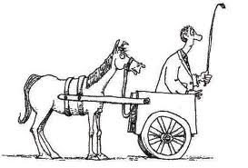
Trying to get the Horse in Front of the Buggy

Slide 2

What we had
Segmented management
Isolated QM standard focus
Misunderstandings
Missing essential elements

Slide 3
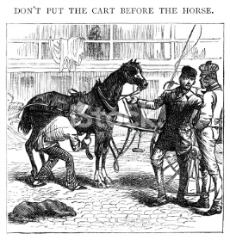
What was needed
Re-education of administration
Needs analysis
Practical plan

Slide 4
Original Proposal in 2014
Prioritizing the standards
Developing timelines

Slide 5
Picking the standards
Alignment: “Critical course elements working together to ensure that students achieve the desired learning outcomes” (QM Rubric, 2014, p. 6).
General Standard 2
  “Learning objectives or competencies describe what learners will be able to do upon completion of the course” (QM Rubric, 2014, p. 12).
General Standard 3
  3.1- “The assessments measure the stated learning objectives or competencies” (QM Rubric, 2014, p. 16).

Slide 6

Developing Timelines
Standard 2
  One year/ 3 faculty in-service days (2014-2015)
Standard 3
  One year/3 faculty in-service days (2015-2016)

Slide 7
Into the Future
  Apply standards 4-6 (2016)
    Completes f2f course revision
  Apply the QM rubric comprehensively to online courses (Standards 1-8) (2017)
    Bulk of standards 2-6 completed previously at this point

Slide 8
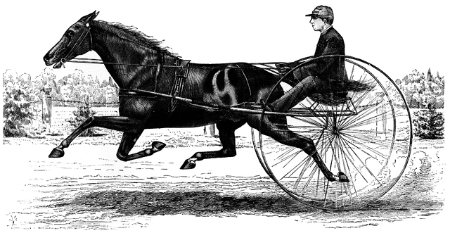
Alignment
Consistency between f2f and online courses
The Horse & Buggy are aligned!!

Slide 9
What changed in 2015?
VP of Academic Affairs offered me a new administrative position- Dean of Online Programs
Shared his vision for the formation of new department
Departmentalized management of virtual college

Slide 10
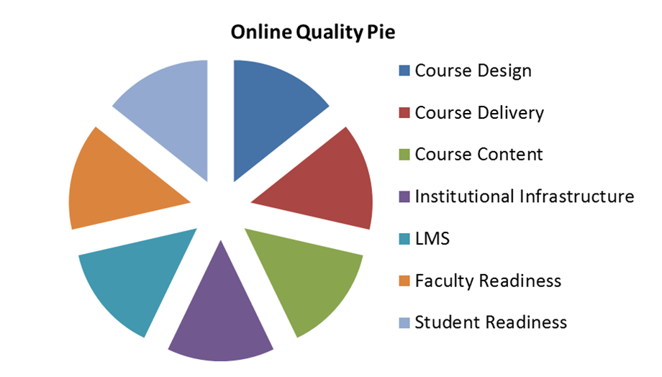
Considerations
© Maryland Online Inc.

Slide 11
Institutional Infrastructure
Formation of new department
  1 curriculum designer
  2 instructional technologists
  1 testing center manager with staff
Departmentalized management of virtual college
  Focus on virtual and hybrid program delivery formats

Slide 12
LMS- Moodle Rooms
Additional URL sites
Utilizing Plugins
  Smarthinking
  Collaborate
  Turnitin
  Kaltura (2016)
  xpLor (2016)

Slide 13
Course Design
Standardized template
  Consistent elements
  Standard weeks & Set weekly due dates
  Pre-designed
Integrating QM (2015-2016)

Slide 14
Course Delivery
Increased Faculty Presence
  Present 5 days per week w/ one weekend day
  Minimum discussion forum participation (2016)
  Weekly office hour (2016)
  Quality feedback (2016)
Increased Accountability
  Weekly announcement
  7 day grading turn-around
  48 response time to student questions/concerns

Slide 15
Faculty Readiness
Opting in
  Full time on-campus faculty
Professional Development Requirements
  QM Design workshops (2015-2017)
  OLC Delivery Workshops (2016-2017)
  UNOH VC Support designed workshops (2015-2017)
  On-going options 2017 +

Slide 16
Course Content
Collaborative faculty/VC Support Dept. effort to revise and refine curriculum (2016)
  Alignment between course and module objectives
  Alignment between assignments and objectives

Slide 17
Student Readiness
Testing Center Orientation
  Proctoring/testing center options
Orientation Course
  Non-credit/free
  Team facilitated
  Noel Levitz CSI (College Student Inventory) component (late 2015)
First year course- first quarter
  For credit
  Team facilitated
Student Support
  Moodle
  New students
  At risk students
  Advising component (late 2015)

Slide 18
Alignment Revisited
Consistency between f2f and online courses
  Shared program goals & course objectives (fall 2015)
How did we get further than originally planned?
  New structure that provided the ability to utilize off campus, part time faculty in collaborative ways and removed online teaching requirements from on-campus faculty
  The Horse is Leading the Buggy!

