Slide 1

Two Approaches to Oral Presentations in Online Classes
Cindy Kenkel, ckenkel@nwmissouri.edu
Joni Adkins, jadkins@nwmissouri.edu

Slide 2

Faculty view of online quality was bleak -- 66% of respondents saying LEARNING OUTCOMES are inferior compared to traditional courses,
and only 6% saying online is superior.
Source: Conflicted Faculty and Online Education
20??

Slide 3
Faculty view of online quality was bleak -- 66% of respondents saying LEARNING OUTCOMES are inferior compared to traditional courses,
and only 6% saying online is superior.
Source: Conflicted Faculty and Online Education
2012

Slide 4
Between 2002 and 2009 the percentage of faculty who viewed
online education as valuable and legitimate has only grown from
27.6 % to ______%.

Slide 5
Between 2002 and 2009 the percentage of faculty who viewed
online education as valuable and legitimate has only grown from
27.6 % to 30.9 %.
Trying to tackle one element we believe
contributes to this dismal view.

Slide 6

Online courses often eliminate
oral presentations from their curricula,
which creates a serious void in a
student’s educational experience

Slide 7


Learning Outcome:
Discuss 2 methods currently being used to
ensure critical competencies, such as ORAL COMMUNICATION SKILLS, are being appropriately included in our online curriculum at Northwest.

Slide 8

How many of you teach a traditional course with a required presentation?

Slide 9

IT Mgt. Business Comm
Rubric
Self/Peer Assessment

Slide 10

Mechanics of this don’t
need to be complicated

Slide 11
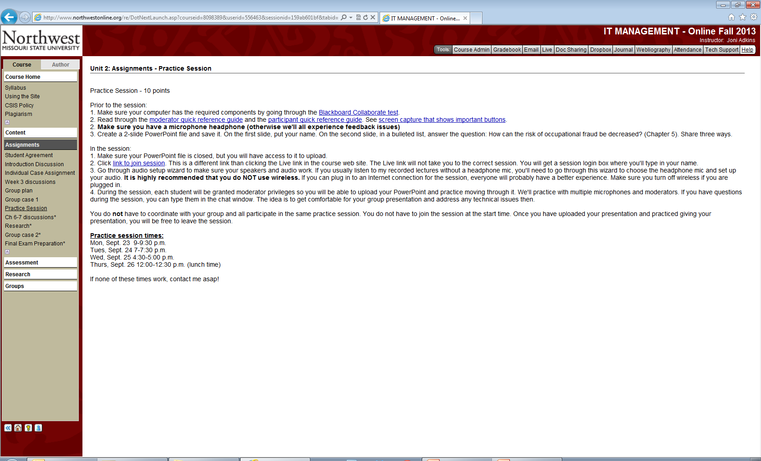

Slide 12
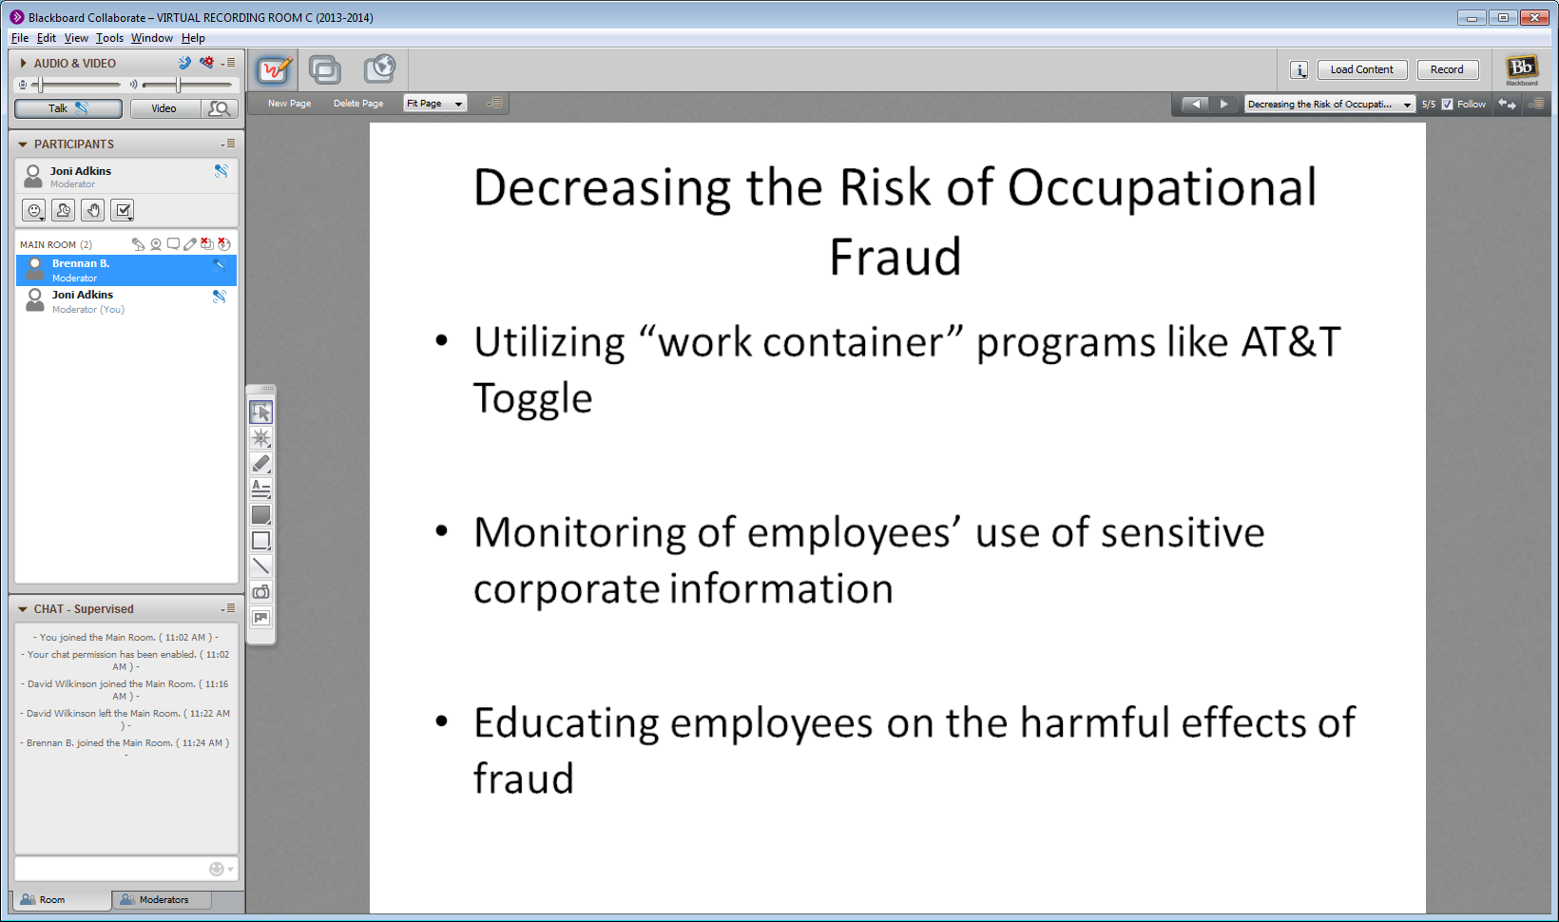
Practice session

Slide 13
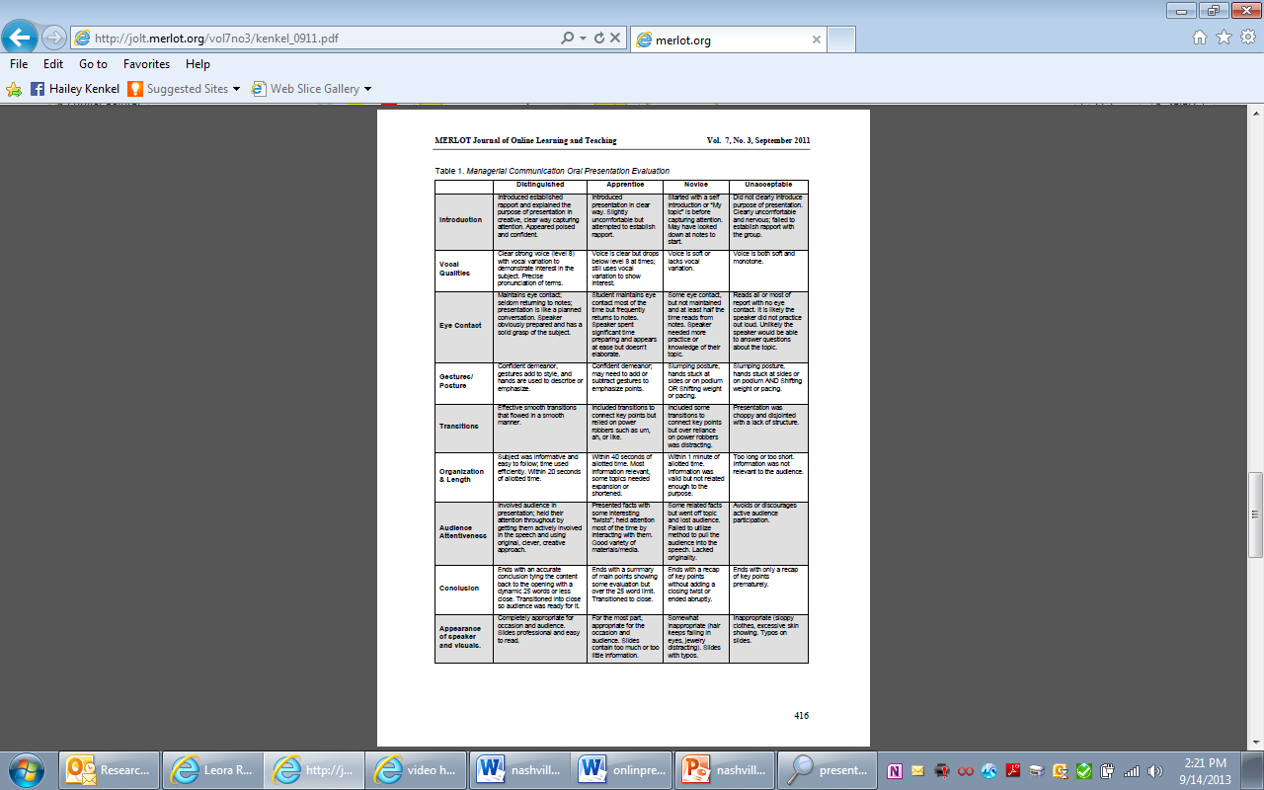

Slide 14

Developmental

Slide 15
IT Management Scoring Guide
Met or exceeded the required number of references. References are from reliable, current sources. It is evident that group members did research to find solid articles. | 5
Included internal citations in notes pages or on the slides. Listed all references in ABC order using correct APA format on slides at the end of the presentation. | 4
Thorough notes pages with details not written on slides. The notes pages provide enough details to replace what would normally be written in a paper. The notes pages are not copied/pasted from a web site or article. The person(s) responsible for a particular slide’s notes pages should include their name(s) in the notes pages. | 8
The opening slide of your presentation has the case title and all presenter names. | 1
There is an appropriate introduction to the presentation that would capture the interest of your audience. In addition, a short overview of the presentation should tell the audience what to expect. | 3
There is an appropriate conclusion to bring together the material presented or to leave a lasting impression. This should not be “In this presentation, we told you….” | 3
Content of case goes beyond case and textbook material and incorporates recent business and/or research information. Presentation answers at least some of the questions posed in the case or presents other more pertinent information (if questions are deemed out of date after doing current research). | 10
Presenters do not read from notes pages. Presenters speak clearly and confidently about their material. | 3
Presenters are able to use technology to present their presentation and handle any difficulties in a professional manner. | 3
Total | 40

Slide 16
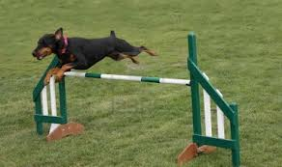
Technology Limitations
No Audience
Obstacles

Slide 17
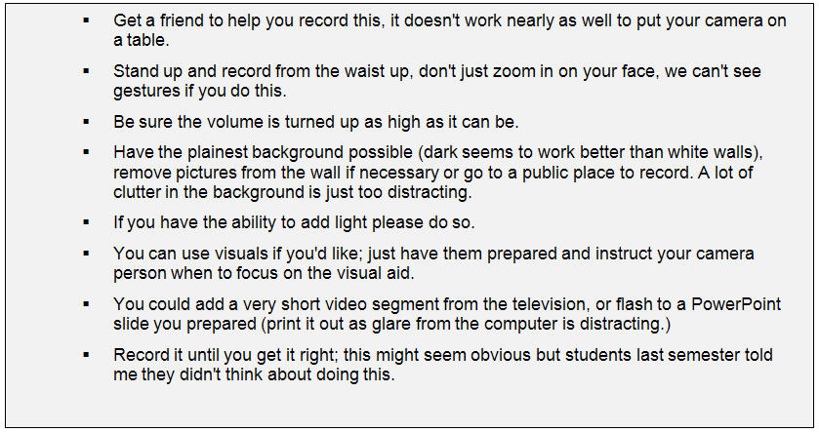
Recording tips

Slide 18
Student Feedback – Bus. Comm.
“Overall I enjoyed the class. I learned the same, if not more than I would have learned in a traditional classroom setting and I think it made it easier to do speeches not having 20 eyes staring at you while you prepared and gave your speech.”
“I also did not like giving a presentation to a camera rather than a classroom, but I was glad that you had us give a presentation rather than not do any at all.”
“I really enjoyed the presentations this summer because we weren't pressured to talk about a certain subject and I think that helps gain confidence in your public speaking skills. It was also a very easy task because the cameras were very easy to work with. I would highly recommend using that same tactic with future online courses.”

Slide 19
Student Feedback – IT Mgt.
“Overall, I think that the virtual presentations are a great way to practice presentations for an online class. With more and more businesses going to virtual presentation I feel that this is a great way to prepare for the real world.”
“I think every online course should has virtual presentations. The future of business is not face to face.”

Slide 20


Where to park the video?

Slide 21

As online courses continue to be scrutinized for quality
Our View:
Important Learning Outcomes such as practicing oral presentations can no longer simply be overlooked or eliminated from the curriculum because it appears too difficult or cumbersome to integrate into the online class.

Slide 22
To learn more:
Kenkel, C. (2011). Teaching presentation skills in online business communication courses. MERLOT Journal of Online Learning and Teaching, 7(3), http://jolt.merlot.org/vol7no3/kenkel_0911.htm
Adkins, J. (2013). Virtual Teams and Synchronous Presentations: An Online Class Experience. Information Systems Education Journal, 11(4), 61-65. http://www.isedj.org/2013-11/N4/ISEDJv11n4p61.html

