Slide 1
Herding Cats: The Initial Roundup
Debbie Beaudry, Ph.D.
Debbie.Beaudry@Rutgers.edu
Joy McDonald
joymcd@rutgers.edu
Academic Technology Services

Slide 2
Objectives
Identify techniques for delivering professional development for designing online courses
Identify methods for evaluating faculty development programs

Slide 3
Context
Rutgers University
  Three campuses
  65,000 students and 9,000 faculty members
  Four learning management systems
Rutgers University-Newark
  12,000 students and 585 faculty members
  Blackboard learning management system

Slide 4
Classes in Blackboard
Spring 2014
Face-to-face: 1,430
Hybrid: 15
Online: 30

Slide 5
Quality Matters at Rutgers
Adopted in spring 2013
Some units developing course with QM focus
No courses have been through the formal QM review process

Slide 6
Our evaluation of professional development
Former methods
Current method
“Identifying several methods and metrics as a starting pointing for determining impact, although perhaps not the ideal, is of far greater worth than waiting to “get it perfect.” (Ragan & McQuiggan, 2014, p.97)

Slide 7
Designing Quality Online Courses (DQOC)
Goals
  Build a shell course based on selected QM standards
  Experience online course as a student
  Model QM-based course design
Format
  Nine weeks
  Completely online
  Offered through Blackboard

Slide 8
Pair & Share
What types of faculty development programs for QM…
Do you have?
Would you like to have?

Slide 9
Research questions
After participating in the Designing Quality Online Courses (DQOC) faculty development program, what do participants apply from the program when they design an online course?
What are the differences in what is applied from the DQOC program between participants who receive a stipend and participants who do not receive a stipend?
What are participants’ perceptions of the effectiveness of the DQOC program?

Slide 10
Data points
Pre-survey
Post-survey
Course review protocol
Interviews

Slide 11
Designing Quality Online Courses (DQOC)
Review course content
  Modified copy of course and research instruments available on Blackboard to guests
  To access: http://tinyurl.com/nsdbhs2
Examine method used to evaluate course effectiveness
Review preliminary results of study

Slide 12
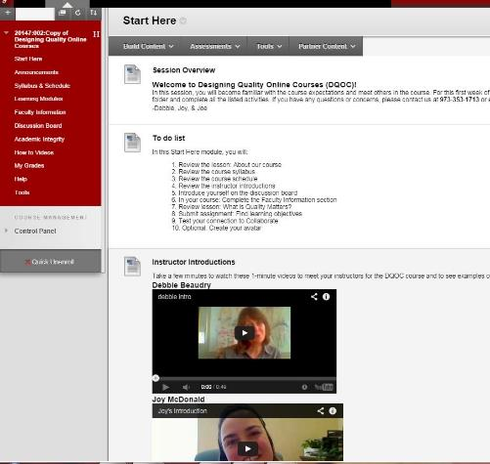
Start Here

Slide 13
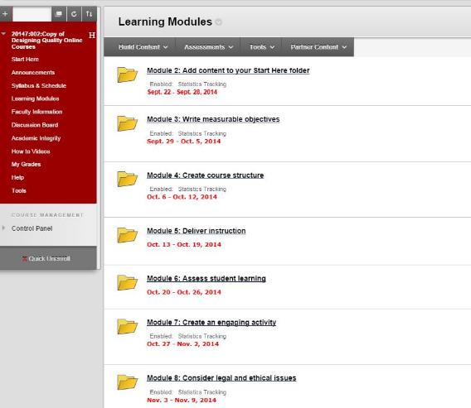
Nine Modules

Slide 14
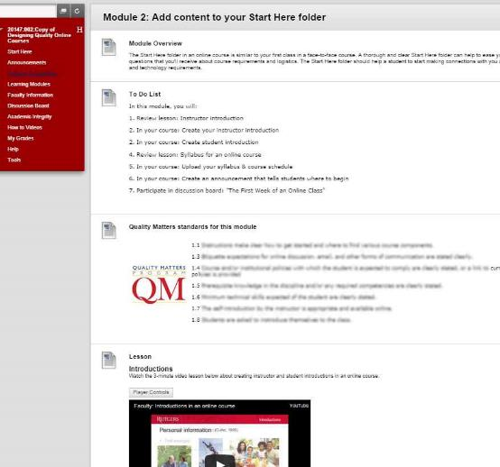
Module content

Slide 15
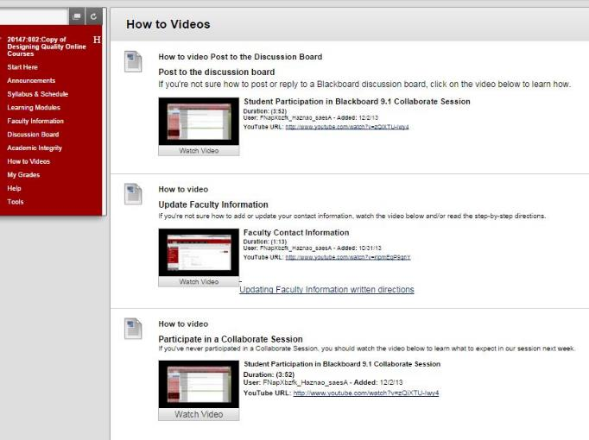
How to Videos

Slide 16
How to Measure Effectiveness of PD?
Calls for more rigorous evaluation of professional development in higher education.
  Brooks, Marsh, Wilcox, & Cohen, 2011
  Kucsera & Svinicki, 2010
Existing models suggested measuring program’s impact at a series of levels
  Guskey, 2000
  Kirkpatrick, 1994

Slide 17
Quality Transformation Faculty Development Assessment Framework (Ragan & McQuiggan, 2014)
Step 1: Participation metrics
Step 2: Faculty input & satisfaction metrics
Step 3: Attitude and knowledge metrics
Step 4: Instructor performance metrics
Step 5: Student performance metrics
Step 6: Return on investment metrics

Slide 18
Pair & Share
How do you measure the effectiveness of your professional development?

Slide 19
Step 1: Participation Metrics
Number of participants
  Ten course participants
  Nine study participants
  Seven reported part of stipend program
Study participant status
  Full time faculty = 43%
  Part-time faculty = 43%
  Graduate assistant = 14%

Slide 20
Step 1: Participation Metrics
Online teaching experience
  57% never taught completely online
  43% taught hybrid course
  14% taught a course that was completely online
Online learning experience
  43% took a completely online course
  43% took a hybrid course
  29% never took an online course before

Slide 21
Step 1: Participation Metrics
Eligible for compensation for participation & designing
  78% reported eligible for compensation
  22% no compensation
Completed or not completed DQOC course
  66% completed
  34% did not complete
Completion of compensated vs non-compensated participants
  71% compensated participants completed
  50% non-compensated completed

Slide 22
Step 2: Faculty Input & Satisfaction Metrics
Course content met my needs to design an online course
  83% strongly agreed
  17% agreed
Course assignments applied directly to design of my course
  83% strongly agreed
  17% agreed
I found the DQOC Blackboard course site easy to navigate
  50% strongly agreed
  33% agreed
  17% disagreed

Slide 23
Step 2: Faculty Input & Satisfaction Metrics
Content was appropriate for my level of technical expertise
  50% strongly agreed
  50% agreed
Weekly discussion board was an important part of my learning
  17% strongly agreed
  83% agreed
I would recommend this course to a colleague
  83% strongly agreed
  17% agreed

Slide 24
Step 3: Attitude & Knowledge Metrics
 | Needs Improvement | Meets Expectations | Exceeds Expectations
Quality | The majority of the course objectives are NOT measurable | The majority of the course objectives are measurable | All course objectives are measurable
Quantity | Lists 1 course objective | Lists 2-3 course objectives | Lists more than three course objectives

Slide 25
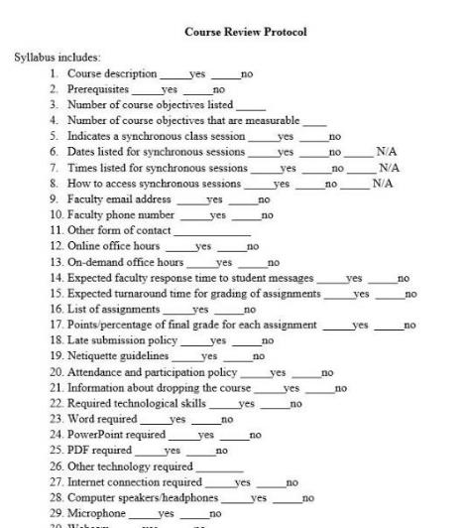
Step 4: Instructor Performance Metrics
Analysis of components
  Compared course to 82-point protocol
  Tallied 43 possible points
One week after DQOC course completed
Six months after course completed

Slide 26
Results by Stipend Status

Slide 27
Results by Completed vs. Not Completed

Slide 28
Step 5: Student Performance Quality Assurance Techniques and Metrics
Step 6: Return on Investment Quality Assurance Techniques and Metrics

Slide 29
Pair & Share
What pieces of this course/evaluation method can you apply to your setting?

Slide 30
Quality Transformation Faculty Development Assessment Framework (Ragan & McQuiggan, 2014)
Step 1: Participation metrics
Step 2: Faculty input & satisfaction metrics
Step 3: Attitude and knowledge metrics
Step 4: Instructor performance metrics
Step 5: Student performance metrics
Step 6: Return on investment metrics

Slide 31
References
Brooks, D. Christopher, Marsh, L., Wilcox, K., & Cohen, B. (2011). Beyond satisfaction: Toward an outcomes-based, procedural model of faculty development program evaluation, Journal of Faculty Development, 25(3), 5-12.
Guskey, T.R. (2000). Evaluating professional development. Thousand Oaks, CA: Corwin Press.
Kirkpatrick, D. L. (1994). Evaluating Training Programs: The Four Levels. San Francisco: Berrett-Koehler.
Kucsera, J., & Svinicki, M. (2010). Rigorous evaluations of faculty development programs. Journal of Faculty Development, 24(2), 5-18.
Ragan, L.C. & McQuiggan, C.A. (2014) A model for determining the effectiveness and impact of faculty professional development. In K. Shattuck (Ed.), Assuring quality in online education (pp. 91-109). Sterling, VA: Stylus Publishing.

