Slide 1
Using a Faculty Learning Community to Take the Next Step
Or, “How to overcome the paralyzing fear of a formal QM Review”

Slide 2

The Challenge
Over 140 Faculty completed APPQMR
ZERO took the next step
Fear? Time? Lack of Understanding?

Slide 3
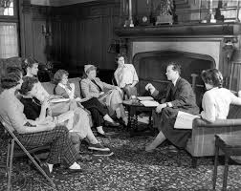
The Concept
Give them Time and Community
Create Structure
Apply the FLC Model
Compensate for Achievement

Slide 4
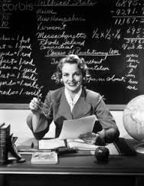
The Requirements
Attend 8 of 12 Workshops
Conduct a Self-Review
Participate in Pair/Share Mini-Review
Complete Course Worksheet
Submit Workshop Evaluation

Slide 5
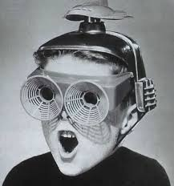
The Schedule
Two Options:
  Monday Afternoon
  Thursday Morning
Begin with Standard 2
Move to Standard 8
Follow with Standards 1, 3, 5, 6, & 7

Slide 6
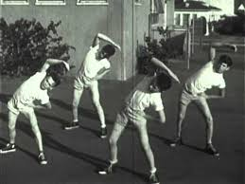
Typical Agenda
Review of Each Specific Standard
Examples of “Met” or “Not Met”
Discussion of Alternatives to Meet Standards
Online Research
Hands on Activity

Slide 7
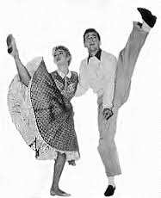
The Materials & Activities
QM Materials
  Helpful Recommendations
  Laminated Bloom’s
  Professor Dancealot
Activities
  Pair/Share of Standard 4
  Write test items for each Bloom’s Level
  Outcome/Assessment Challenge
  Document Styles for Accessibility

Slide 8
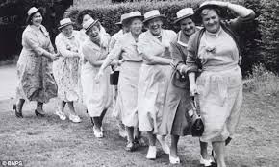
The Results
9 of 12 Completed the Requirements
2 classes completed “Informal Review”
3 Instructors Committed to Formal Review
1 Currently under Formal Review

Slide 9
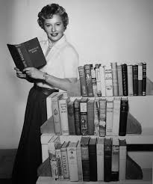
Feedback from Participants
All respondents reported that:
  Participation in the FLC significantly built their confidence in course design.
  They are likely to recommend this FLC to their colleagues.
75% of respondents:
  would repeat the FLC next year to revise another hybrid or online course.
  plan to submit their course for a complete, informal review.

Slide 10
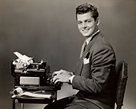
Other Comments from Participants
The FLC is a great opportunity for exchange among instructors.
I got some really helpful feedback from a peer.
This gave me the specific tools that I needed.
The FLC gave me the experiential training and support needed to feel confident in making the changes to my course.
Getting involved in this FLC was well worth my time.

Slide 11
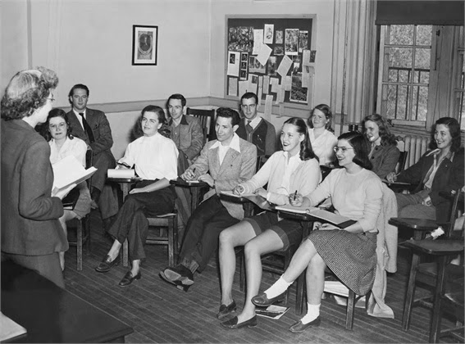
Repeat!
VP of Instruction funded it again!
16 Faculty joined the Learning Community
Focus this year on Hybrid Courses
Increased involvement from a broader range of disciplines

Slide 12
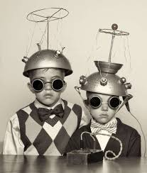
Presenters
LAURIE ADAMSON: PR, MR, OFC FOR APPQMR
FACULTY
LADAMSON@OLYMPIC.EDU
KATHY BRIGHT: PR, MR, OFC for APPQMR/IYOC
ELEARNING DIRECTOR
KBRIGHT@OLYMPIC.EDU
All images courtesy of Google Images, Labeled for non-commercial reuse.

