Slide 1
Using Pecha Kucha in Online Environments
Michelle M. Byrne PhD, RN, CNE, CNOR
Professor of Nursing
University of West Georgia

Slide 2
Objectives
Describe context and background of Pecha Kucha.
Describe potential topics for a Pecha Kucha by either teachers or students.
Plan an outline for a Pecha Kucha Presentation.

Slide 3

Poll
How many of you have heard of a Pecha Kucha?
How many of you have created a Pecha Kucha?
How many of you have assigned students to do a Pecha Kucha?

Slide 4
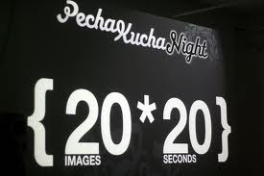
Pecha Kucha
Used by architecture design
2003 1st time used
Means “chitchat” in Japanese
Briskly paced sequence of 20 slides – 20 seconds for each slide
Demands planning and rehearsal
Total time 6 minutes 40 seconds

Slide 5
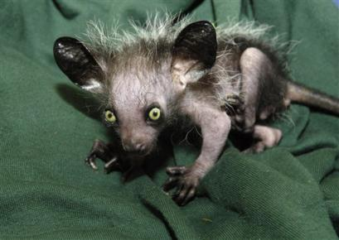
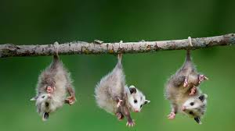
A picture is worth a thousand words

Slide 6
Why use Pecha Kucha?
TEACHERS
STUDENTS
Power of the visual
Alternative to PowerPoint and Prezi
Works for F2F and online
Aesthetic component
Strategy for highlighting or overview or introduction
Synthesis of content
Individual or group work
Visual, auditory, and kinesthetic learning styles
Student engagement with materials

Slide 7
Online Environment
LINKAGES with QM Rubric:
Course overview & Introduction
Learning objectives
Assessment & Measurement of student learning
Instructional Material
Course Activity and Learner Engagement
Course technology

Slide 8
Used in MBA programs
Students ranked Pecha Kucha as top assignment from 6 different assignments.
Students practiced > 2 hours with P K and less than an hour with traditional presentation styles.
Pecha Kucha stronger student evaluative ratings of group performance over traditional presentation styles.
Levin, M. & Peterson, L. (2013).
Oliver, J. & Kowalczyk, C. ( 2013).

Slide 9
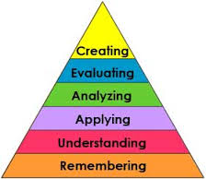
Bloom’s taxonomy

Slide 10
Some potential student outcomes include:
Utilize effective communication skills
Apply X theory to Y phenomenon
Illustrate signs and symptoms or progression of X disease or process
Compare and contrast X phenomenon
Illustrate the historical progression of Z

Slide 11
Tips for using P-K format
Choose appropriate topics (allow creativity)
Align with learning outcomes
Provide examples Pecha Kucha –just google lots of YouTube
Provide students with a grid for planning slides and narrative
Tutorial on pptx and using timed slide advancement

Slide 12

Contemporary Issues in nursing Education N9001 ONLINE
Laura Phillips MSN, RN
Jayme Roseth, MSN, RN-C
Amy Yarbrough MSN, RNC-MNN
https://mix.office.com/watch/ldt5wl0evihv

Slide 13
Aesthetic Pecha Kucha
Marcus Amaker
Charleston, SC community events

Slide 14
Now you create an outline
Topic appropriate?
Write student learning outcome
Create grid (length, depth of content)
For each cell in grid (5 slides x 5 sec, 10 slides x 10 sec, 20 slides x 20 sec), identify topic and image.

Slide 15
Questions

Slide 16
References
Bang-Jensen, V. (2010). Pecha Kucha: A quick and compelling format for student PowerPoint presentations. The Teaching Professor. 24(5), 5-5.
Beyer, A. (2011). Improving student presentations: Pecha Kucha and Just Plain PowerPoint. Teaching of Psychology. 38(2): 22-26.
Byrne, M. (201x). Presentation Innovations: Using Pecha Kucha in Nursing Education. Accepted for publication in Teaching and Learning in Nursing.
Levin, M. & Peterson, L. (2013). Use of Pecha Kucha in marketing students’ presentations. Marketing Education Review, 23 (1): 59-63.
Oliver, J. & Kowalczyk, C. ( 2013). Improving student group marketing presentations: A modified Pecha Kucha Approach. Marketing Education Review, 23 (1): 55-58.

