Slide 1
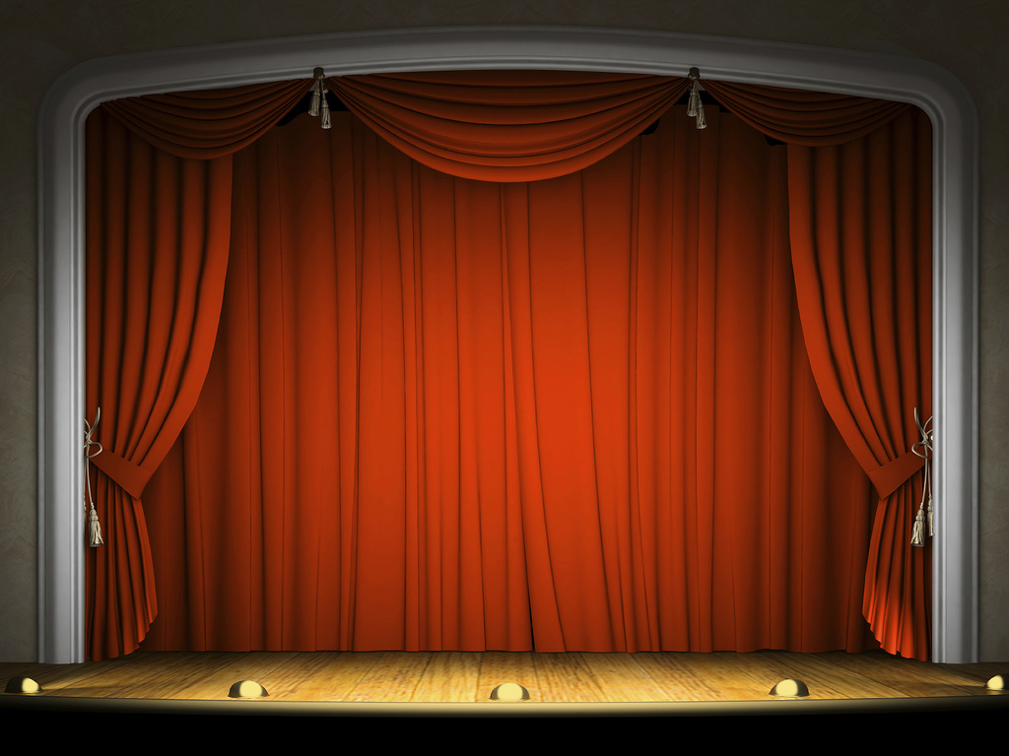
Using theater
to introduce QM

Slide 2
Today’s presenters
Lauren Easterling,
Center for Teaching and Learning,
Indiana University-Purdue University Indianapolis
Renee Petrina,
Institute for Learning and Teaching Excellence,
Indiana University Southeast

Slide 3
What is your role with QM on your campus?

Slide 4
Skit discussion questions
Are there any “pivots” in the conversation?
How is QM presented? Key words or concepts?
What are the faculty member’s needs?
Is this the best fit for those needs? Why or why not?
DO listen for tone and content.
DO NOT watch for body language – we are not pros.

Slide 5
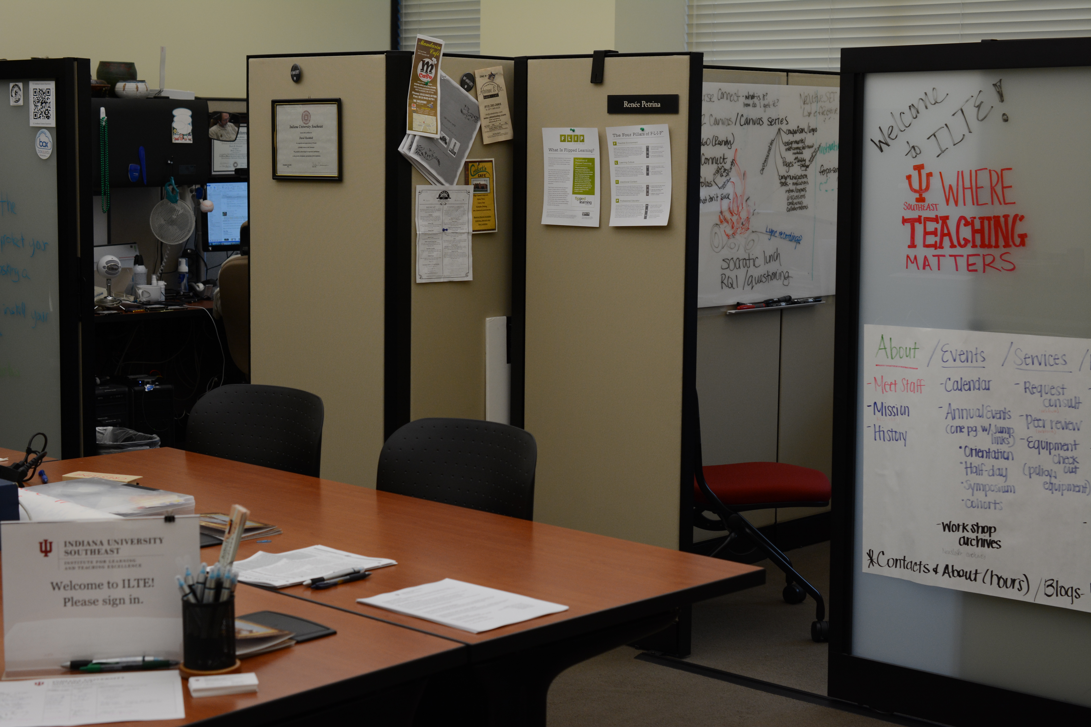
Insert skit background image here

Slide 6
Skit debrief
Are there any “pivots” in the conversation?
How is QM presented? Key words or concepts?
What are the faculty member’s needs?
Is this the best fit for those needs? Why or why not?

Slide 7
The making of a QM skit
Multi-campus, train-the-trainer
QM was very new to us
Characters inspired by real life
Checked script with higher-ups
Apply QM to real job situation
Debrief is essential

Slide 8
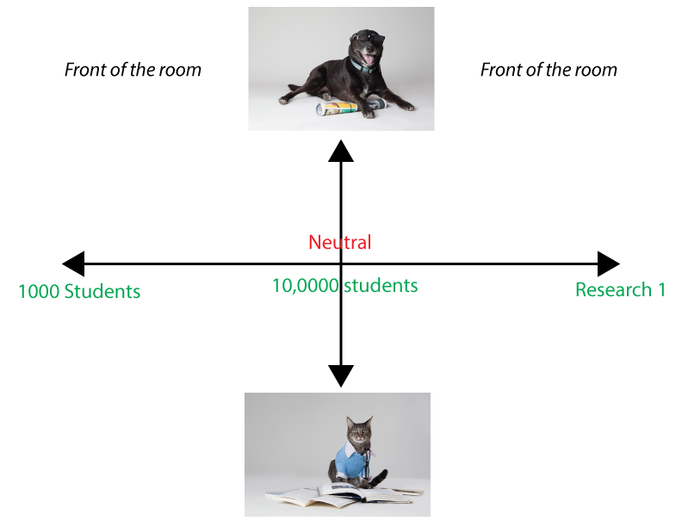

Slide 9
Group activity questions
Briefly share your work situation
Strengths of the script?
How might you adapt the script?
Strengths of the debrief?
How might you adapt the debrief?

Slide 10
Contact your presenters
Renee Petrina
rpetrina@ius.edu
@Skill2Teach
Lauren Easterling
easterli@iupui.edu
@LEasterl76

