Slide 1



Where’s the Beef?
Analyzing Aggregated QM Reviewer Feedback for Continuous Improvement
Carol Parenteau
Manager of Assessment & Academic Quality
April 2014

Slide 2

Purpose of Presentation
  To show results of analysis of QM reviewer feedback and discuss how it is used for continuous improvement after courses have been certified.

Slide 3
Learning Objectives
Describe criteria used to analyze feedback from peer reviewers.
Identify patterns and trends that emerged from analyzing peer reviewers’ recommendations.
Evaluate the benefits of analyzing qualitative data from QM peer reviews.

Slide 4
Mission Statement and Values
University of the Rockies provides high-quality, accessible learning opportunities globally for
diverse groups of individuals seeking preparation
for life goals, professional practice, service,
and distinguished leadership.
Integrity, Service, Excellence and Diversity

Slide 5
By the numbers
9 Programs
3 Schools
300 + Faculty
2,000 Students
Notes:
PhD in Organizational Development & Leadership
PhD in Human Services
PhD in Education
Doctor of Psychology (PsyD)
Master of Arts in Psychology
Master of Arts in Counseling
Master of Arts in Organizational Development and Leadership
Master of Arts in Human Services
Master of Arts in Education
School of Professional Psychology
School of Organizational Leadership
Social of Social, Human, and Educational Development
300 + Faculty
2,000 + Students

Slide 6
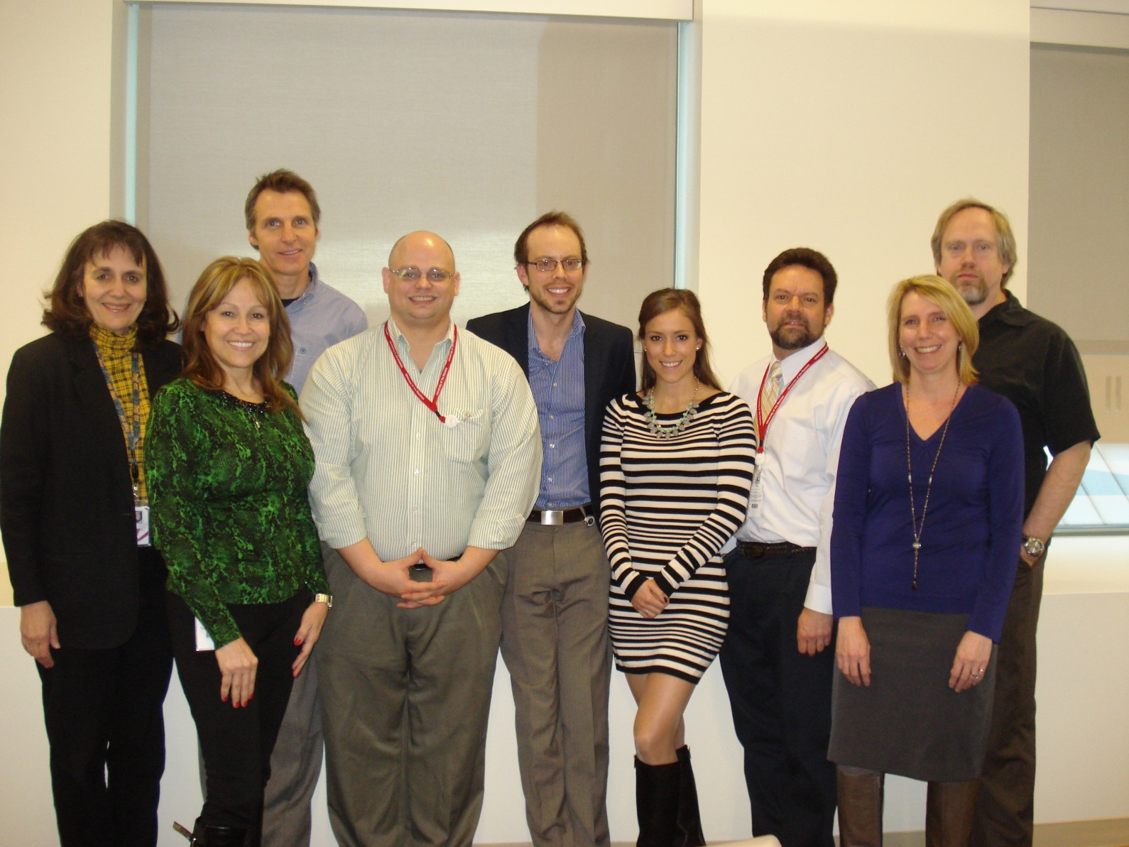
Assessment, Academic Quality & Instructional Design Team

Slide 7
Quality Matters Training at Rockies
Quality Matters
QM Certified Courses | 156 courses, 64.14% 39 in 2013
QM Peer Reviewers | 79 or 23% of faculty members (347) 12 staff
Applying the QM Rubric | 98 faculty and staff 28 %
Master Reviewer Training | 11 faculty
Improving your Online Course | 2 staff

Slide 8
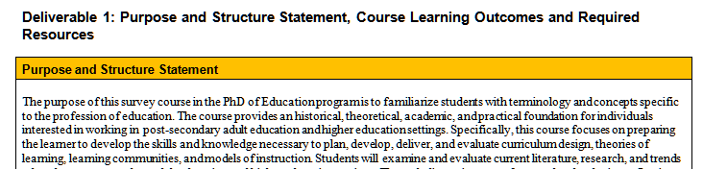
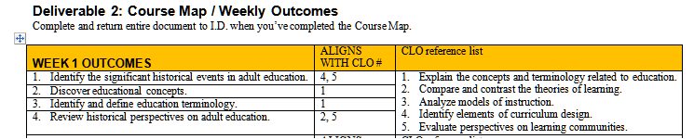
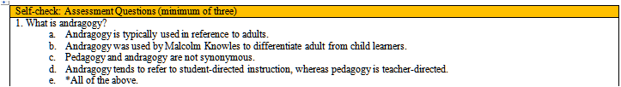
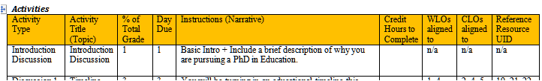
How We Ensure Course Quality
Standard 1.2
Standard 2
Standard 3.5
Standard 2

Slide 9
QM Rankings for 2013
(Source: http://www.qmprogram.org/qmresources/courses/grouped_by_inst.cfm?year=2012&program=0)
Top QM Institutions for 2013
Name of Institution | No. of Courses
1 Ashford University | 119
2 Capella University | 64
3 Florida International University | 63
4 University of the Rockies | 39
5 Regent University (VA) | 36
6 Tidewater Community College (VA) | 36
7 Prince George's Community College (MD) | 20
8 Frederick Community College (MD) | 17
9 Nashville State Community College | 17

Slide 10
Our Process
Quick Evaluation And Prep
QM
Program ?
Course
Amendment recommendations

Slide 11
Continuous Improvement
QM Certification
Curriculum
Program
Course
Analysis
Feedback to Curriculum team

Slide 12
Analysis of QM Reviewers Feedback
Were all comments evaluated?
  Instructional designers were focused on courses that did NOT meet standards
  Reports on courses that met standards the first time were not fully evaluated

Slide 13

QM Criteria for Reviews
Constructive
Specific
Measurable
Balanced
Sensitive
The majority of QM reviewers adhered to these criteria when furnishing critiques of our courses. Exceptions were in the areas of specificity and measurability.

Slide 14
Methodology
  Read through all comments by reviewers for all 2013 reviews
  Looked for patterns and color-coded those as they relate to QM standards in a spreadsheet
  Added the number of times they occurred

Slide 15
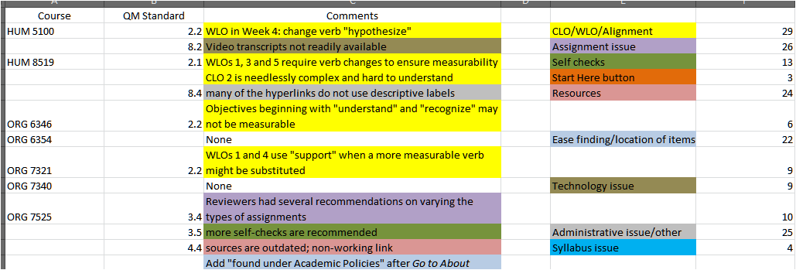
Methodology

Slide 16
Areas Observed

Slide 17
Learning Outcomes/Alignment (29)
  Measurability (poor choice of verbs)
  CLOs not aligned with types of assignments or with WLOs
  Confusing wording/error
  Learning outcomes too “low” on Bloom’s taxonomy for the level of the course
Curriculum
Notes:
Learning Outcomes and Alignment issues: The bulk of the issues in this category were related to the learning outcomes themselves or misalignment between the course learning outcomes, the weekly learning outcomes, and/or the assignments. One reviewer for ORG/PSY 6120 noted that CLO #5 used the verb “integration,” but there were no assignments in the course that emphasized that particular task.
The majority of the issues were related to poor selection of verbs from Bloom’s taxonomy: many were not considered “measurable” or were deemed to be too low on the taxonomy for the level of the course. For example, one reviewer for ORG 8542 felt the CLOs supported a master’s level course rather than a doctoral level one.
A portion of the observations were relatively minor, and dealt with various proofing errors, or confusing language. For example, one reviewer for ORG/PSY 7210 observed that some WLOs were aligned to CLO #8, but there were only seven CLOs in the course.

Slide 18
Learning Outcomes/Alignment (29)
Improvement
  Expanding our understanding of verbs for learning outcomes to go beyond Bloom’s taxonomy
  Providing a guideline for developers to consider rigor of the course as well as appropriate levels for the cognitive
  Adjusting the template to ensure alignments is not an afterthought.
Curriculum
Notes:
Learning Outcomes and Alignment issues: The bulk of the issues in this category were related to the learning outcomes themselves or misalignment between the course learning outcomes, the weekly learning outcomes, and/or the assignments. One reviewer for ORG/PSY 6120 noted that CLO #5 used the verb “integration,” but there were no assignments in the course that emphasized that particular task.
The majority of the issues were related to poor selection of verbs from Bloom’s taxonomy: many were not considered “measurable” or were deemed to be too low on the taxonomy for the level of the course. For example, one reviewer for ORG 8542 felt the CLOs supported a master’s level course rather than a doctoral level one.
A portion of the observations were relatively minor, and dealt with various proofing errors, or confusing language. For example, one reviewer for ORG/PSY 7210 observed that some WLOs were aligned to CLO #8, but there were only seven CLOs in the course.

Slide 19
Navigation (20)
  Academic Policies tab
    Too many items are located here and should be moved (perhaps to Start Here)
    It was not intuitive that certain items would be located here
      About Discussions/“Netiquette” rules (reviewers for 10 courses made this observation)
  Course Guide
  Instructor Response Time
Curriculum
Notes:
Location/Ease of Finding Items: These observations addressed navigation and accessibility of information on the course webpages. The bulk of the reviewers commented that some important information required for students success were “hidden” under the Administrative Policies tab on the course menu, and that it was not intuitive that one should look for particular kinds of information there. The majority of the comments in this regard dealt with the “About Discussions” and “netiquette” rules. Many reviewers suggested moving this to Start Here or otherwise making it more conspicuous.
There were also a few comments about the fact that the Course Guide (which most reviewers liked) was buried at the bottom of the Course Materials page, and the Instructor Response Time should be moved to Start Here or somewhere near the top half of the course page.

Slide 20
Assignments (18)
Improvement
  Discussed need with LMS provider, add a tab at the top of the page for non-content items
  Other items such as the placement of the course guide and the instructor policies will be re-positioned.
  .
Curriculum
Notes:
Assignment issues: These observation addressed the assignments used in the courses. Most comments dealt with the repetitive format of our courses (2 discussion forums followed by a written assignment in each module) and suggested adding some variety, such as more group projects or simulations, where appropriate. [Several reviewers liked the formatted approach, and suggested students knew what to expect as a result].
Some comments critiqued the rigor of the courses. At least two reviewers felt that ORG 8542 was insufficiently rigorous for a doctoral-level course, while another observed that ORG/PSY 7302 emphasized basic research skills, rather than what was implied by the title of the course: Advanced Research Methods.
A few noted that the discussion forums did not, in fact, encourage any real discussion as they imposed only the obligation to answer a question and “comment” on the contributions of other classmates. This does not encourage actual interaction between course participants, as noted by a reviewer for ORG/PSY 6120.

Slide 21
Assignments (18)
  Insufficiently varied
  “Discussion forums” did not encourage actual discussions
  Lacked academic rigor
  Inadequate amount of assigned reading
Notes:
Assignment issues: These observation addressed the assignments used in the courses. Most comments dealt with the repetitive format of our courses (2 discussion forums followed by a written assignment in each module) and suggested adding some variety, such as more group projects or simulations, where appropriate. [Several reviewers liked the formatted approach, and suggested students knew what to expect as a result].
Some comments critiqued the rigor of the courses. At least two reviewers felt that ORG 8542 was insufficiently rigorous for a doctoral-level course, while another observed that ORG/PSY 7302 emphasized basic research skills, rather than what was implied by the title of the course: Advanced Research Methods.
A few noted that the discussion forums did not, in fact, encourage any real discussion as they imposed only the obligation to answer a question and “comment” on the contributions of other classmates. This does not encourage actual interaction between course participants, as noted by a reviewer for ORG/PSY 6120.

Slide 22
Assignments (18)
Improvement
  Rigor guidelines distributed to new developers
  Credit hour requirement now in course builder template.
  Recommendations to program reviewers
  .
Curriculum
Notes:
Location/Ease of Finding Items: These observations addressed navigation and accessibility of information on the course webpages. The bulk of the reviewers commented that some important information required for students success were “hidden” under the Administrative Policies tab on the course menu, and that it was not intuitive that one should look for particular kinds of information there. The majority of the comments in this regard dealt with the “About Discussions” and “netiquette” rules. Many reviewers suggested moving this to Start Here or otherwise making it more conspicuous.
There were also a few comments about the fact that the Course Guide (which most reviewers liked) was buried at the bottom of the Course Materials page, and the Instructor Response Time should be moved to Start Here or somewhere near the top half of the course page.

Slide 23
Resources (14)
  Texts/material dated
  Not in APA format

Slide 24
Resources (14)
Improvement
  Undergoing program review, Deans, faculty will review content
  Vendor provided comprehensive list of resources that will be going out of print.
  .

Slide 25
Self Assessments (13)
  Quantity
  Variation

Slide 26
Self Assessments (13)
Improvement
  We have already seen an improvement in this area after adding this as a requirement for developers
  We are planning to use Respondus in the future
  Collaboration with sister institution (webinars for faculty)
    Google quizzes
    Big Think and Ted Talks
    Flash card machine
  .

Slide 27

Open Discussion

