Slide 1
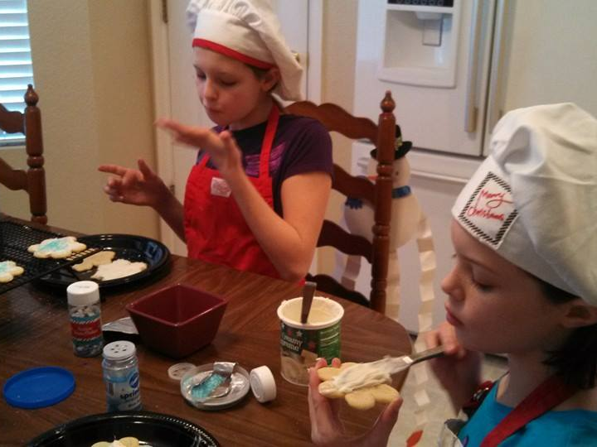
With a Dash of Encouragement and a Sprinkle of Expectations
Karen Kaemmerling
Colorado Mountain College
Instructional Chair for Online Learning

Slide 2
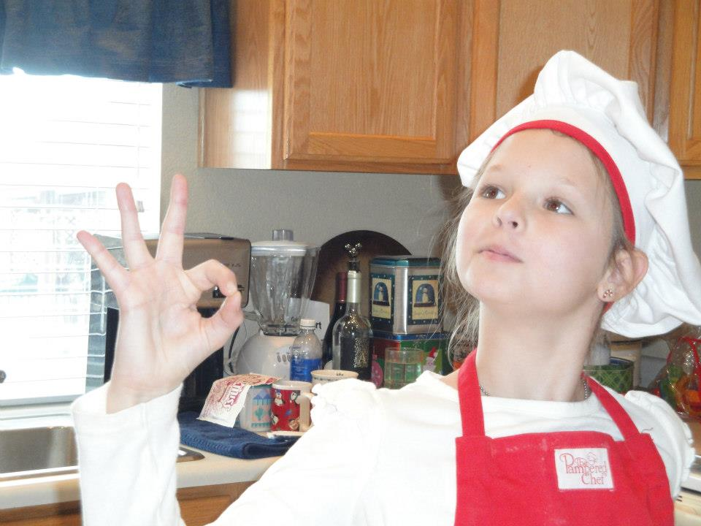
Online Course Quality Task Force
Course Design
Instructor Pedagogy
Design Process
Implementation and Continuous Improvement

Slide 3
Course Design
Quality Matters Rubric
Instructor Pedagogy
Instructor Evaluation Plan
Course Development Process
Developoment Process
Implementation & Continuous Improvement
CMC Course Design Checklist
Self-Review
New Development Design Scoring Sheet
Course Map
Training opportunities and requirements
Quality Matters self-review
Course Template
Once a semester meetings of Task Force
Review of student success data
3 E's of Excellence

Slide 4
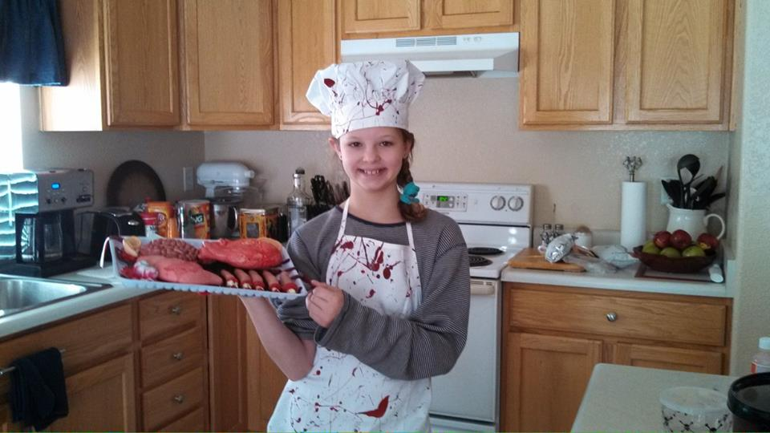

Slide 5
3 E’s of Excellence
Educate
Encourage
Continue education cycle using webinars, workshops, videos, and site visits with a greater emphasis on action
Evaluate
Provide Conversation Webinars and face to face discussion opportunities for instructors
Disseminate documents to all teaching in delivery method
Look for early adopters in a variety of disciplines who might also become facilitators and mentors later on.
Identify courses that may need more immediate action
Formal evaluation of courses for course design and pedagogy will begin using Design Checklist and Instructor Self-Review Form
Encourage all instructors to use Course Design Checklist
Welcome volunteers to use design standards and pedagogy self-review tools
All courses will be evaluated at least once a year with courses not meeting standards to be revised and re-evaluated.

Slide 6
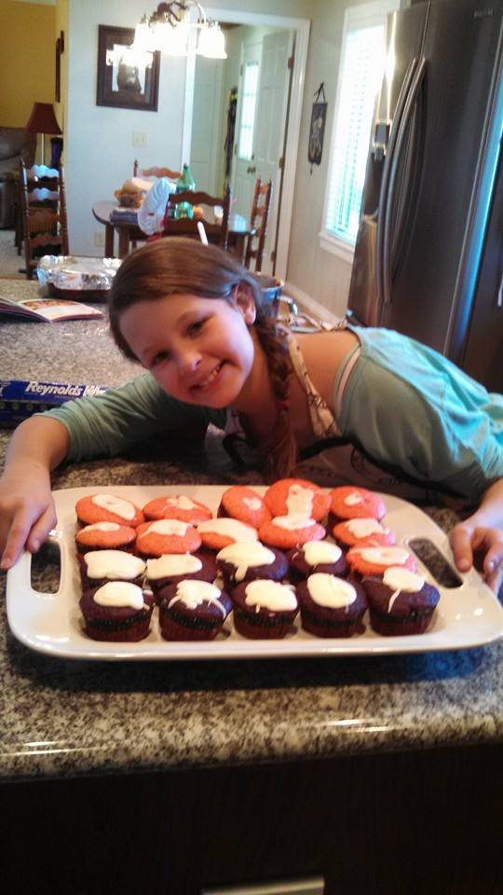
Results

Slide 7
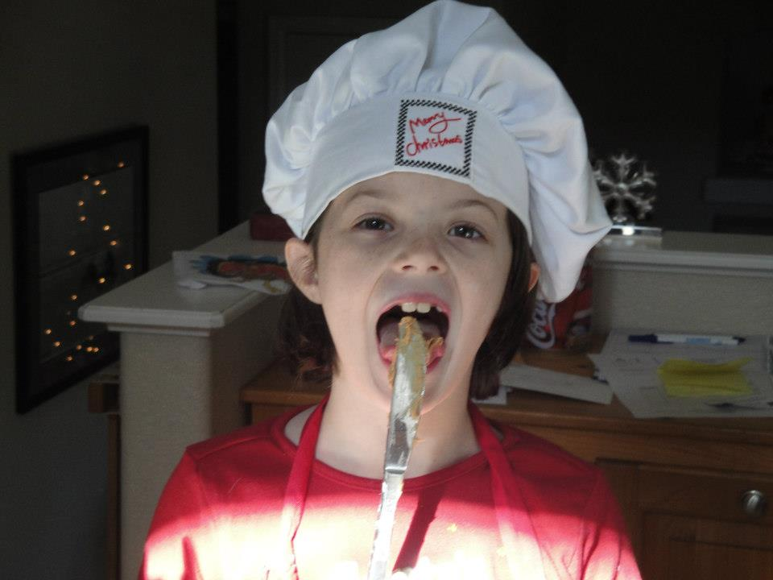
Volunteer Tasters
Attendance in Webinars and Workshops
5 Internal QM Review volunteers
  2 Completed Process
18 Self-Evaluations scheduled for the spring term. (4 completed in pilot in Summer 2014)

Slide 8
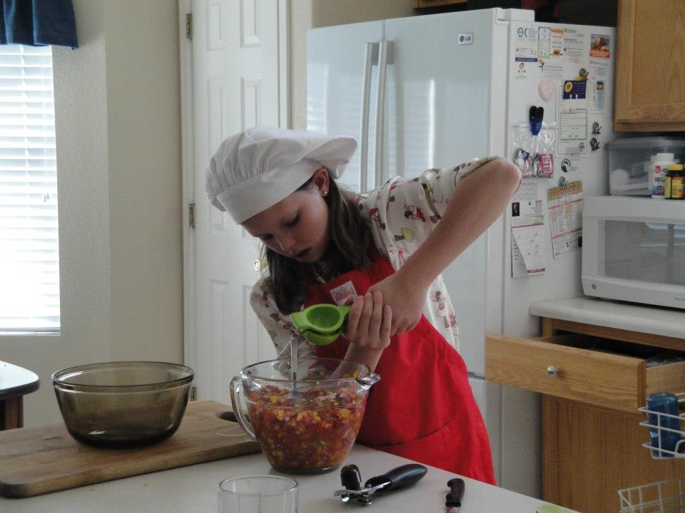
Rolling up Their Sleeves
10 week Online Pedagogy offered to all existing online instructors:
  7 completed
  66/80 instructors accessed the workshop at least once
  average log in time was 2.5 hours

Slide 9
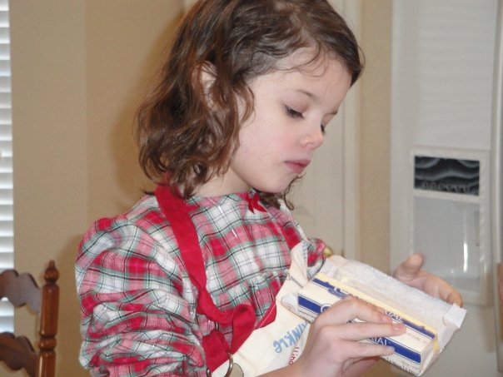
Let’s Get Cookin’
Approximately 110 faculty and adjuncts
Each discussion between instructor and Instructional Chair takes about 1 hour
Prep before each call=at least 1 hour for instructor and Chair
Follow up is about 30 minutes to an hour
Friendly email reminders

Slide 10
Use of Introduction Discussions

Slide 11
Average # of Discussions per Course

Slide 12
Courses with No Discussions

Slide 13
Instructor Clearly Establishes Presence in Discussions

Slide 14
Blank Home Pages

Slide 15
Give Individualized Feedback

Slide 16
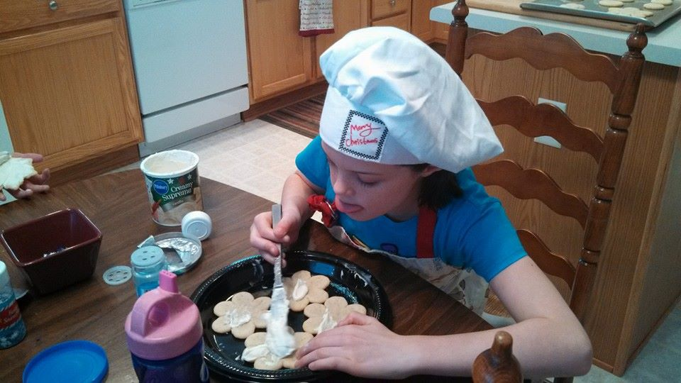
Consistent Items
Use of Canvas Rubrics-25%
Number of Announcements per Course-1 per week
Timely Grading-85%

Slide 17
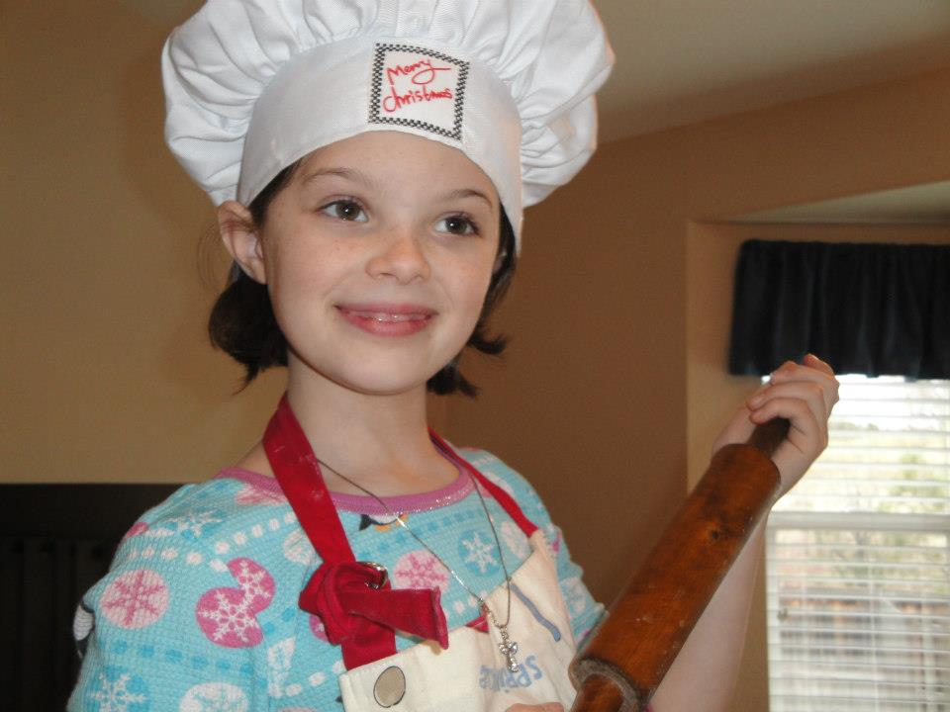
More Encouragement

Slide 18
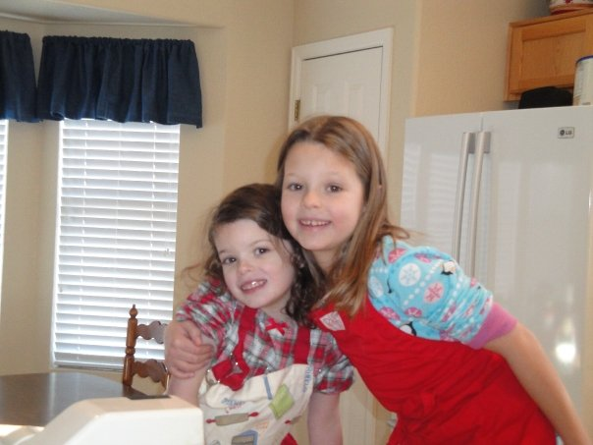
Contact Information
kkaemmerling@coloradomtn.edu

