Slide 2
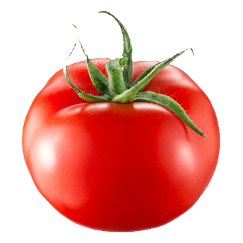
Objectives
Discuss aligning learning activities to stated learning objectives within a course, and brainstorm various approaches to meeting Standard 5.1 within the QM Rubric.
Review activities provided, determine if they effectively provide learners with the opportunity to interact and become actively engaged within a course, meeting Standard 5.2 of the QM Rubric.
Discuss and compare instructor response time, instructor feedback, learner interaction requirements, and recommend different approaches to meeting Standards 5.3 and 5.4 of the QM Rubric.

Slide 3
Standard 5.1
“The learning activities promote the achievement of the stated learning objectives or competencies.”
  Quality Matters Higher Education Rubric Workbook: Design Standards for Online and Blended Courses (Fifth ed.). (2014). Annapolis, MD: MarylandOnline.

Slide 4
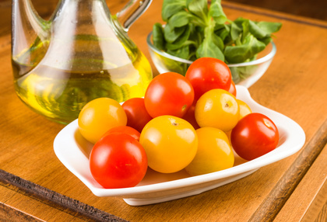
Sample Course and Objective
Course: US and International Health Disparities
Objective: “Discuss the impact of population, sociocultural, economic, and environmental factors on health disparity around the world.” (Joshi, P., 2016)

Slide 5
Standard 5.2
“Learning activities provide opportunities for interaction that support active learning.”
  Quality vs. Quantity
  Active Learning
  Activities
  Quality Matters Higher Education Rubric Workbook: Design Standards for Online and Blended Courses (Fifth ed.). (2014). Annapolis, MD: MarylandOnline.

Slide 6
Sample Objective
Objective: “Discuss the impact of population, sociocultural, economic, and environmental factors on health disparity around the world.” (Joshi, P., 2016)

Slide 7
Learning Activity 1
Within your group (you were assigned to these at the beginning of the course), build a Wiki that includes at least six characteristics of disparities and elaborate on at least two factors that influence health outcomes.

Slide 8
Learning Activity 2
Create a journal that compares and contrasts developing countries longevity for their populations.

Slide 9
Learning Activity 3
Via a synchronous collaborative session, debate the impact of the world’s population based on environmental factors and health disparity.

Slide 10
Standard 5.3
“The instructor’s plan for classroom response time and feedback on assignments is clearly stated.”
  Email
  Discussion Boards
  Grades
  Quality Matters Higher Education Rubric Workbook: Design Standards for Online and Blended Courses (Fifth ed.). (2014).
  Annapolis, MD: MarylandOnline.

Slide 11
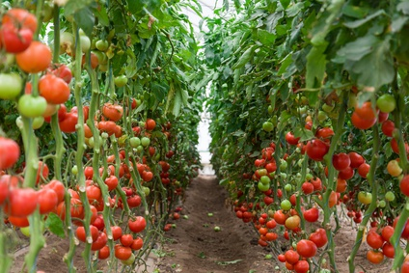
Which one would you pick?

Slide 12
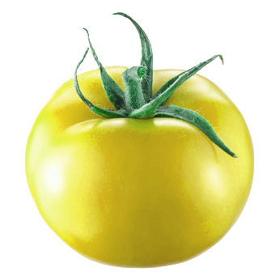
  Please check often for responses to email and discussion posts. Assignments will be graded and grades posted to the Grade Center within two weeks of submission. There will be no responses to email over the weekend or after 10:00 p. m. If there is a change in this policy, it will be conveyed via Announcements.
  Emails will be responded to within 24 hours. Discussion postings will be responded to within 72 hours. Assignments will be graded and grades posted to the Grade Center within ten days of submission. If there is a change in this policy, it will be conveyed via course email and Announcements.

Slide 13
Standard 5.4
“The requirements for learner interaction are clearly stated.”
  Learner Participation
  Frequency
  Time
  Interaction
  Quality Matters Higher Education Rubric Workbook: Design Standards for Online and Blended Courses (Fifth ed.). (2014). Annapolis, MD: MarylandOnline.

Slide 14
Which one would you pick?

Slide 15
  It is good practice to log in to the course each day, checking Announcements, Grade Center, Email, and Discussion Posts. When communicating with the instructor and/or other learners, please follow the University’s Netiquette Statement posted in the Syllabus. You should expect to spend between 10 and 15 hours per week working within this course.
  Logging in to the course daily is good practice. Communicate with others in your normal way, but don’t be rude. This course requires you to spend a good amount of time on the content and assignments.

Slide 16


Slide 17
Contact Information
Cara Richard, MLIS
    cara.richard@lamar.edu
Karen Girton-Snyder, Ed.D.
    karen.girton-snyder@lamar.edu
    Special thanks to Kendall Wilkerson, student graphic designer.

